Slide 1


Older Adult Behavioral Health Initiative An overview of the initiate and the role of the specialist

Slide 2
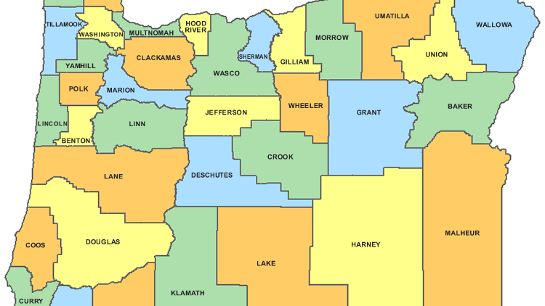
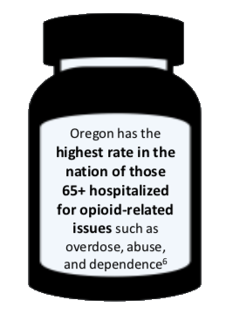
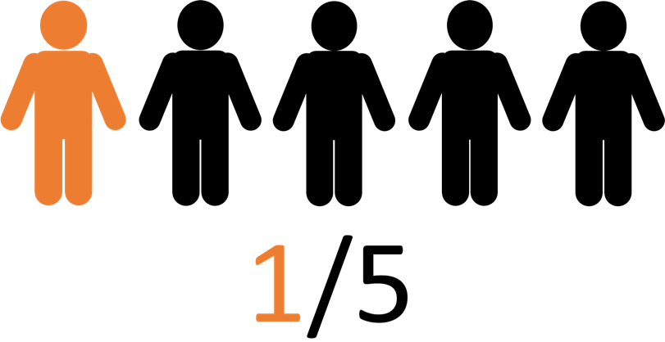
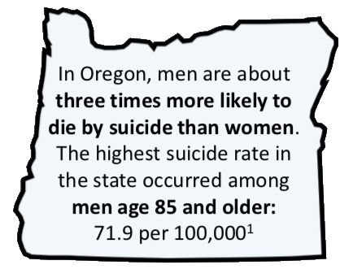
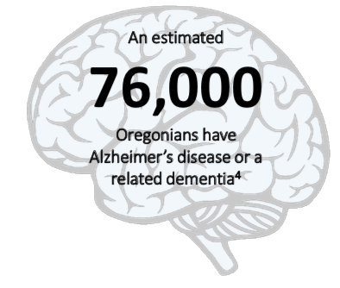
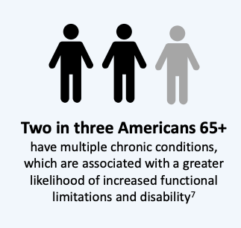
Facts that led to the creation of the OABHI
By 2035, older Americans are projected to outnumber children for the first time in U.S. history - there will be 78.0 million people 65 years and older compared to 76.7 million under the age of 18.
18.6% of Oregon’s population is 65+ as of 2021
By 2030 there will be 1 million adults age 65 or old in Oregon (20% of the population)
Up to 23% of old adults contend with prescription drug misuse
Loneliness and social isolation among older adults is associated with an estimated $6.7 Billion in additional Medicare spending annually
Oregon ranks among the nation’s worst
Heavy drinking among older adults
Lifetime diagnosis of depression
Hospitalization for opioid use or overdose
In the US 25% of older adults experience anxiety and depression since the start of COVID-19
In Oregon an estimated 103,000 older adults struggle with alcohol dependency and 9,500+ have a gamble disorder. On average, only 0.05% are getting treatment.
Suicide was the #9 cause of death in Oregon & Dementia was the #5 as of 2020
This Photo by Unknown Author is licensed under CC BY-SA-NC
Notes:
Why the focus on this historically underserved population? First, of all, with advancements in sanitation, medicine, and nutrition Americans are living longer lives. Currently, over 15% of Oregonians are 65 years or older and by 2030, that number will reach 20%, in fact, some counties are already seeing that number. Additionally, 1 in 5 Americans over 65 have one or more mental health or substance use conditions. In Oregon, the highest suicide rate is among men age 85 and older. There are an estimated 76,000 Oregonians who have Alzheimer’s disease or another related dementia. Oregon has the highest rate in the nation of 65+ hospitalizations for opioid-related issues. Finally, 2 in 3 Americans 65 and older have multiple chronic conditions. We also want to make sure that younger adults who are living with persistent mental health conditions continue to receive the appropriate care into their later years.

Slide 3
Using the facts and understanding the needs
The Oregon Health Authority began statewide engagement in 2013. 35 individuals with diverse backgrounds and expertise studied the challenges older adults and adults with physical disabilities face when trying to access behavioral health services.
The group completed their work and submitted the 2014 Senior Mental Health Specialist Investment report to the Senior Mental Health Budget Note Committee on August 13th 2014.
In 2014, advocates for older adults and people with disabilities succeeded in lobbying the Oregon Legislature to fund the Behavioral Health Initiative for Older Adults and People with Physical Disabilities. This investment created 25 new positions throughout the state to place professionals who specialize in behavioral health for older adults and people with disabilities in local and regional community.
https://oregonbhi.org

Slide 4


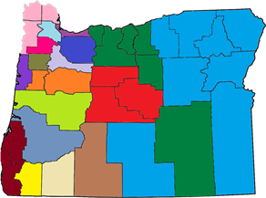
Behavioral health +
Mental health services
Substance use disorder treatment
APD =
Aging and People with Disabilities
(Locally Northwest Senior and Disability Services, NWSDS)
Older Adult Behavioral Health Specialist
Goal of the Initiative
To better meet the needs of older adults and people living with physical disabilities by improving timely access to care from qualified providers who work together to provide coordinated, quality and culturally responsive behavioral health and wellness services.
Behavioral health specialists
There are 24 specialists statewide who have social work and psychology training.
Notes:
NIRMALA
Behavioral Health, in the context of the Initiative, refers to the promotion of mental health, resilience and wellbeing; the treatment of mental and substance use disorders; and the support of those who experience these conditions, along with their families and communities (SAMHSA)
I serve as the director of the Behavioral Health Initiative for Older Adults and People with Physical Disabilities. This Initiative began in 2014, when the Oregon State Legislature allocated funding to the Oregon Health Authority for this Initiative. The behavioral health specialists were hired between May and December 2015; the first 12 were on board by July and the final four by the end of December.
The overarching goal of this Initiative is to better meet the needs of older adults and people with disabilities by improving timely access to care from qualified providers who work together to provide coordinated, quality and culturally responsive behavioral health and wellness services.
There are currently 20 Behavioral Health Specialists located throughout the state, though there are typically 24 when we’re at full capacity. Specialists are placed according to population (1 FTE per 30,000 adults 65+). As illustrated in this map, 15 of the Specialists work in one county, while the rest of the Specialists serve two or more counties. Not surprisingly, those in eastern Oregon serve the greatest geographical areas.
Most of the Behavioral Health Specialists have behavioral health clinical expertise. The vast majority have graduate degrees in social work or psychology. Most have some experience working with older adults, but few had extensive experience in aging services prior to joining the Initiative. They work in community mental health programs (CMHPs) and other nonprofit agencies throughout the state.

Slide 5


Who the Initiative serves
The Initiative serves older adults and people living with disabilities who also have behavioral health needs.
People with physical disabilities
Older adults
People with behavioral health needs
The needs of older adults and people living with disabilities overlap, but each group has unique characteristics and needs.
Notes:
The Initiative serves older adults and people living with physical disabilities who also have behavioral health needs.
One reason for this multi-population focus across aging services and behavioral health services is that many individuals who receive services often do so across these two service sectors and their is a need to ensure greater collaboration and coordination between them.
While it is important to recognize there is overlap between people with living with physical disabilities, older adults, and those with behavioral health needs, these populations certainly have unique characteristics and needs.

Slide 6
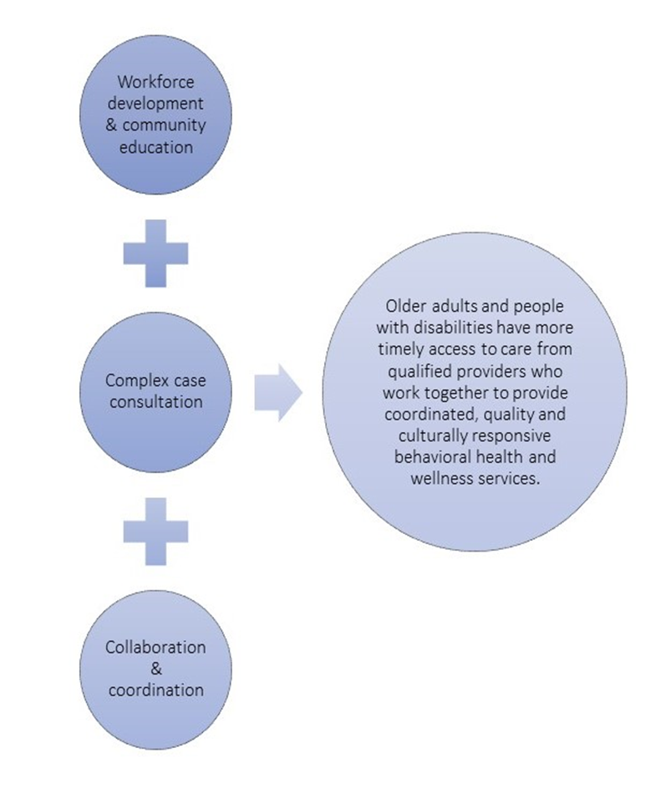



What Do the Specialist Do?

Slide 7
Three Primary Job Functions:
Work Force Development and Community Education:
Stage & host trainings and community health education events
Increase direct service staff knowledge of normal aging processes, as well as services provided by aging services, behavioral health, and primary care
Increase direct service staff knowledge of how behavioral health conditions/disorders present in an older population and best practices for addressing them
Promote local education and awareness activities that focus on risk and protective factors for older adults and people with disabilities
Complex Case/Care Consultation:
Facilitate and accept referrals for complex case consultations
Promote a multi-disciplinary team and multi-morbidity approach
Track trends and promote best practices
Payer blind
Make sure older adults and people with disabilities receive the appropriate help at the right time and at the right level of care
Collaboration and Coordination:
Promote partnerships and linkages
Interagency/multi-system planning for better coordination among behavioral health, aging services, primary care providers and hospitals.
Create a stakeholder group with a focus on the needs of older adults
Identify systems that need improvement; remove barriers to care, break down “silos”

Slide 8
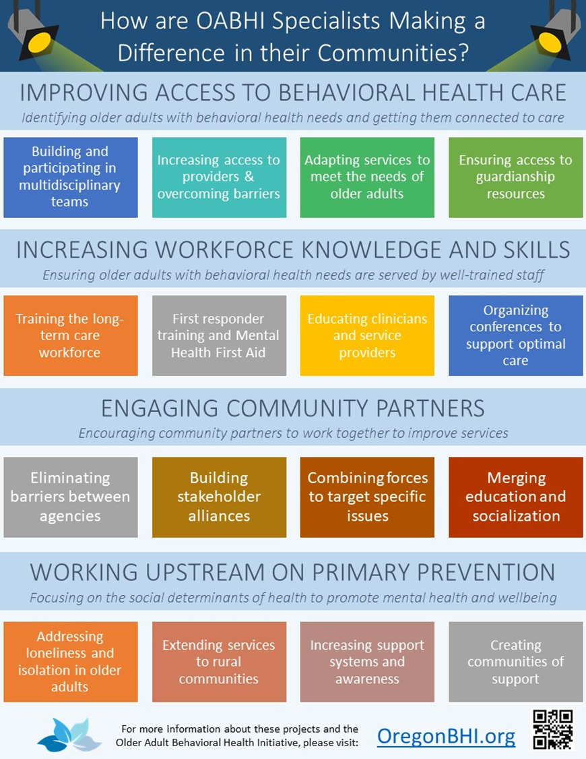
Outcomes
Oregon is Investing in Senior BH by;
Improving Access to Care
Promoting/Coordinating Quality Physical & BH Services
Promoting the Use of Clinical Best Practices
Improve the population’s knowledge about signs and symptoms of behavioral health problems and how to address them
Increasing the Knowledge/Skills of the Workforce
State Funders & Taxpayers Expect;
Improved Quality of Life
Decrease in Cost of Care
Health System Efficiency & Effectiveness

Slide 9

For more information, complex case/care consult or for upcoming trainings/educational events contact: Lacey Plasker plaskerl@co.yamhill.or.us desk:503-474-6853 cell: 971-267-0548

