Slide 1
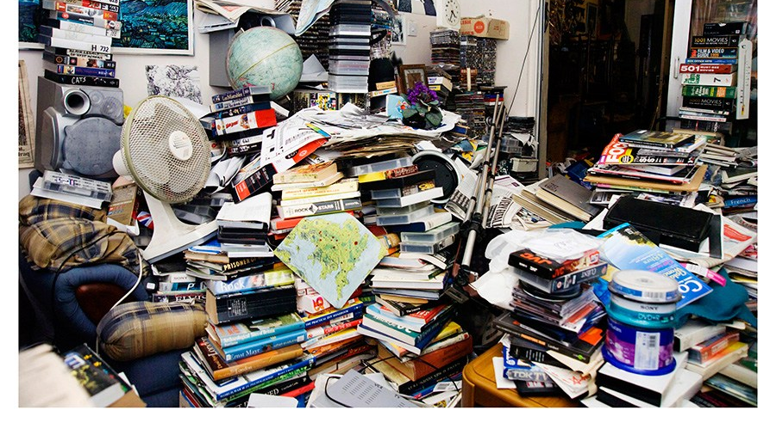

HOARDING
Stephanie arciga
behavior consultant
This Photo by Unknown Author is licensed under CC BY-NC-ND

Slide 2

Learning Objectives
Participants will know about the prevalence, vulnerabilities and key features of this disorder
Participants will gain knowledge about interventions.

Slide 3
What are your first thoughts when you hear the word hoarding?

Slide 4
Boxes
Irreplaceable
Sentimental
DISORDER
Collecting
Family Members
Depression
Unhealthy
dangerous
possessions
unique
newspaper
Obsessive compulsive
I may need this in the future.
Can’t live without
indecision

Slide 5
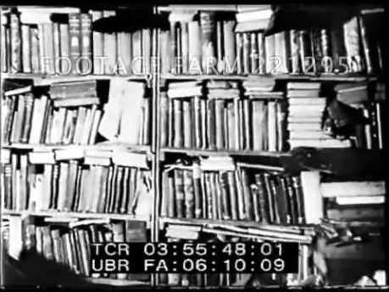
A CAUTIONARY TALE OF TWO BROTHERS
The Collyer Brothers: Homer and Langley of New York City.
They were found dead in their home in 1947, surrounded by 140 tons of collected items.
City workers had to dig their way into the house to discover the bodies.
Langley’s body took several days to discover
Dhar , Nirmala

Slide 6
WHAT IS HOARDING?
Dictionary: a supply or accumulation that is hidden or carefully guarded for preservation, future use, etc.
Mayo Clinic: the excessive collection of items, along with the inability to discard things
The International OCD (Obsessive-Compulsive Disorder) Foundation: Three connected problems:
  Collecting too many items
  Difficulty getting rid of items, and
  Problems with organization
“The acquisition of and inability to discard items even though they appear (to others) to have no value”.(Frost & Gross 1993)
A syndrome characterized by excessive collecting and saving behavior that results in cluttered living space and significant distress or impairment

Slide 7
COLLECTING VS HOARDING
COLLECTING
HOARDING
Organization
Mint condition
Kept in specific areas
Quality of life not compromised
Pride
Usually disorganized
Takes over areas of the home
Cause of distress
Risk to health
Safety concerns
Dhar, Nirmala

Slide 8
Who hoards?
Equal Opportunity Affliction
  Wealthy, middle income, poor, homeless
  Elderly, middle age, young adults, children

Slide 9
WHY DO PEOPLE HOARD?
VULNERABILITIES
INFORMATION PROCESSING DEFICITS
MEANING/VALUE
POSITIVE & NEGATIVE
REINFORCEMENT
Dhar 2015

Slide 10
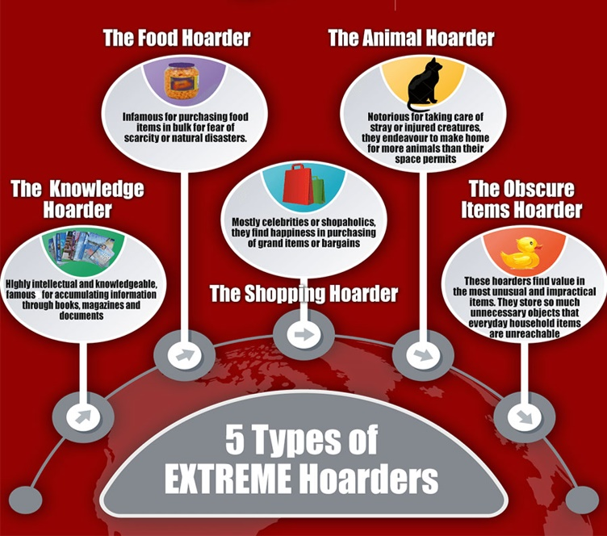
Variations of Hoarding

Slide 11
Consequences of Hoarding
Health problems – unsanitary living conditions
Safety threats – fire, falls, infestation, structural (weight of items), blocked egress
Interpersonal difficulties –with family members, neighbors, social isolation, poor personal hygiene
Legal problems – threat of eviction, child welfare involvement
Diminished self-esteem – shame, guilt
Work impairment or loss of employment

Slide 12

Diagnosing Hoarding Disorder
Specific symptoms for a hoarding diagnosis include:
  Lasting problems with throwing out or giving away possessions, regardless of their actual value.
  The problems are due to a perceived need to save the items and to distress linked to parting with them.
  Items fill, block and clutter active living spaces so they cannot be used, or use is hampered by the large amount of items (if living spaces are clear it is due to help from others).

Slide 13
Hoarding Disorder in Older Adults(OA)

Slide 14
IMPORTANT
75% of individuals who hoard have either depression or anxiety.
These individuals are behaviorally de- activated with decreased motivation and clean up and clutter protocols become hard to implement.
Screen for depression and anxiety
Dhar, Nirmala

Slide 15
An assessment for hoarding may include questions such as:
Do you have trouble discarding (or recycling, selling or giving away) things that most other people would get rid of?
Because of the clutter or number of possessions, how difficult is it to use the rooms and surfaces in your home?
To what extent do you buy items or acquire free things that you do not need or have enough space for?
To what extent do your hoarding, saving, acquisition and clutter affect your daily functioning?
How much do these symptoms interfere with school, work or your social or family life?
How much distress do these symptoms cause you?

Slide 16

Causes and Risk Factors

Slide 17

Treatment

Slide 18
Empathy and Building a Trusting Relationship with a Hoarder

Slide 19
IDENTIFY NEEDS
Fears of Mistakes/Decisions
“Need” vs. “Want”
Responsibility (guilt) for objects and people
Opportunity
Memory (memory aid, poor memory)
Identity – I am what I have
Uniqueness / one of a kind
Completeness and perfectionism
Need for control – it’s mine; no one can touch
Dhar, Nirmala

Slide 20
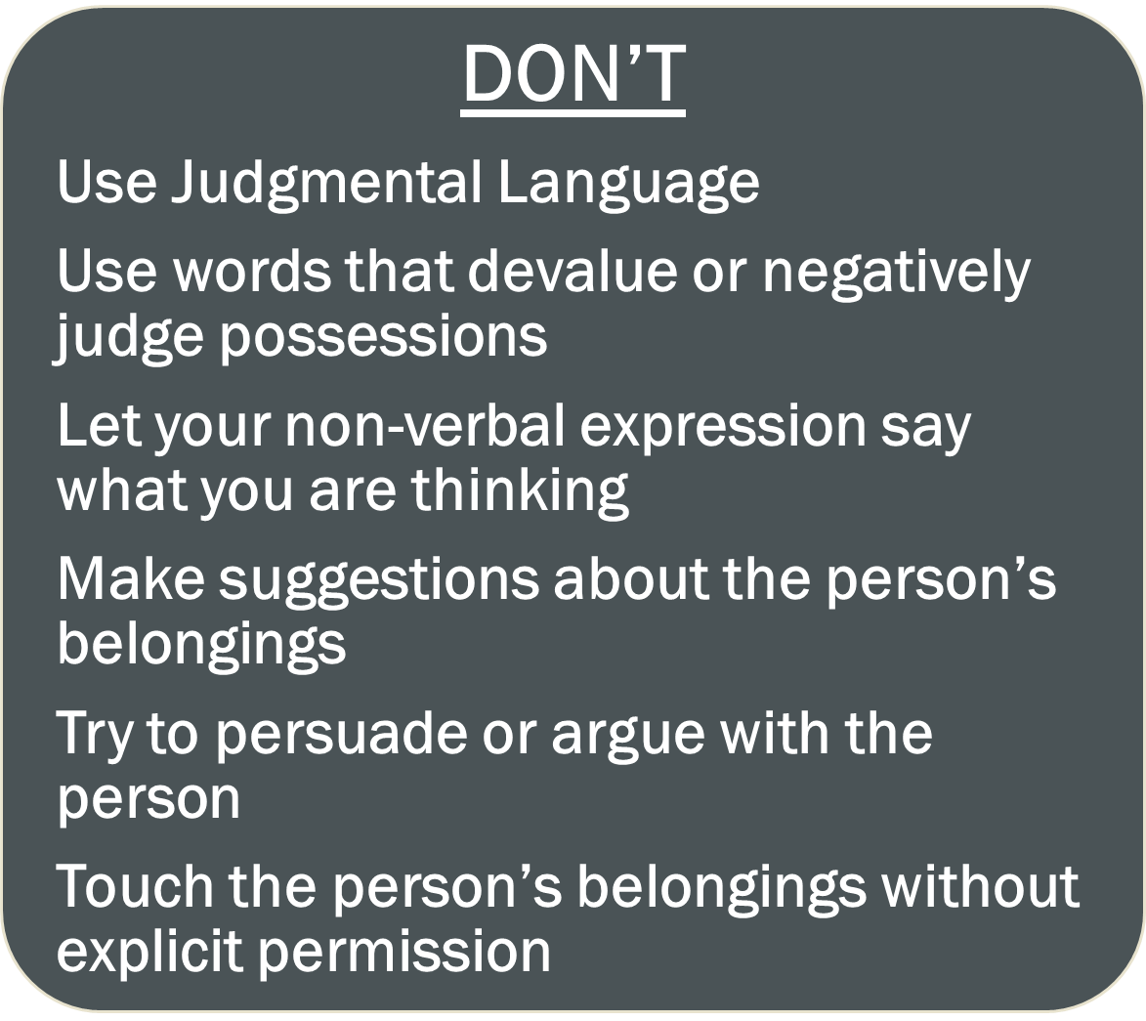

Communicating with Hoarders

Slide 21
Ineffective intervention strategies
Make decisions (about a plan of action) for a resident
Argue or persuade
Pressure them to discard
Give verbal and non-verbal cues that are judgmental or negative in nature

Slide 22

Communicating with Hoarders
DO
Imagine yourself in the hoarding client’s shoes
Match the person’s language
Use encouraging language
Highlight strengths
Focus the intervention on safety and organization of possessions and later work on discarding

Slide 23
Effective Intervention Strategies
Be clear about expectations and limitations
Ask open-ended questions
Reflectively listen
Use respectful, non-judgmental language
Mirror the language used by the resident
“Work with” the resident instead of “doing for”

Slide 24
Proactive Strategies
Having empathy and establishing a trusting relationship
Listen to their concerns
Respect their preferences on how they want their items saved
Help them stay on task when organizing with gentle cues but give time to talk if an item brings up strong memories
Set up a day/time to help clean (do mini sessions) – make a sign to post in their room as a friendly reminder
Sorting sessions, image clutter scale (referenced later in this PowerPoint)
Label items – provide suggested list of general expiration/food storage length
Have trusted individual(s) help
Understand how you can best support the resident.
DOCUMENT

Slide 25
Reactive Strategies
If Client refuses help, don’t insist that work needs to be done
Refer to lists, schedule, etc.
Ask about belongings: “this important to you because…” gain insight into the situation
Don’t try to argue or explain your viewpoint.

Slide 26
SORTING INTO THREE PILES
Create rules for acquiring and discarding
Sort into three piles – keep, discard, “I don’t know”
All items in “keep” pile must have a final location by end of sorting session
Discard can mean dumpster, recycle, sell, give away
“I don’t know” pile is intended as temporary to move the session along – decision for this pile also needs to be made by the end of session
Dhar, Nirmala

Slide 27
Decision Tree
Save
category
Move to
Interim
spot
Move to
Final
place
Save or
Discard
Trash
Discard
category
Move to
Interim
spot
Move to
Final
place
Re-
cycle
Charity
Sell
Dhar, Nirmala

Slide 28
Use the Clutter Image Scale
http://www.hoardingconnectioncc.org/Hoarding_cir.pdf

Slide 29
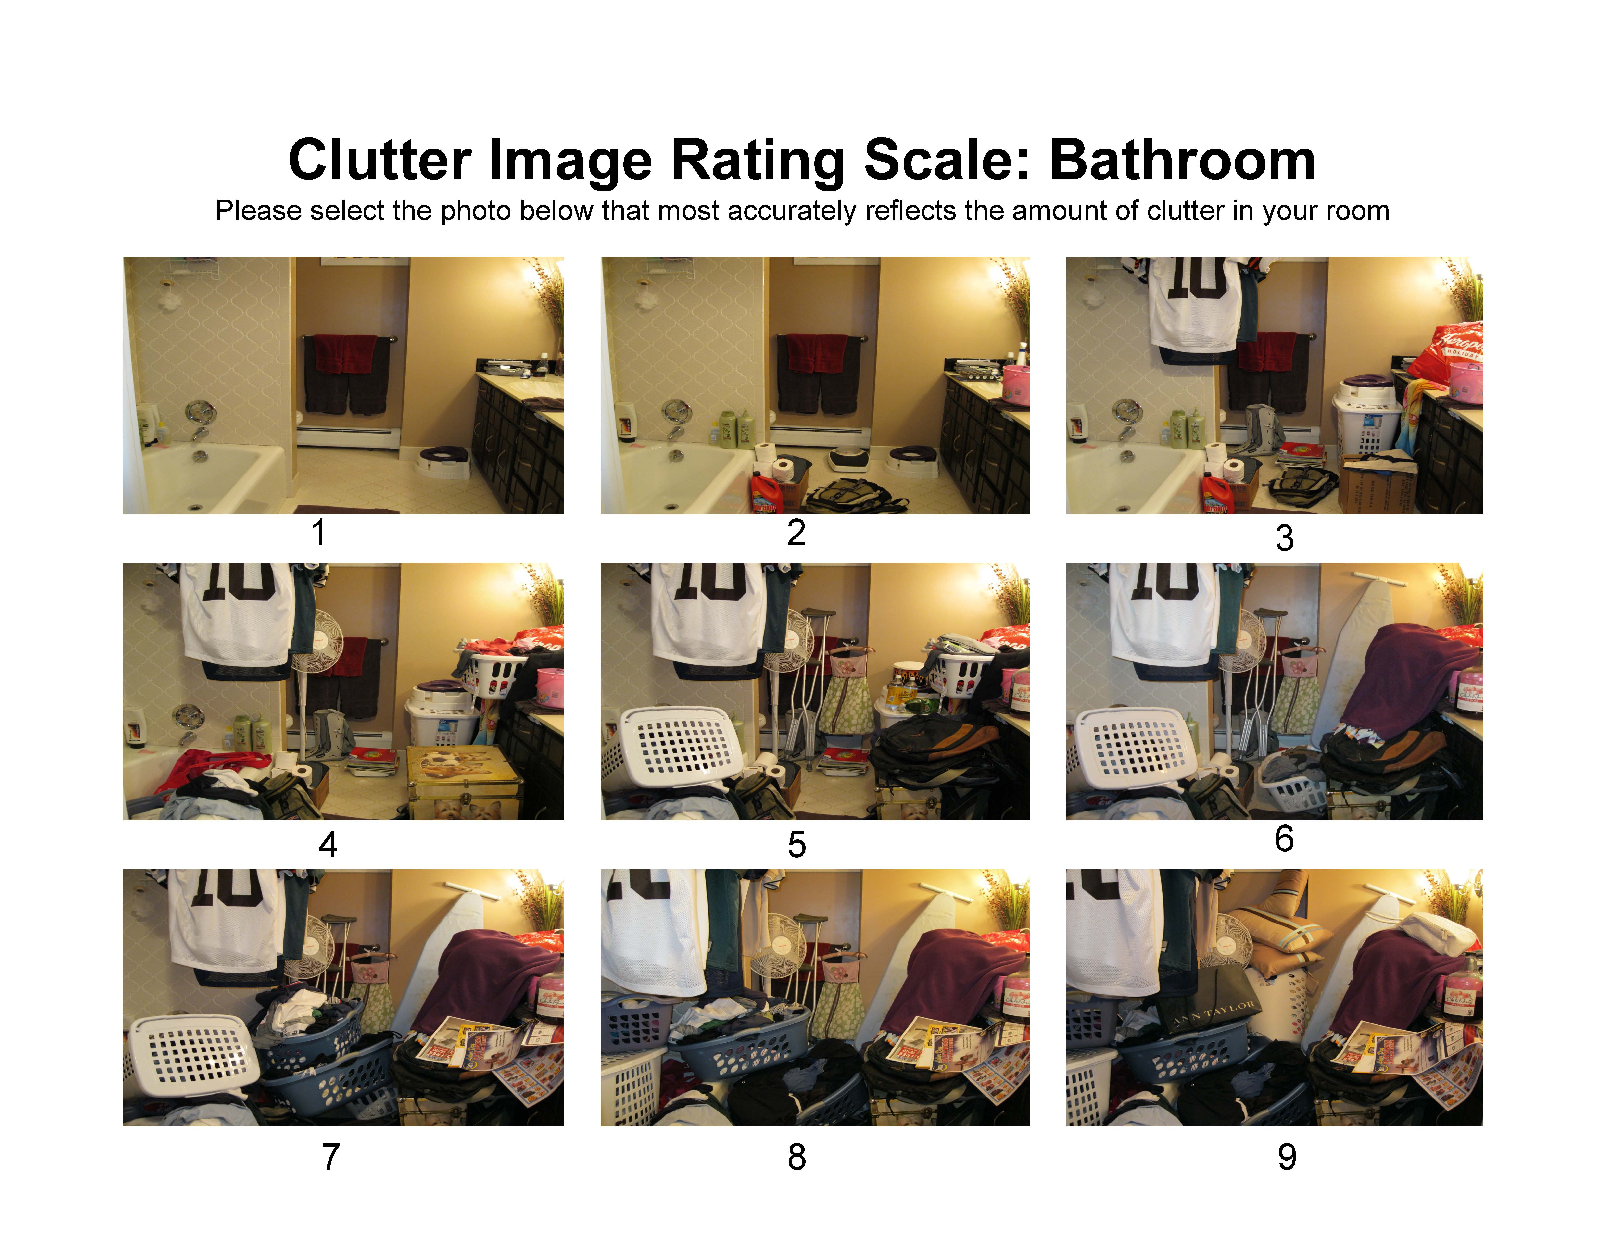

Slide 30
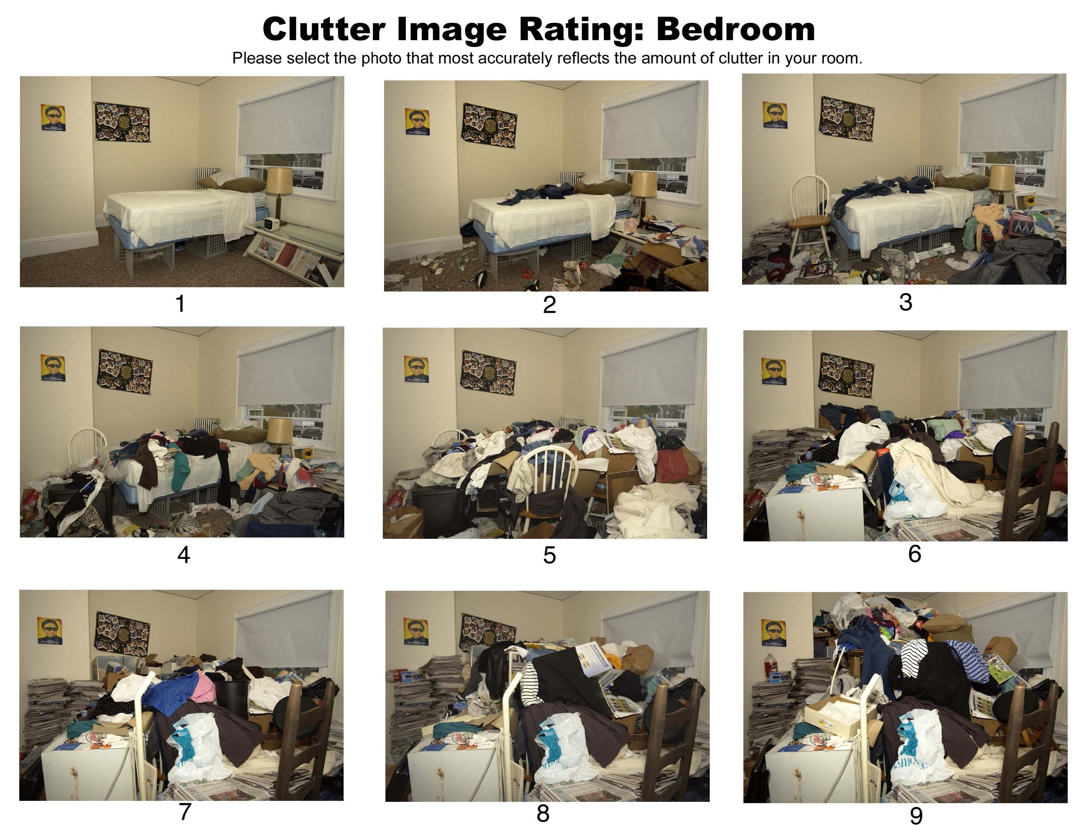

Slide 31
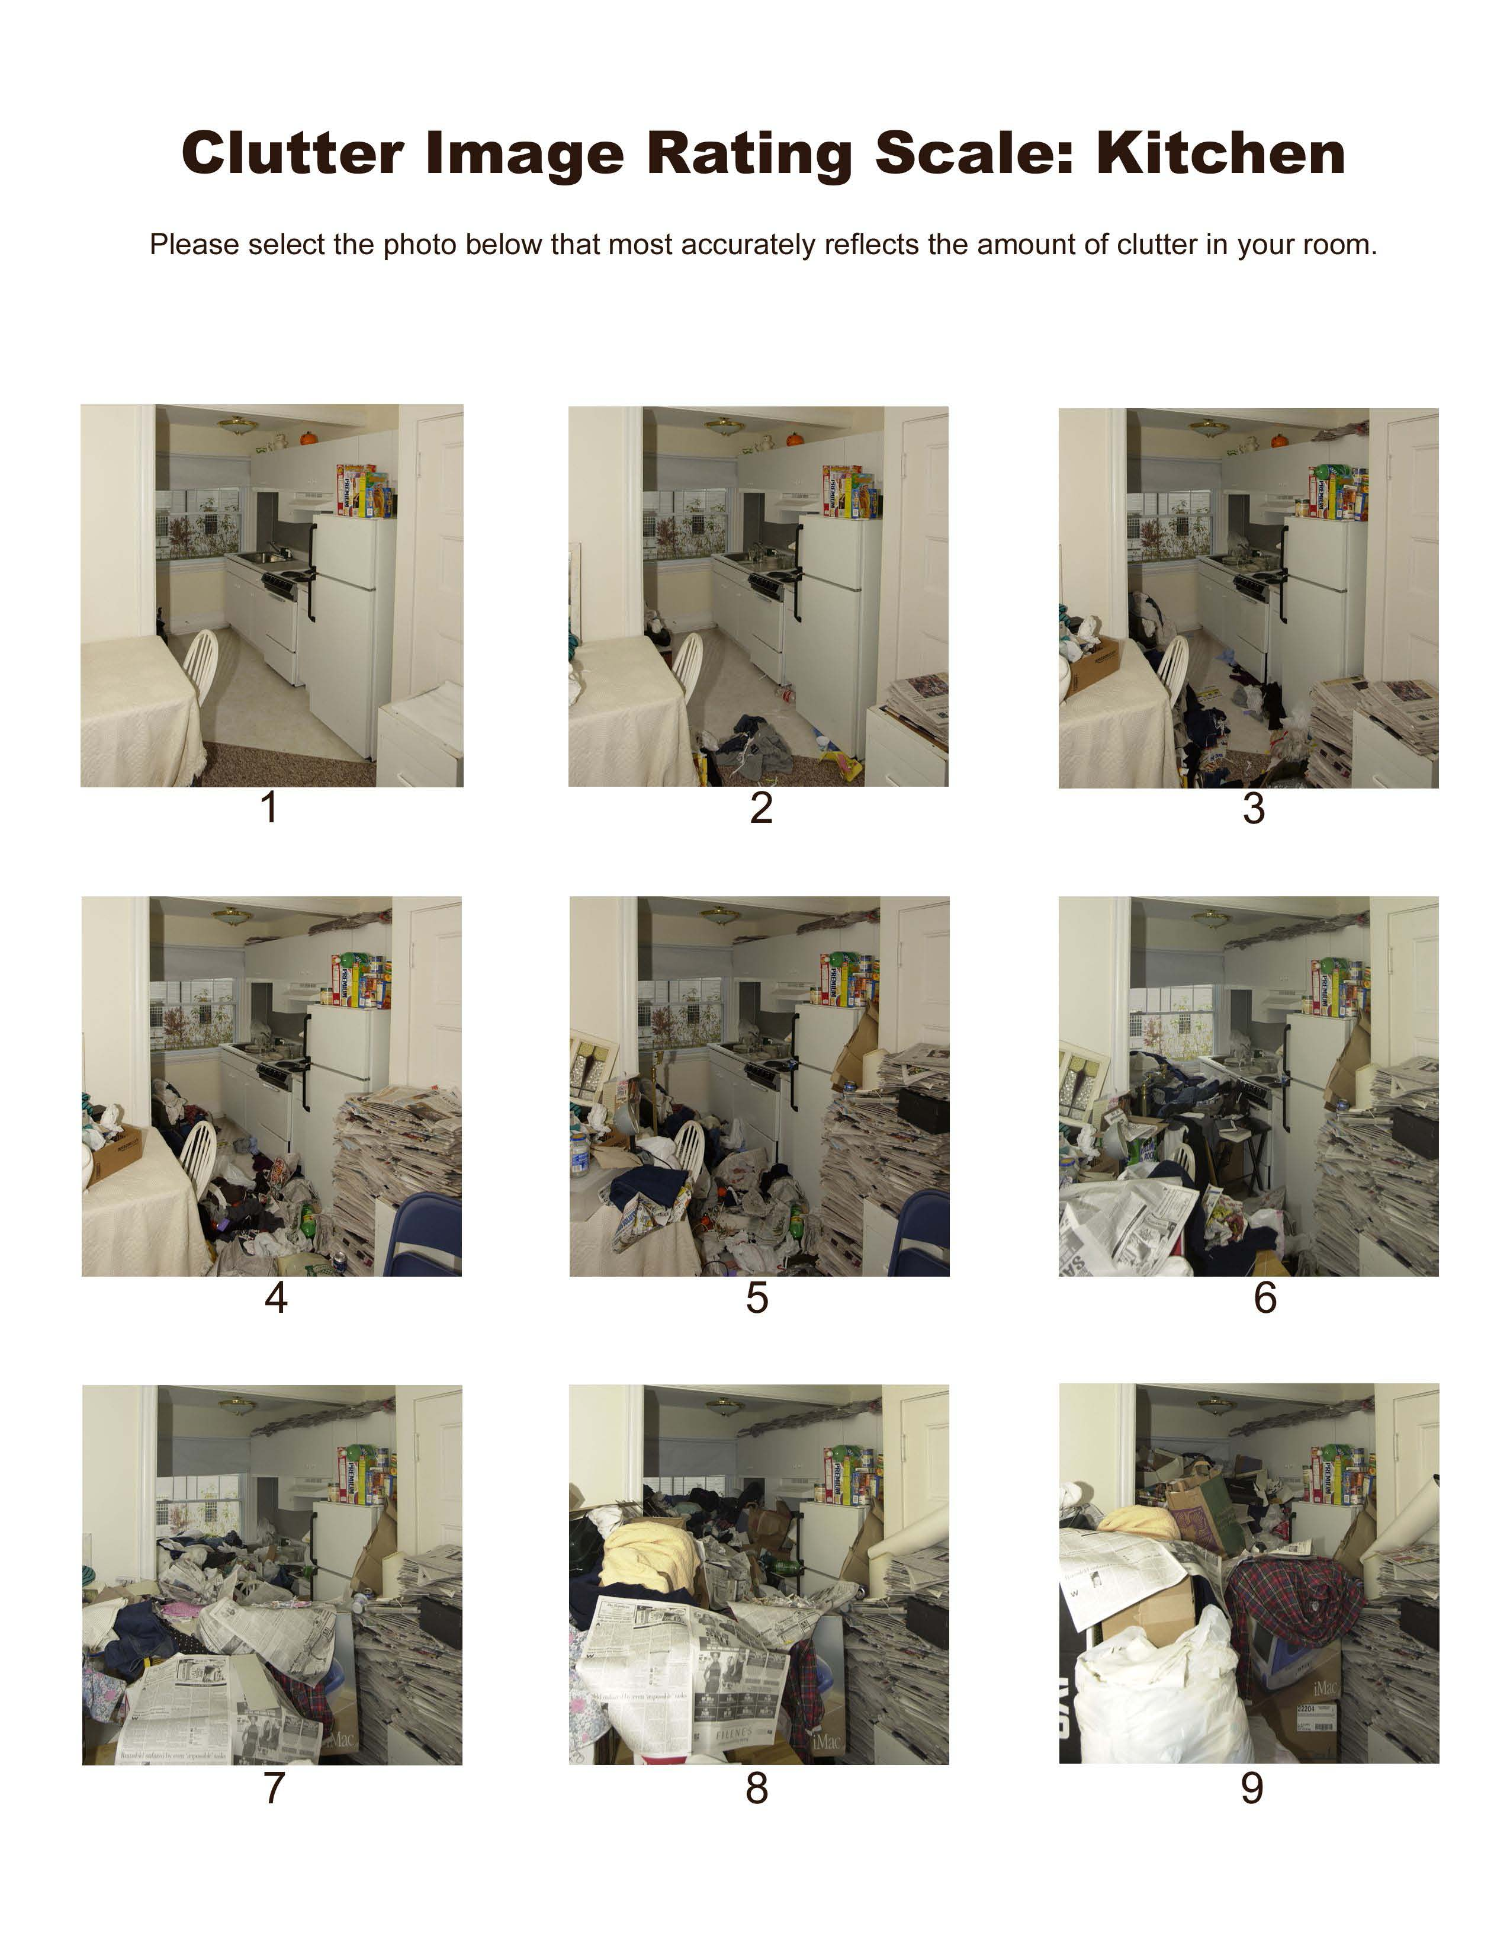

Slide 32
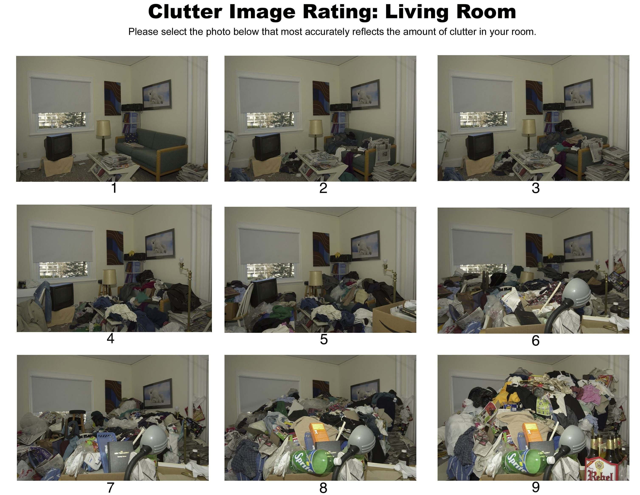

Slide 33

Use the Clutter Hoarding Scale
www.challengingdisorganization.org

Slide 34
ICD’s Clutter Hoarding Scale
Structure and Zoning | Animals and Pests | Household Functions | Health and Safety | Personal Protective Equipment (PPE)
Assessment of access to entrances and exits; function of plumbing, electrical, HVAC (any aspect of heating, ventilation or air conditioning) systems and appliances; and structural integrity | Assessment of animal care and control; compliance with local animal regulations; assessment for evidence of infestations of pests (rodents, insects or other vermin) | Assessment of safety, functionality and accessibility of rooms for intended purposes | Assessment of sanitation levels in household; household management of medications for prescribed (Rx) and/or over the- counter (OTC) drugs | Recommendations for PPE (face masks, gloves, eye shields or clothing that protect wearer from environmental health and safety hazards); additional supplies as appropriate to observational level
The ICD® Clutter–Hoarding Scale®

Slide 35
LEVEL I GREEN LOW
Household environment is considered standard. No special knowledge in working with the chronically disorganized is necessary.
LEVEL II BLUE GUARDED
Household environment requires professional organizers or related professionals who have additional knowledge and understanding of chronic disorganization.
LEVEL III YELLOW ELEVATED
Pivot point between a cluttered household environment and a potential hoarding environment. Those working with Level III household environments should have significant training in chronic disorganization and will require a community network of resources, especially mental health professionals.
LEVEL IV ORANGE HIGH
Household environment requires a coordinated collaborative team of service providers in addition to professional organizers and family: mental health professionals, social workers, financial counselors, pest and animal control officers, crime scene cleaners, licensed contractors and handypersons.
LEVEL V RED SEVERE
Professional organizers should not work alone in a Level V environment. Requires a collaborative team, potentially including family, mental health professionals, social workers, building manager, zoning, fire, and/or safety agents. Formal written agreements among the parties should be in place before proceeding.
The ICD® Clutter–Hoarding Scale®

Slide 36
What if it doesn’t Work?
Family Intervention Plan
Health Care Worker/Providers
Adult Protective Services
Hoarding Task Forces
  Pegasus Moving & Cleaning https://www.pegasusupdx.org/ / 503-308-9430
  Cleaning and Restoration Services
    http://www.smptld.com/ / 503-483-4036
Other Resources:
    Aging and Disability Resource Connection of Oregon (ADRC): 1(800)ORE-ADRC (673-2372) . Provides information about services to address aging or disability needs.
    Institute for Challenging Disorganization (link is external): Providing education, research and strategies to benefit people challenged by chronic disorganization.
    Mental Health Call Center: (503) 988-4888 or toll-free 1(800) 716-9769. 24-hour call line providing crisis counseling (translation services available). 24/7 mobile crisis outreach for in-person assessment, referral to low-cost or sliding scale agencies, help finding mental health providers.
This list is for informational purposes only and is not meant to be a recommendation of agencies or resources.

Slide 37
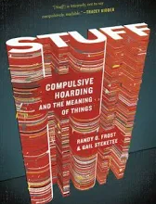

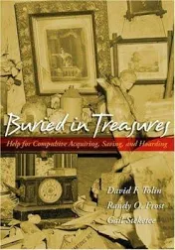
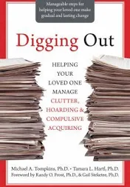
Suggested Reading
Notes:
Buried in Treasures: Help for Compulsive Acquiring, Saving and Hoarding by David Tolin, Randy Frost, and Gail Steketee
Digging Out: Helping Your Loved Ones Manage Clutter, Hoarding, & Compulsive Acquiring by Michael A. Tompkins and Tamara L. Harti
Stuff: Compulsive Hoarding and the Meaning of Things by Gail Steketee and Randy Frost
The Hoarding Handbook: A Guide for Human Service Professionals by Christiana Bratiotis

Slide 38
Resources to review / useful links:
  http://psychcentral.com/blog/archives/2011/03/19/compulsive-hoarding and-6-tips-to-help/
  http://www.mayoclinic.com/print/hoarding/DS00966/METHOD=print&DSECTION=all
  http://www.harthosp.org/InstituteOfLiving/AnxietyDisordersCenter/CompulsiveHoarding/OnlineAssessment/default.aspx
  http://www.icarevillage.com/common-concerns-hoarding.aspx
  https://www.challengingdisorganization.org/
  https://www.challengingdisorganization.org/clutter-hoarding-scale-
  NIRMALA DHAR, LCSW, ACSW OREGON HEALTH AUTHORITY HOARDING
  “To keep or not to keep… is that a question…?”
  (….apologies to Shakespeare)
Alzheimer's Association
Clutterers Anonymous
The Hoarding Project
International OCD Foundation
Messies Anonymous
National Institute of Mental Health

Slide 39
Thank you!
arcigas@co.yamhill.or.us
971-267-6391

