Slide 1


Dementia 101
Lacey Plasker, Behavior Consultant

Slide 2
What You Should Take Away From This Presentation
Knowledge of what dementia is (its symptoms, diagnosis and treatment)
General understanding of a few specific types of dementia
What dementia looks like behaviorally and physically
How to communicate with someone experiencing dementia
Empathy for those experiencing dementia by watching a day in the life of someone with dementia

Slide 3
Definition of Dementia
A chronic or persistent disorder of the mental processes caused by brain disease or injury and marked by memory disorders, personality changes, and impaired reasoning

Slide 4

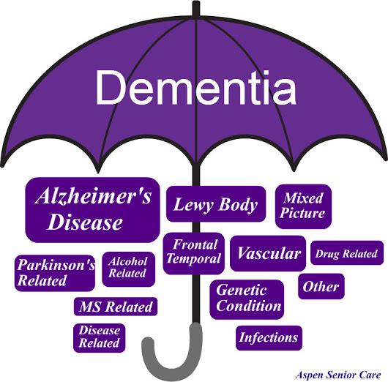
Dementia is an “umbrella” term to describe the symptoms of a group of more than 100 conditions that impair memory, behavior and thinking

Slide 5
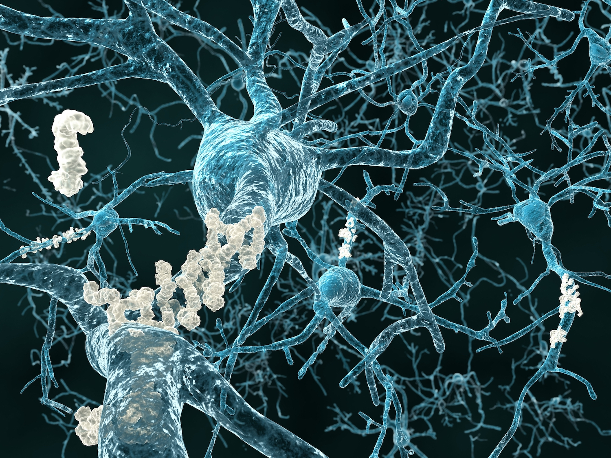
What Causes Dementia
Dementia is caused by physical changes in the brain that happen as the result of the disease. As dementia progresses, the structure and chemistry of the brain changes, which causes nerve cells to die. As more nerve cells die, the brain becomes damaged. The damage interferes with the ability of brain cells to communicate with each other. When brain cells cannot communicate normally, thinking, behavior and feelings can be affected.
Many dementias are progressive, meaning symptoms start out slowly and gradually get worse
Often there is no known reason for the physical changes in the brain

Slide 6
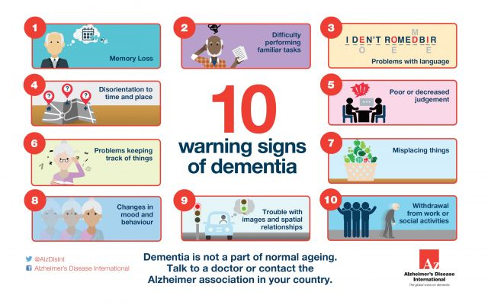
Symptoms of Dementia

Slide 7
Diagnosis of Dementia
There is no one test to determine if someone has dementia. Doctors diagnose Alzheimer's and other types of dementia based on a careful medical history, a physical examination, laboratory tests, and the characteristic changes in thinking, day-to-day function and behavior.

Slide 8

Dementia Treatment
Treatment of dementia depends on its cause. In the case of most progressive dementias, including Alzheimer's disease, there is no cure and no treatment that slows or stops its progression. But there are drug treatments that may temporarily improve symptoms.

Slide 9
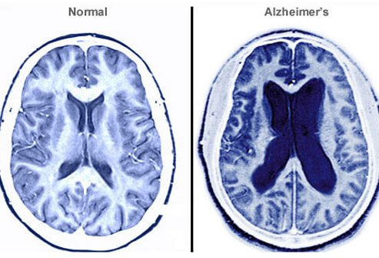
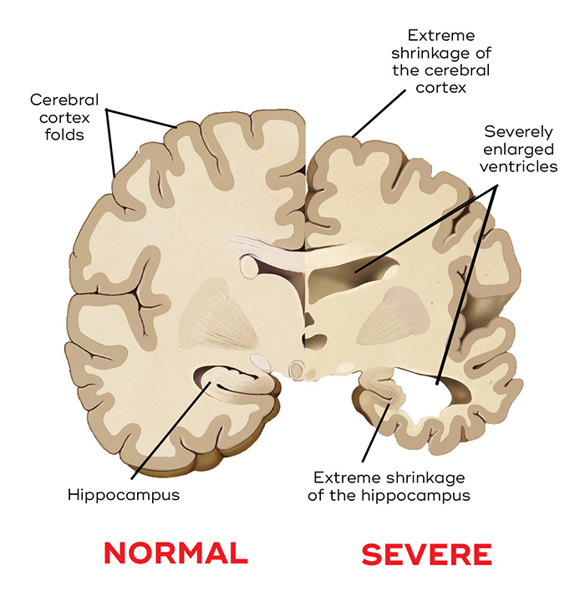
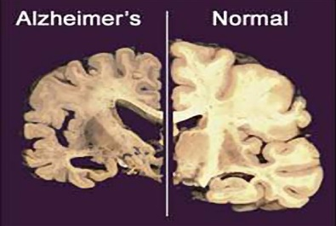
Impact of Dementia on the Physical Brain

Slide 10
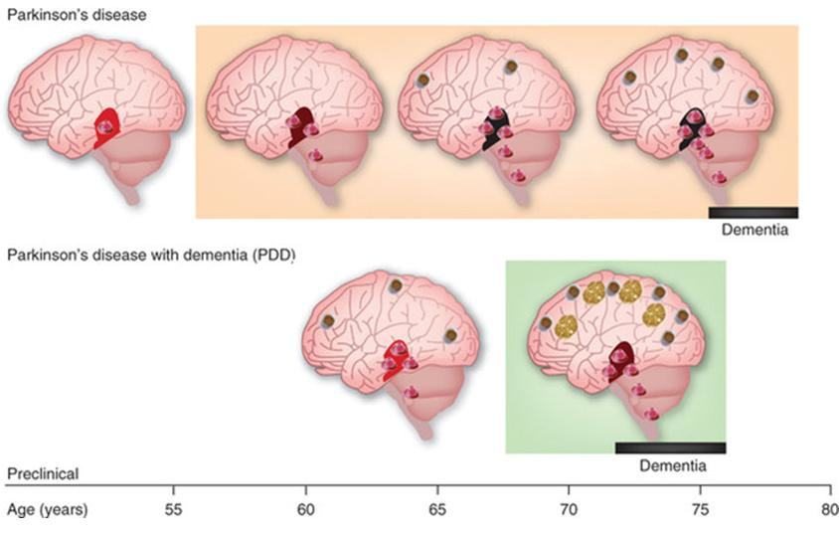
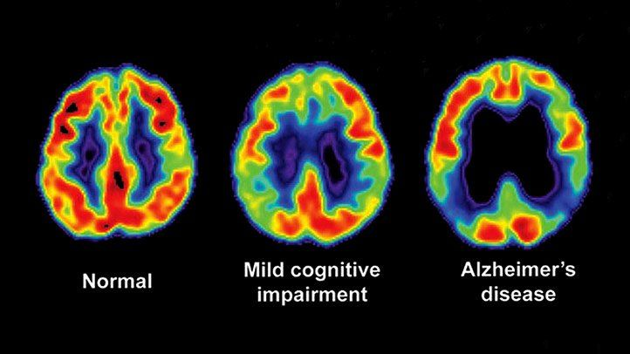
Impact of Dementia on the Physical Brain
Progressive Images of what Can Happen to the Brain

Slide 11
A Look at Different Forms of Dementia
Alzheimer’s Disease
Vascular Dementia
Dementia with Lewy Bodies (DLB)
Most common type of dementia; accounts for an estimated 60 to 80 percent of cases. Alzheimer’s causes abnormal structure called ‘plaques’ and ‘tangles’ to build up inside the brain.
Symptoms: Difficulty remembering recent conversations, names or events is often an early clinical symptom; apathy and depression are also often early symptoms. Later symptoms include impaired communication, poor judgment, disorientation, confusion, behavior changes and difficulty speaking, swallowing and walking.
Previously known as multi-infarct or post-stroke dementia accounting for about 10 percent of dementia cases. This dementia is the result of problems with the blood supply to the brain.
Symptoms: Impaired judgment or ability to make decisions, plan or organize is more likely to be the initial symptom. Occurs because of brain injuries such as microscopic bleeding and blood vessel blockage. The location, number and size of the brain injury determines how the individual's thinking and physical functioning are affected.
This dementia gets its name form tiny clumps of protein that develop inside the nerve cells, called Lewy bodies.
Symptoms: People with this dementia often have memory loss and thinking problems common in Alzheimer’s but are more likely than people with Alzheimer's to have initial or early symptoms such as sleep disturbances, well-formed visual hallucinations, and muscle rigidity or other parkinsonian movement features.

Slide 12
A Look at Different Forms of Dementia
Frontotemporal Dementia (FTD)
Alcohol Related Dementia
Mixed Dementia
Frontotemporal dementia is an umbrella term for a group of uncommon brain disorders that primarily affect the frontal and temporal lobes of the brain. These areas of the brain are generally associated with personality, behavior and language.
It is often misdiagnosed as a psychiatric problem and tends to occur at a younger age often begins between the ages of 40 and 65.The most common signs of frontotemporal dementia involve extreme changes in behavior and personality.
This is a chronic memory disorder caused by severe deficiency of thiamine (vitamin B-1). The most common cause is alcohol misuse.
Symptoms: Memory problems may be strikingly severe while other thinking and social skills seem relatively unaffected.
One form of this dementia is known as Wernicke-Korsakoff Syndrome.
Dementia abnormalities linked to more than one type of dementia occurring simultaneously in the brain. Example: The abnormal protein deposits associated with Alzheimer's disease coexist with blood vessel problems linked to vascular dementia. Recent studies suggest that this dementia is more common than previously thought.
Mixed dementia symptoms may vary, depending on the types of brain changes involved and the brain regions affected.

Slide 13
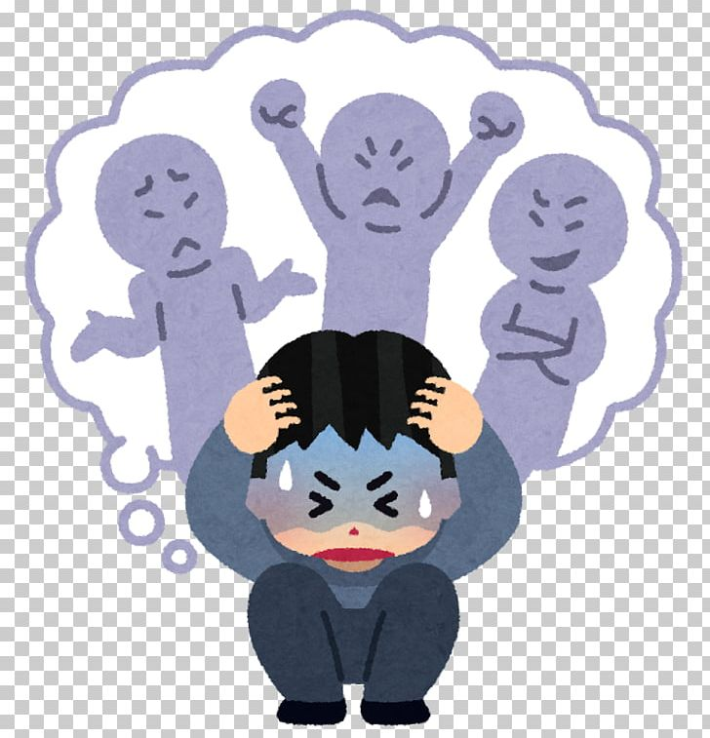
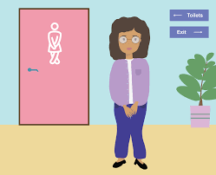
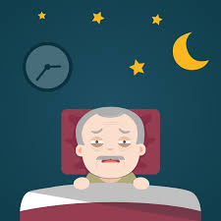

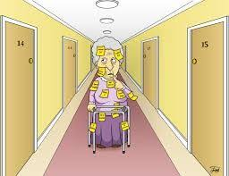
Common Behaviors of Concern
Confusion
Repetitiveness/actions
Agitation/aggression
Verbal and physical outbursts
Pacing
Daytime and nighttime switching
Sleep disturbances
Disinterest
Hallucinations/delusions
Sexual behavior (touching self, taking clothing off)
Intense mood swings
Taking/stealing from other (going into other’s rooms)
Toileting/hygiene related issues (refusal, confusion with sequencing)

Slide 14

How to Communicate, as a Caregiver, With Someone Experiencing Dementia
Before you speak
Be calm. If needed take a moment to calm yourself. Take a few deep breaths.
Consider what you are going to talk about. Ask yourself what you want or need to achieve from the conversation.
Make sure you have the person’s full attention.
Make sure that the person can see you clearly.
Try to make eye contact. This will help the person focus on you.
Minimize competing noises, such as the radio, TV, or other people’s conversations.

Slide 15

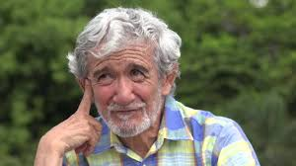
How to Communicate as a Caregiver with Someone Experiencing Dementia
What to say
Try to be positive
Avoid asking too many direct questions. People with dementia can become frustrated if they can’t find the answer. If you have to, ask questions one at a time, and phrase them in a way that allows for a ‘yes’ or ‘no’ answer.
Try not to ask the person to make complicated decisions. Giving someone a choice is important but too many options can be confusing and frustrating.
If the person doesn’t understand what you are saying, try to get the message across in a different way rather than simply repeating the same thing.

Slide 16
How to Communicate as a Caregiver with Someone Experiencing Dementia
How to speak
Speak clearly and calmly
Speak at a slightly slower pace, allowing time between sentences for the person to process the information and to respond.
Use short, simple sentences.
Avoid raising your voice, as this may distress the person.
Show respect and patience when talking.
Try to include the person in conversations with others. Be included in social groups can help a person with dementia to preserve their sense of identity. It can also help to reduce feelings of exclusion and isolation.
Avoid using the words “no,” “you can’t,” “remember,” “don’t” as these can be triggering and a source of frustration for others.

Slide 17
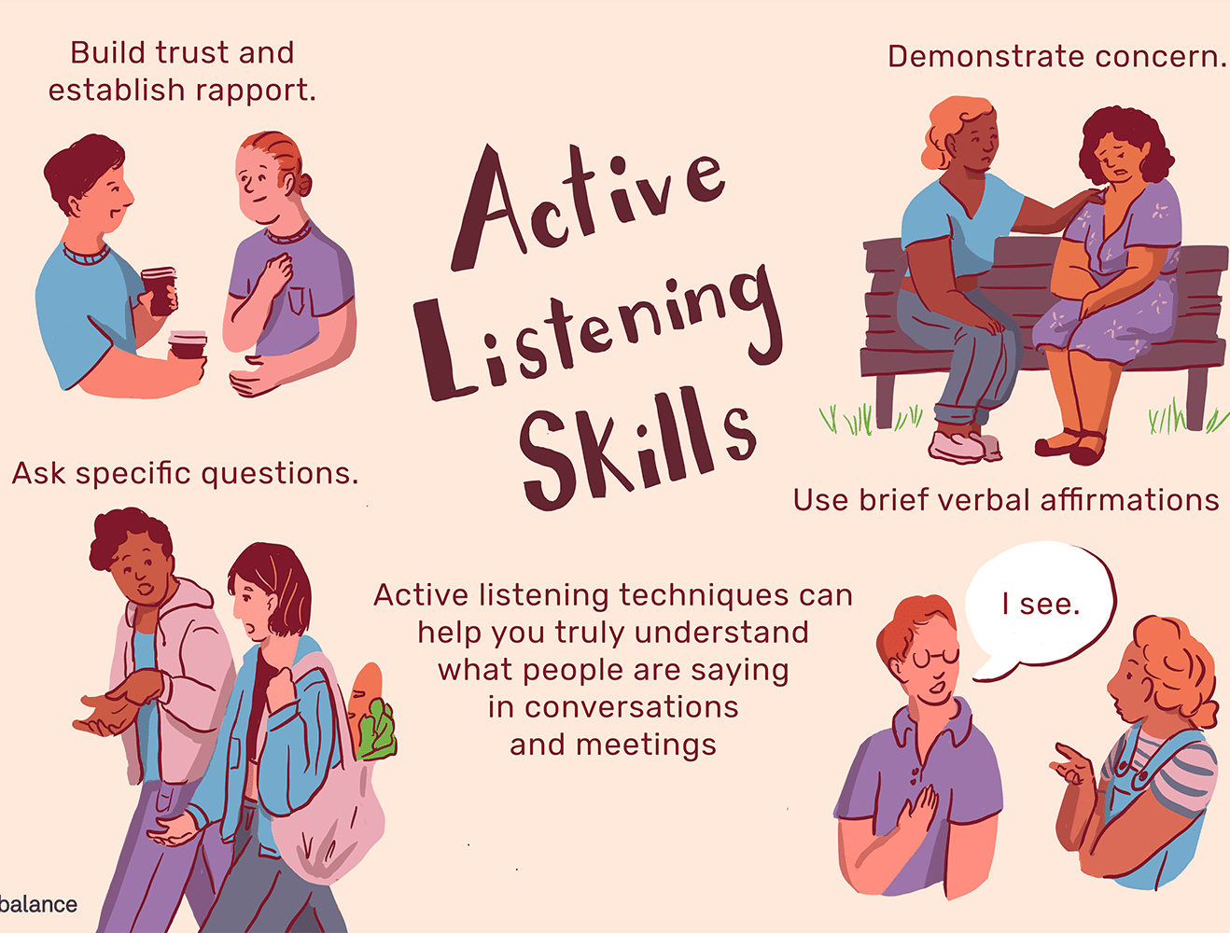
How to Communicate as a Caregiver with Someone Experiencing Dementia
Listening
Listen carefully to what the person is saying.
Give them plenty of encouragement.
When you haven’t understood fully, tell the person what you have understood and check with them to see if you are right.
If the person has difficulty finding the right word or finishing a sentence, ask them to explain it in a different way. Pay attention to their body language, and their facial expression.
If the person is feeling sad, let them express their feelings without trying to ‘jolly them along’. Sometimes the best thing to do is to just listen.
Due to memory loss, some people won’t remember things such as their medical history, family and friends. You will need to use your judgement and act appropriately around what they’ve said.

Slide 18
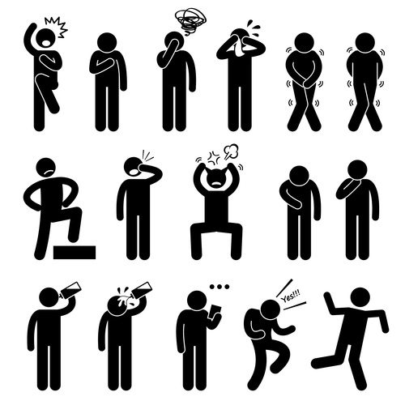

How to Communicate as a Caregiver with Someone Experiencing Dementia
Body language and physical contact
A person with dementia can and will read your body language. Often non-verbal communication is easier to read and understand for someone experiencing dementia.
Make sure that your body language and facial expression match what you are saying.
Never stand too close or stand over someone to communicate it can feel intimidating. Instead, respect the person’s personal space and drop below their eye level. This will help the person to feel more in control of the situation.
Use physical contact to communicate your care and affection, and to provide reassurance – don’t underestimate the reassurance you can give by holding or patting the person’s hand.

Slide 19
A Virtual Experience: An Afternoon in The Life of Someone Experiencing Dementia

Slide 20

How does a person with dementia see the world?

Slide 21
Take a second to breath and reflect on that clip
How was that experience?
How are you feeling about those that you know are experiencing dementia?
Do you feel empathy for those that experience these situations every day?

Slide 22
Congrats you completed this presentation
Questions?
Email Lacey Plasker at
plaskerl@co.yamhill.or.us

Slide 23
For More Information About Dementia
www.alz.org
www.brainandlife.org
Dementia 101: 101 dementia related evidence-based questions and answers for health professionals, families and carers. by Rachel Fitzgerald R.N (Author), Nick Fitzgerald R.N (Author)
Dealing with Dementia Easy to Understand Tips and Resources for Families and Caregivers By: Paige Cooper RN
The 36-Hour Day: A Family Guide to Caring for People With Alzheimer’s Disease, Other Dementias, and Memory Loss in Later Life by Nancy L. Mace and Peter V. Rabins. 4th ed. Baltimore: Johns Hopkins University Press, 2006
Mayo Clinic Guide to Alzheimer’s Disease: The Essential Resource for Treatment, Coping and Caregiving by Ronald Petersen, ed. Rochester, MN: Mayo Clinic Health Solutions, 2006
Inside Out (2015) Pixar movie “Memory Storage Area” “Memory Minors”

Slide 24
References
www.alzheimers.or.uk
www.alz.org
www.mayoclinic.org
https://www.youtube.com/watch?v=q_sWiwI3yP0

