Slide 1

Behavior Support Services
Behavior as communication: It is the individual’s inability to communicate that often leads to the challenging behaviors.

Slide 2
Behavior Support Services Objectives
Reduce frustration, injuries, stress, placement failures and other concerns
Focus on support within the person’s environment and improving interactions with caregivers to address:
*Challenging behaviors *Cognitive processing *Communication Skills
*Impulse control *Self-help activities *Adaptive Skills

Slide 3
Behavior Support Services
Provide support by assisting with the following:
Training and education for caregivers
Help care providers improve their skills and relationships with clients
Assist in sustaining placement
Assist in positively changing the environment for clients and their caregivers
Provide support to meet needs and problems behaviors
Assist in increasing client’s quality of life
*** We work directly with the Staff; our goal is not to change the client***

Slide 4
Who is eligible for Behavior Support Services?
Eligible if:
Not Eligible:
Medicaid, HCBC Community First Choice State Plan Option
Currently living in an Adult Foster Home, Assisted Living Facility, Memory Care, specialty AFH or living at home with hired in-home caregivers and has agreed to services
Currently living in a nursing home or is in the hospital
Receiving a service payment which duplicates BSS
Living at home with in-home caregivers but has NOT agreed to the service
Is in an unstable medical or mental health condition needing immediate attention from medical and/or mental health professionals
***Behavioral Support is not a mental health service***

Slide 5
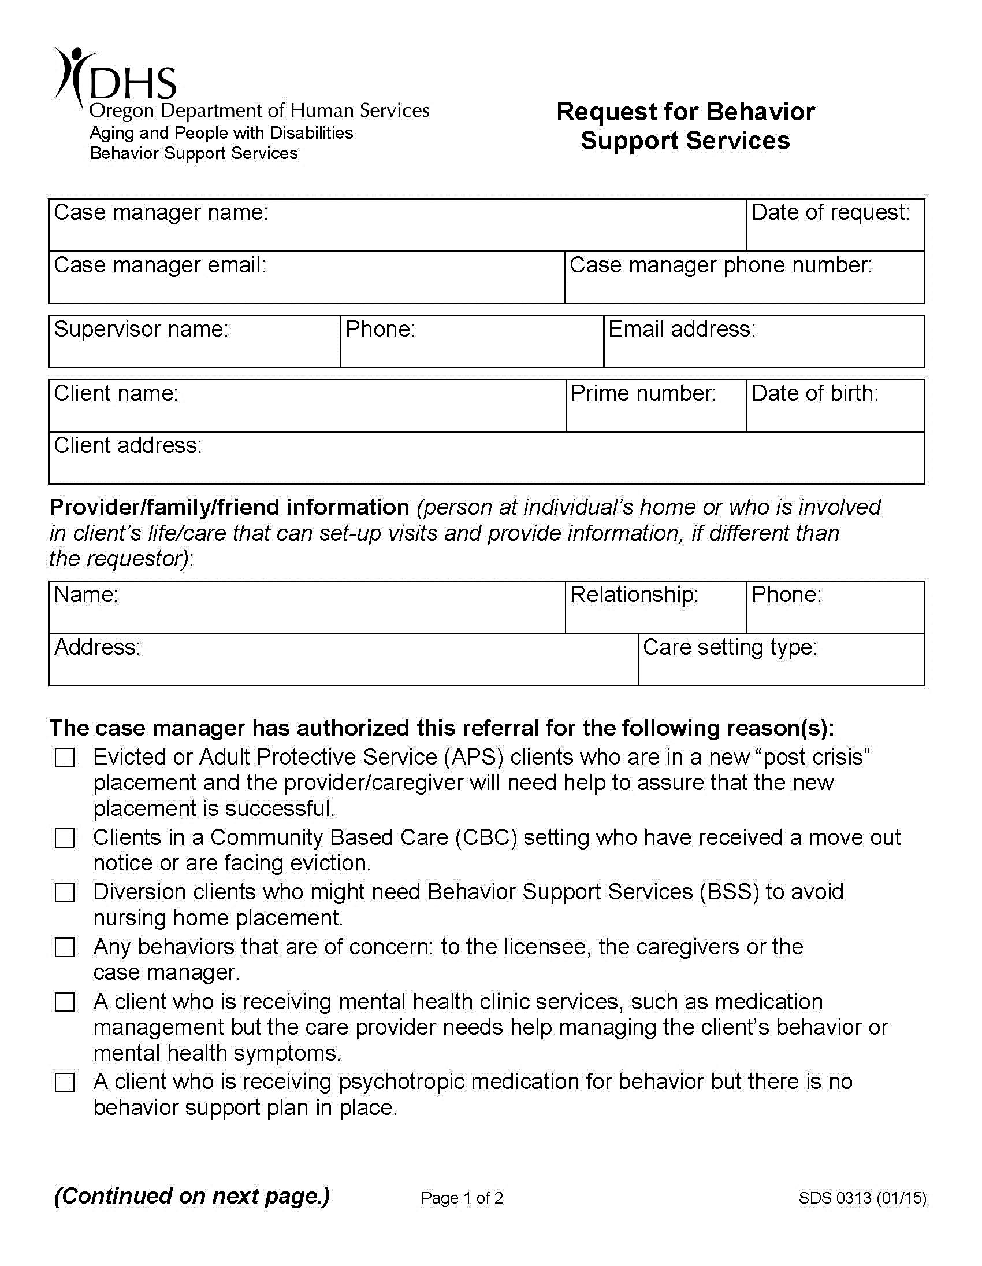
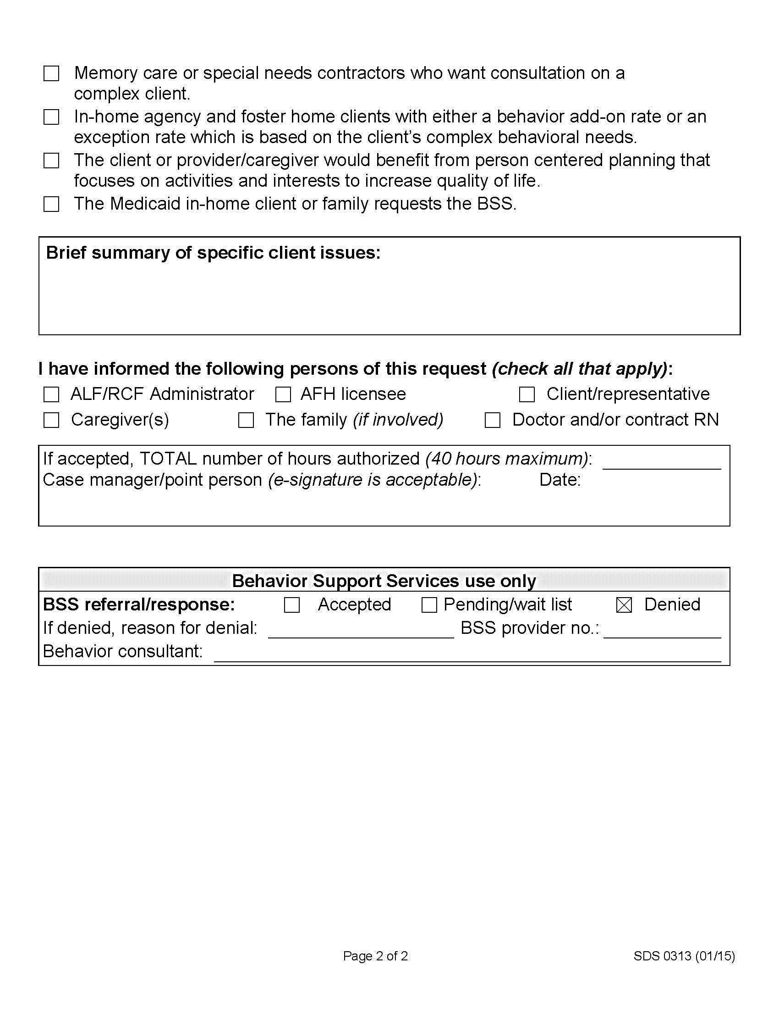
Please provide as much information regarding behaviors…

Slide 6
Important timelines to know
BSS team has 2 business days to respond to the referral (accepted-pending activation list, denied or activated)
Once a case is activated the consultant has 5 business days to see a client/provider
20 business days for plan development
Consultant gets around 120 days and 40 hours to consult on a case (can get additional 40 hours)
A case can be suspended for reasons such as a short hospitalization, short term rehabilitation, or recent loss of a caregiver (in-home)
A client can receive behavior support once a year (Timeline starts over)

Slide 7
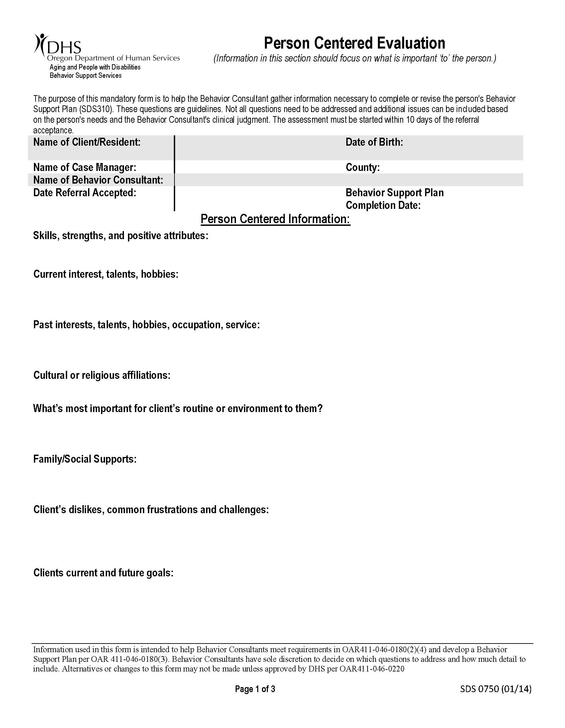
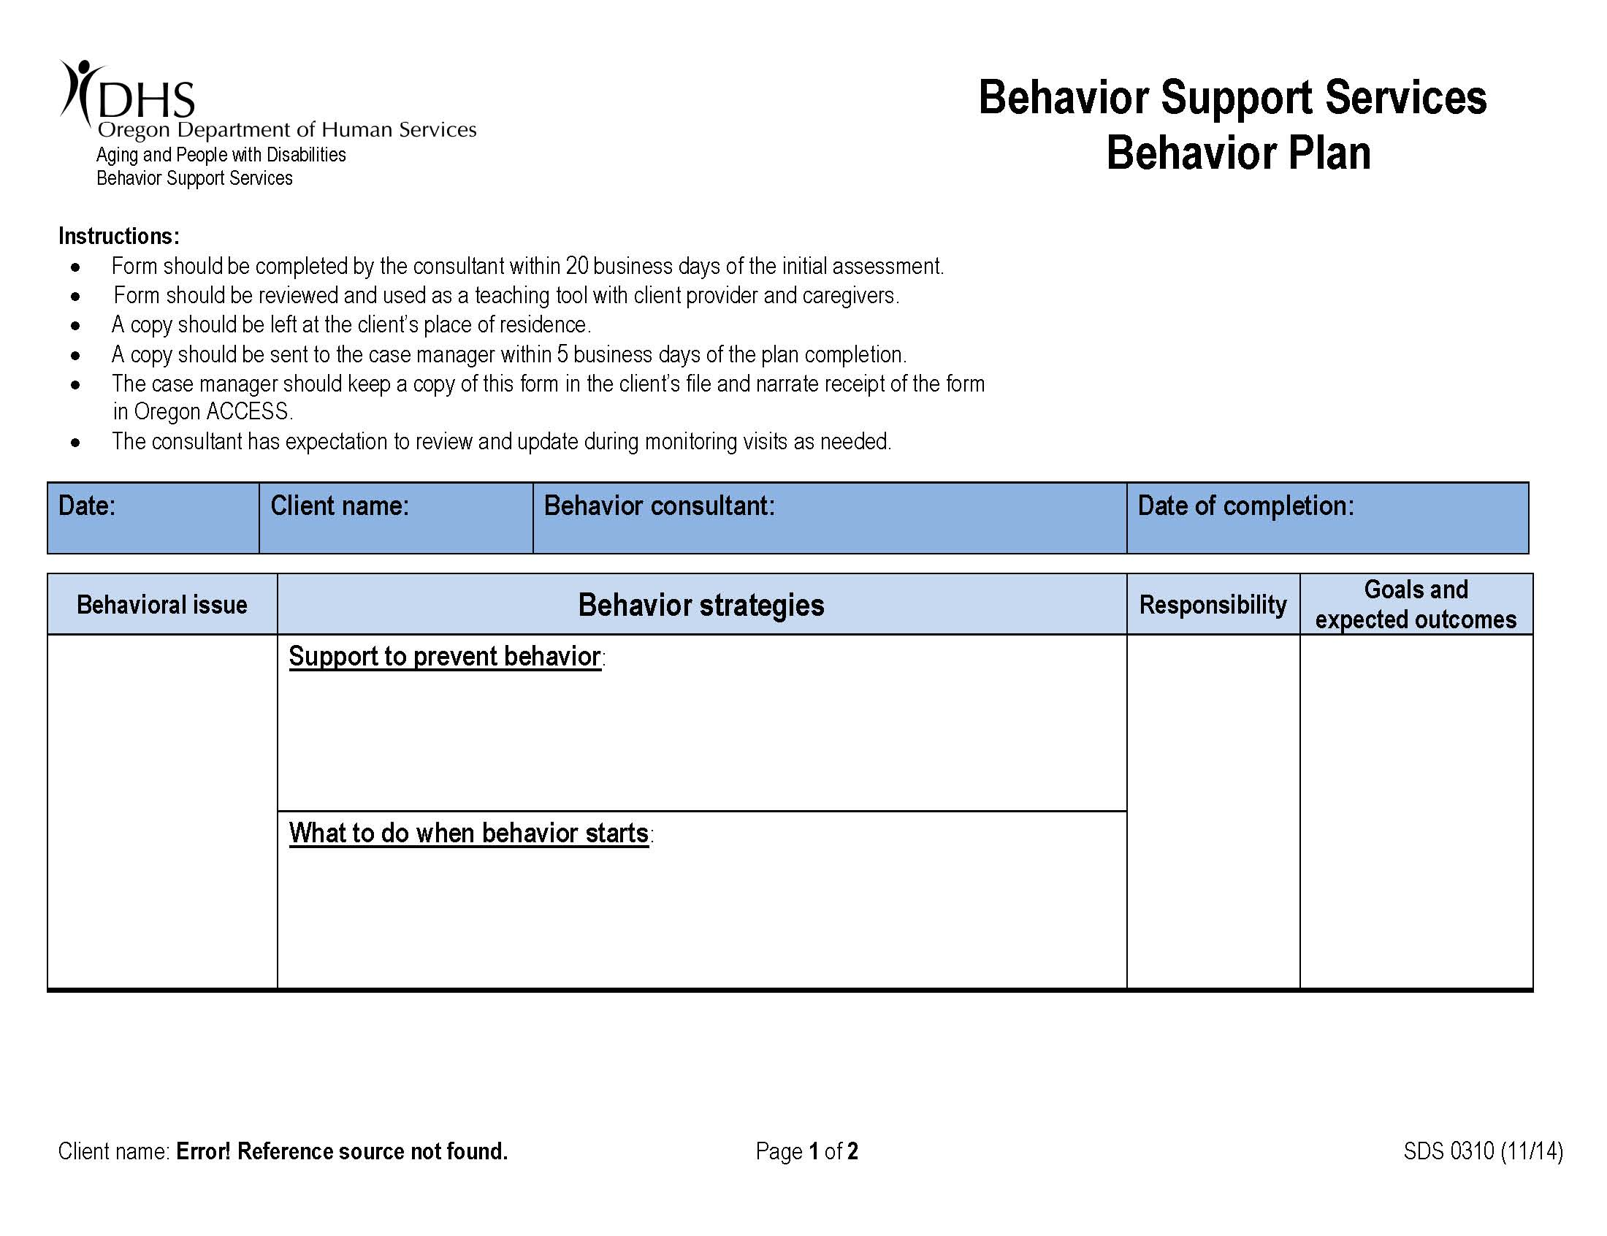
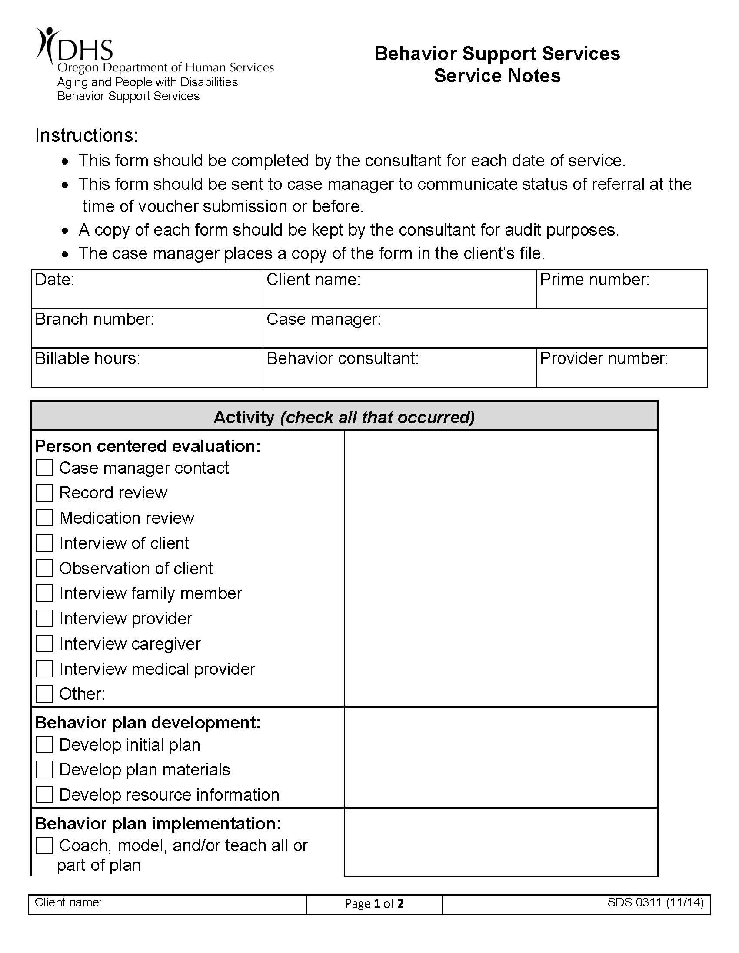
What do you as a referring case manager receive from us:

Slide 8
Important things to know as a referring case manager
It’s appropriate to make a referral when Providers state they are having difficulties with a client or conflicts are noted when visiting the home or facility.
If a client that has already had behavior support and relocates, please remember to send the existing behavior plan to the new provider.
If a client has already received behavior support, please attempt these strategies before re-referring:
Review the behavior plan with the provider and see if they are attempting any of the strategies provided
See if there are new behaviors that are not addressed in the plan
Talk with client about other supports such as: mental health counseling, AA, chemical dependency, physical therapy, senior peer support, etc.

Slide 9
Please let us know
As soon as possible if a client has moved to a new placement, no longer qualifies for APD services, or has passed away
If there has been a case manager change
When the case has been transferred to a different county
If there are any new concerns
Of any major special circumstances such as a loss of funding, loss of in-home caregiver, hospitalization, arrest, etc.
The best and fastest way to reach you as a case manager (phone, email, in-person)

Slide 10
Provider and Consultants
Yamhill County Health and Human Services
Primary email for referrals and questions:
bss@co.yamhill.or.us
Behavior Consultants Contact
Stephanie Arciga: arcigas@co.yamhill.or.us (971)-267-6391
Lacey Plasker: plaskerl@co.yamhill.or.us (971)-267-0548
Supervisor Contact
Krisan Pendleton: pendletk@co.yamhill.or.us (503)-472-4022

