Slide 1

Understanding Sexual Behaviors in Residents
By Stephanie Arciga, Behavior Consultant

Slide 2
Sexual Behaviors in the care setting
What are some examples of sexual behaviors in the care setting?
What makes them unwanted, inappropriate and challenging?
Who experiences these behaviors?
What are some strategies that you can implement when it comes to sexual behaviors in the care setting?

Slide 3
What is Sexuality?

Slide 4
Sexual needs
Sexual interest is not lost in old age.
There is no age when sexual activity abruptly ends.
When residents with dementia exhibit sexual needs our approach may be prejudiced by our own values and beliefs
We must understand that it is not the sexual need that is unacceptable, but the behavior accompanying it that needs to be appropriately managed.

Slide 5
What does research say
Inappropriate sexual behavior is not particularly common in people with dementia. It is more likely to occur in the moderate to severe stages of most forms of dementia, though it is sometimes evident in residents with mild cognitive impairment.
The reasons for sexual disinhibition or inappropriate behavior in people with dementia remain unclear, but may include disease-related factors, social factors, psychological factors and certain drugs and alcohol.
Research suggests that staff, residents and family often disagree on what is meant by appropriate or inappropriate behavior.
Some studies have suggested there is equal frequency in inappropriate behavior in men and women. Several other studies suggest much higher frequency in men, but this may be linked to subjective definitions and overreporting of men to women.

Slide 6
Types of
Inappropriate Sexual Behaviors (ISB)
Sex talk (most common)
Sexual acts
Implied sexual acts

Slide 7
ISB Encompasses range of Behaviors:
Inability to express sexual needs appropriately
Limited capacity to change behaviors due to Dementia and memory loss
Personality changes due to Dementia
Worsening or impaired judgment
Misidentification of someone else as usual sexual partner
Misinterpretation of cues or gestures as communication
Lack of habitual sexual partner
Boredom or loneliness
Verbal requests for sex
Unwanted touching
Masturbation
Ambiguous behaviors (appearing naked or incompletely dressed)
“sexual disinhibition” due to dementia, symptoms for this may include: Decreased awareness of behaviors and what’s appropriate
Confusion and/or disorientated to place and person
Impulsiveness
Changes in communication skills due to damage to their brain from Dementia

Slide 8
Sexual behavior: case Example
Notes:
UCLA Alzheimer's and Dementia Care Program

Slide 9

Notes:
These videos are free for public access; if you are an organization seeking to use the videos, please cite and link back to this page.
Video source: https://www.uclahealth.org/dementia/sexually-inappropriate-behaviors

Slide 10
Video discussion
(Pause to discuss/ write down thoughts/ answer questions- you will have about 2 minutes)
During the first part of the video, what happened? Why did it happen? What were the triggers to the behavior?
What are some personal experiences using the recommended response.
Ideas to what staff can do today to remove triggers?
Additional strategies you may think of?

Slide 11
How should you respond:
Manage inappropriate behavior when it happens
Explain sexual behaviors to other people
Identify triggers
Adapt the environment to the situation.

Slide 12
Manage inappropriate behavior when it happens
  Stay calm and be patient
  Gently but firmly tell the person that the behavior is inappropriate
  Match you body language to your words
  Maintain consistent, firm boundaries.
  Move the resident to another location.
  Use humor when appropriate
  Leave the situation, if appropriate.
  Substitute another staff member of the opposite sex to provide care

Slide 13
Explain sexual behavior to others
Reassure
Reassure family, friends and visitors
Ask
Calmly ask other adults to excuse their behavior or advise them to step back a bit.
Keep
Keep a little space between the resident and other people when you walk them into a room, leave enough space so they can’t easily touch someone, especially if they tend to grab.

Slide 14
Identify triggers
Triggers can vary from person to person
Observe the behavior
Track the behavior
Common triggers may include: getting close to someone, needing help with personal hygiene, by what you say (i.e. sweetie, honey, etc.), bending over someone, or sometimes the need to use the restroom.

Slide 15
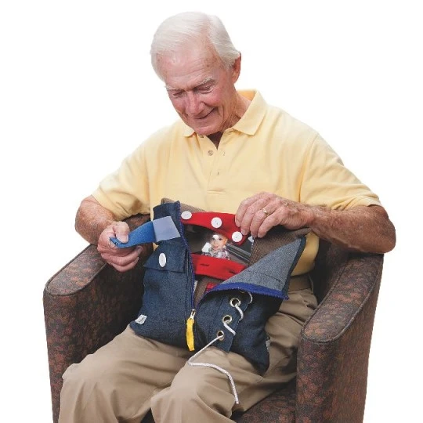
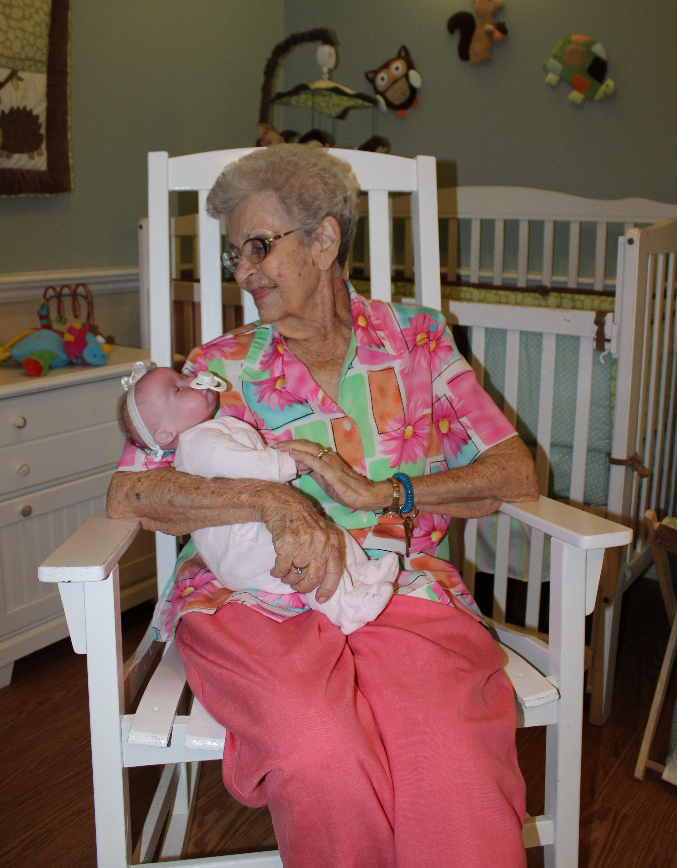

Adapt the environment to the situation
  Try to predict situation where the behavior is more likely to occur and plan ahead for this. For example, keeping their hand occupied with fidget activity or sensory activity.
  Provider alternatives to cuddling- a soft blanket, stuffed animal, body pillow, or doll can satisfy the need to touch.
  Boredom can also cause sexual behavior. Keep the resident happily occupied with different types of engaging activities
  Consider adaptive clothing options
  Putting a pillow on someone’s lap can provide a barrier between his hands and his genitals.

Slide 16
How should you respond:
Do not take it personally!
Consult with family, doctors / other professionals involved in resident’s care
Review facility policies, talk with administrative staff to learn more and provide further guidance on this.
To view the hyperlinks below: Ctrl + Click or right click over the heading and click “open link"
  Sex and Intimate Relationships
  Sexuality, Intimacy, and Dementia in Residential Care Settings

Slide 17



overview
This Photo by Unknown Author is licensed under CC BY-NC
This Photo by Unknown Author is licensed under CC BY-SA

Slide 18

Stephanie Arciga arcigas@co.yamhill.or.us
971-267-6391

Slide 19
Resources
Video source: https://www.uclahealth.org/dementia/sexually-inappropriate-behaviors
https://terranova.org/film-catalog/sexuality-intimacy-and-dementia-in-residential-care-settings/
https://www.dshs.wa.gov/sites/default/files/ALTSA/hcs/documents/Dementia%20Training.pdf
https://alzheimer.ca/en/Home/Living-with-dementia/Understanding-behaviour/Intimacy-and-sexuality/Sexual-conduct
https://alzheimer.ca/en/durham/We-can-help/Resources/Shifting-Focus/Examples-of-responsive-behaviour/Sexual-behaviour/Sexual-behaviour-examples
https://www.alzheimers.org.uk/get-support/publications-and-factsheets/dementia-together-magazine/help-husbands-inappropriate-sexual-behaviour

