Slide 1

Understanding Behaviors
By Stephanie Arciga, Behavior Consultant

Slide 2
What are behaviors?
Behaviors are a form of communication.
A Behavior is defined as an observable activity. It can be seen and/or heard and has a starting and a stopping point. Behavior is related to many things. Behaviors can be an action or reaction under a given circumstances. Usually it has a purpose and has a function. Often, behaviors are a pattern.
Notes:
What is a Behavior?
Behaviors are a form of communication. We all express behaviors in our everyday interaction. It includes our observable actions such as smiling, talking, eating and dressing. Different situations or environments have different rules or expectations about how to behave. For example, we are expected to behave differently in a library than we do at a ball game. Also, beliefs about what is expected may differ with each person.
A Behavior is defined as an observable activity. It can be seen and/or heard and has a starting and a stopping point. Behavior is related to many things. Usually it has a purpose and has a function. Examples of purpose and function are getting something, avoiding something undesirable or enjoying something.

Slide 3
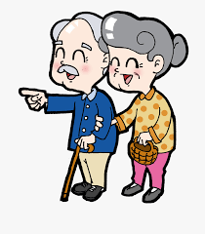
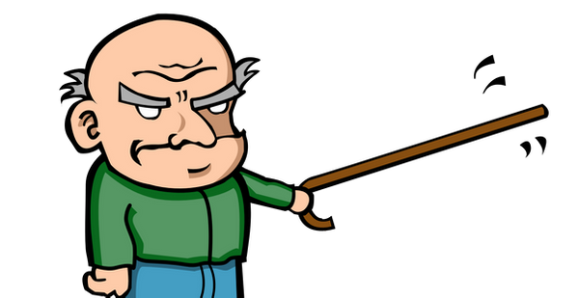
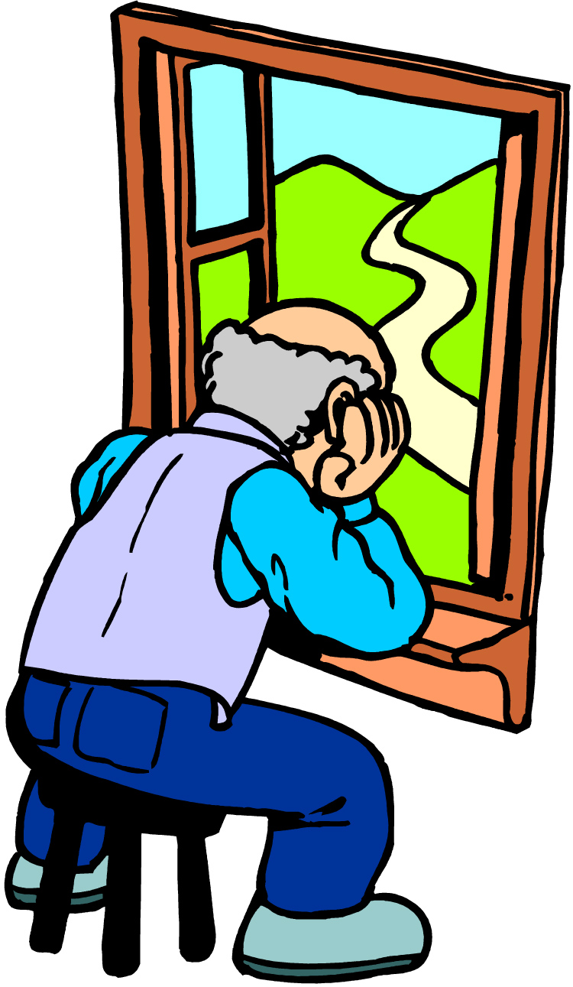
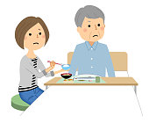
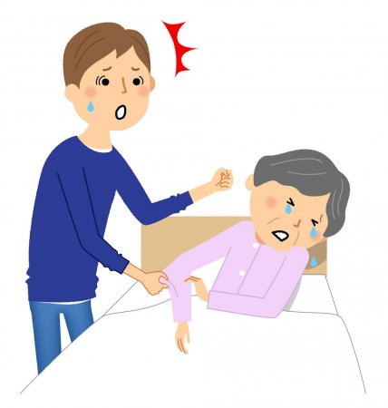
What sort of behaviors do you see?
This Photo by Unknown Author is licensed under CC BY-NC-ND
Notes:
Take a moment to thing about behaviors that you see in the residents who you care for. What makes them challenging?Challenging behaviors are actions that can cause physical or emotional harm to the person or others, case property damage, limit the person’s ability to participate in social or recreational activities and/or label th person as a “behavior problem”. Some examples of challenging behaviors may include: isolation, refusal of care which can lead to infections/unhealthy weight loss, physical aggression can cause harm to themselves or others, and other behaviors.
Keep in mind that everything is a behavior whether good or bad. The main focus of this powerpoint is to talk about challenging behaviors.

Slide 4

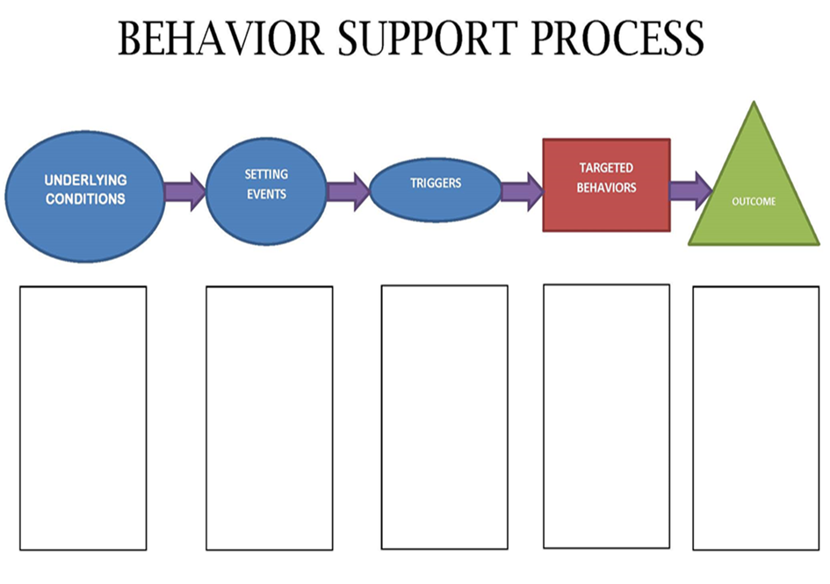

Definitions to keep in mind:
Antecedents
Anything, as an act or event, which serves as a stimulus and initiates or precipitates a reaction or series of reactions. Typically occur before the targeted behavior.
  Things that we do not see.
  Some examples are medication reactions, history of trauma/abuse, etc.
Stressors that stack up.
The manner of behaving or acting. Observable activity.
Whatever occurs immediately following a behavior, or as an immediate result of the behavior.
Notes:
Here are some definitions to keep in mind. When thinking about behaviors this is a good outline to follow. When doing so its often easier to start by thinking about the behavior itseld and moving background to understand what might be the overall outcome. The behavior produces a result for the individual. When a behavior is repeated over time, we assume it serves a useful “function” for the individual, it meets a need. The individual gain or avoids something by engaging in the behavior.

Slide 5
Behavioral Causes or Influences
(triggers):
Physiological - such as feeling full or satisfied, feeling pain, having skips in your heart [that can mean you have less oxygen to the brain], low blood sugar so you feel really hungry and can’t think, needing to go to the bathroom, etc.
Social - such as seeing a face that reminds you of someone you don’t like, going to a party, seeing the same faces day after day, sitting in church, going to a movie, being at a dance, etc.
Psychological - such as an angry response to a particular word, hearing someone laugh when we don’t understand why, being called a name, being given a compliment, feeling frustrated because things are not as you want them to be, thinking about something nice that happened, etc.
Environmental - such as a dark corner, a rainstorm, a beautiful garden, a hot sultry day, a car horn blowing, coffee brewing, etc.
Notes:
Behavior is a result of or response to something the person is experiencing or has experienced. The stimulus for a particular behavior can come from any of these sources:
• Physiological (from within the physical part of us);
• Social (from any situation involving all people we have ever encountered);
• Psychological (from emotions, feelings or thought processes); or
• Environmental (from any part of our surroundings).
Effectively responding to an individual who is expressing any challenging behaviors may depend largely on his/her diagnosis, habits and self-control abilities. Having a better understanding of what may trigger that resident will help in knowing how to best respond to them. Always consider what the person may be trying to meet with their behavior?

Slide 6

WHAT WE SEE
WHAT WE DON’T SEE
This Photo by Unknown Author is licensed under CC BY
Notes:
When thinking of behaviors I like to think about the iceberg analogy. What does an iceberg look like. The behavior we see is the tip of the iceberg, and what we see on the surface. However the hidden base of the ice-berg are things beneath that we don’t’ know of, we dontsee. For example. Someone repeating phrases can have a brain injury resulting in memory problems, maybe dementia. Someon staying in bed all day, power stuggling with staff who try to prompt hygiene tasks may have difficulty organizing/initiating tasks with multiple steps. Someon refusing medications may be due to a mental health condition such as schizophrenia in which the individual thinks staff are trying to poison him.

Slide 7
Three-step approach:
Examine the behaviors and triggers
Explore potential solutions
Try different responses

Slide 8
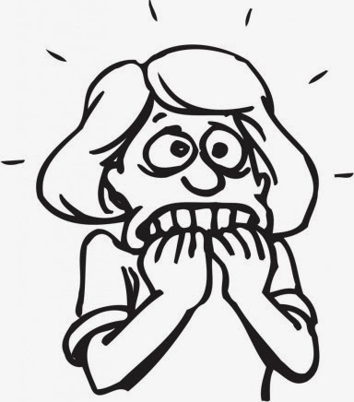
Behavior and possible causes
Aggression and bathing
Sexual Behaviors
Refusal of medication
This Photo by Unknown Author is licensed under CC BY-NC-ND
Notes:
Bathing is in intimate care need. And it can be painful for older adults due to arthiritis, fatigue and weakness, fear and misunderstanding related to congnitive issues, and/or previous negative experiences, anxiety related of fear of being naked with others, fear of falling, general discomfot, feeling rushed.
SEXUAL Behaviors: May not be sexual, for example an individual may be simply expressing a personal need. For example a man pulling down his pants may be needing to go to the bathroom.
Refusal of medication: significant across all age groups-most of us have been non-compliant at some point in our lifes. Don’t make assumptions. But this could be due to forgetfulness, paranoid ideation, side effects, lack of knolwdge and understanding,
These are just two example and possible reasons to why they may be happening of may behaviors. Please if you have any questions about a specific resident write them down. Talk with the administrator, nurse, med tech, other caregivers/members of your team. What you may see they might not and its could to know what behviors are happening as there are resources in which outside services can get involved to help.

Slide 9
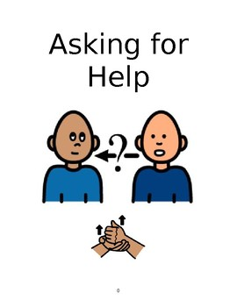
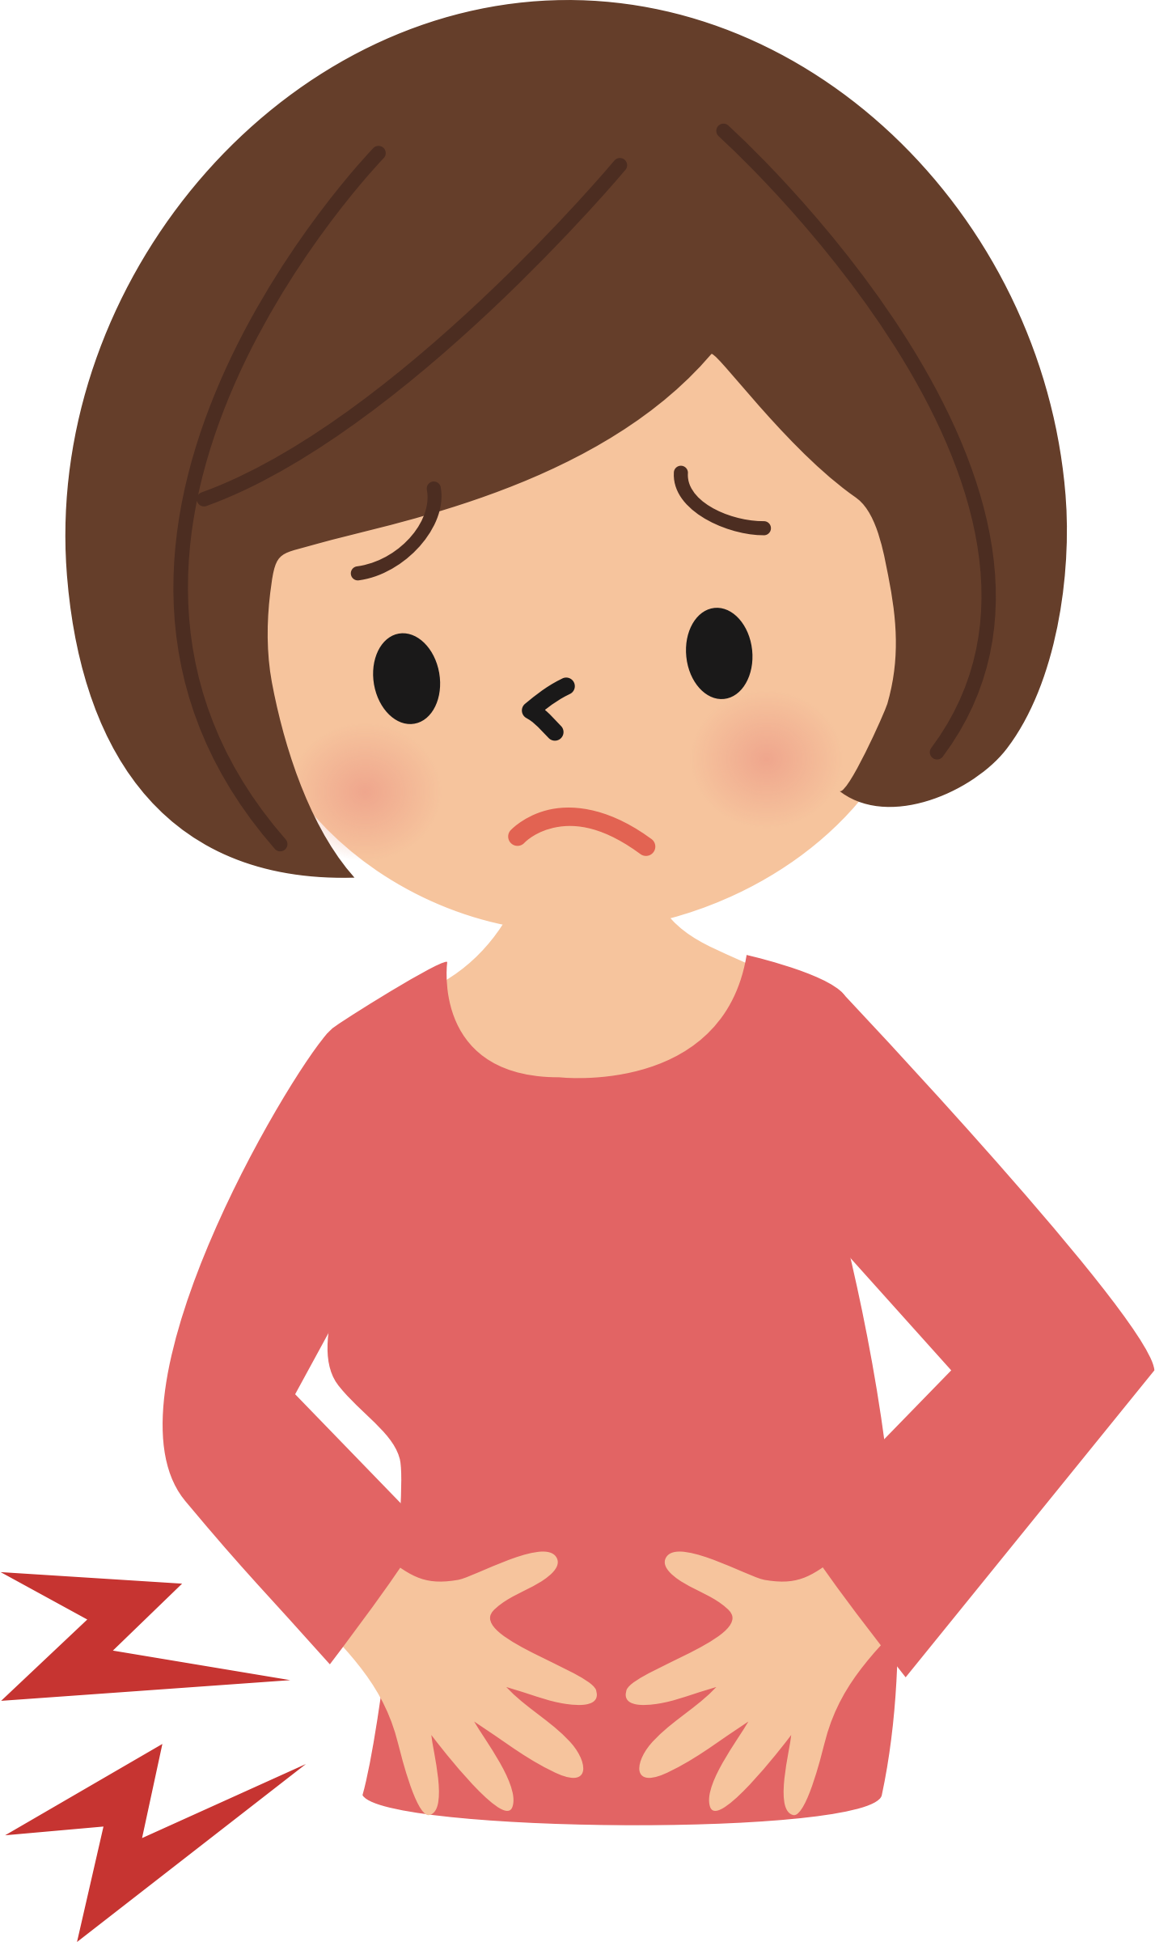
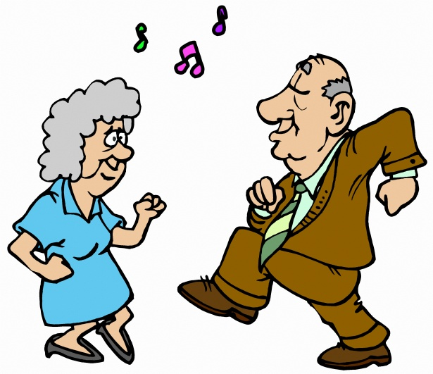
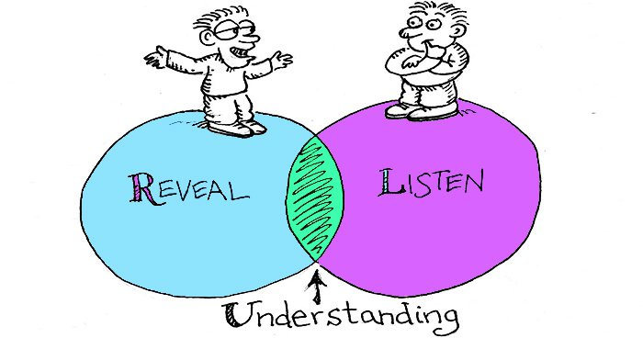
ACTIVITY: Behavior as communication
How do they communicate when requesting affection, help, a need such as hunger, thirst?
When experiencing pain or discomfort?
Feelings-happiness, sadness, frustration?
What types of information do they understand and/or how must that information be presented in-order for them to understand?
This Photo by Unknown Author is licensed under CC BY-SA-NC
Notes:
I want you to take some time to think about a resident you know and answer the following questions. How does he/she communicate when requesting affection, help, a need such a hunger, thirst. When experiencing pain or discomfort. Feelings-happiness, sadness, frustration. What types of information does s/he understand and how must that information be presented in order for her/him to understand?
Think about what the behavior means for them.
I am going to give you a moment to think about this.

Slide 10
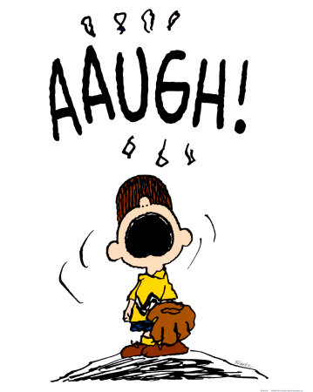
ACTIVITY: Behavior as communication
If the behavior had a voice, what would it say?
  It’s important to consider that the individual’s communication abilities affect his or her behavior. Most of the people you support can probably say, “I’m hungry”, but note if there are times when they express needs differently as their moods change due to medical or mental health symptoms.
This Photo by Unknown Author is licensed under CC BY-NC-ND

Slide 11
Describing Behavior
Use words that are free of emotion
Describe the actions of the individual
Pinpoint the description by including:
  Clear description of the behavior
  Frequency of the behavior
  Duration
  Intensity
Answer questions like:
  What was going on in the environment just prior to the behavior occurring?
  What was the individual doing just before, what did the behavior look like, what did you do in response, and what did the individual look like when they calmed down?
  What does the individual do that tells us that he or she is becoming agitated? What are his or her “early warning signs”?
Notes:
A “pinpointed” description incudes:
Clear description of the behavior (e.g. Stella yells “Nooo!” at staff while laying in bed)
Frequency of its occurrence-how often the behavior occurs in a particular time span (e.g. Stan shouts 4 times a day)
Duration-how long the behavior last
Intensity-the observable impact or toll the behavior has on the person / Severity-the observable impact the behavior has on the environment (refusal to complete hygiene causes skin breakdown

Slide 12
Staff Role in Monitoring for Effectiveness
Complete detailed documentation as instructed regarding:
  Targeted behaviors of concern
  Unusual behavioral incidents
****Behavior data and incident reports are crucial for monitoring challenging behaviors.
Notes:
What type of behavior tracking do you implement, when one of your resident’s are having behaviors?

Slide 13
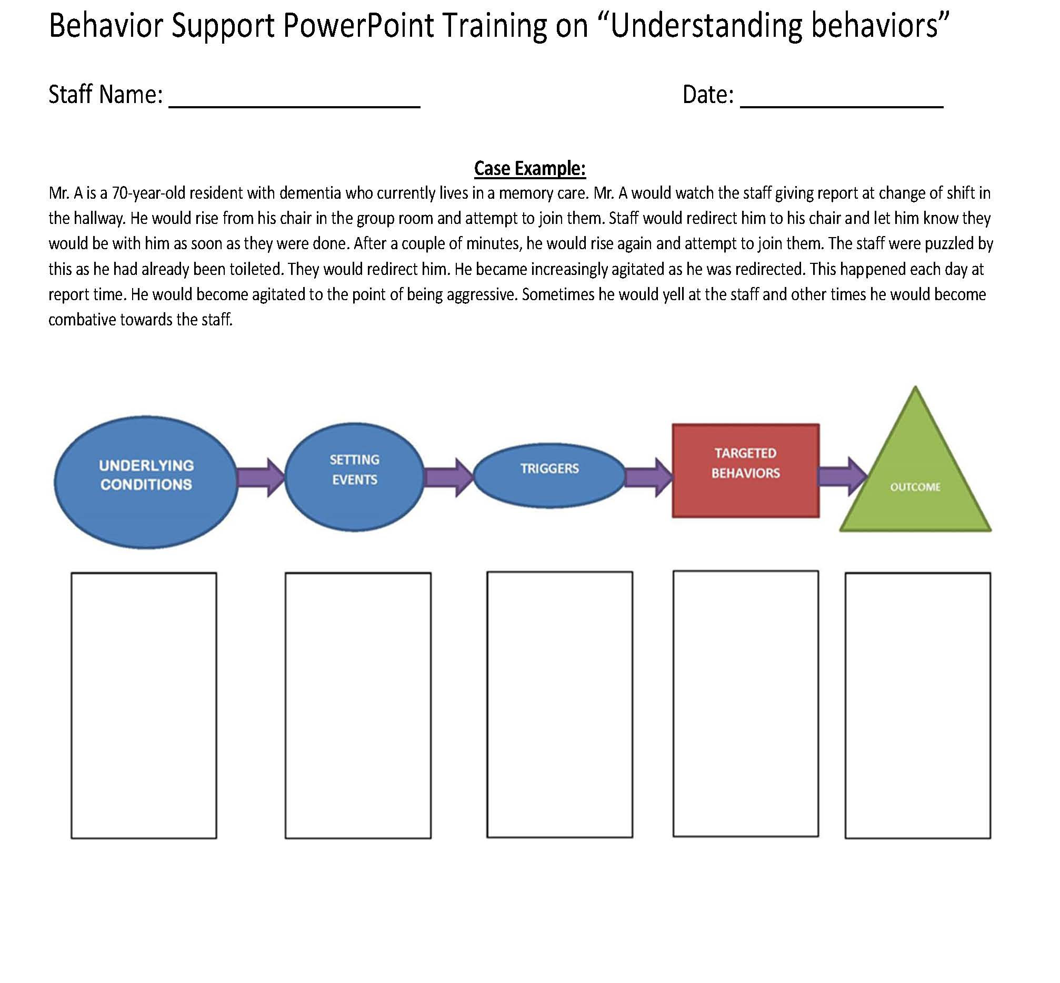
Test your knowledge
Notes:
Please make sure to have the handout and a pen or pencil. If you don’t, please take some time to gather your materials. I will be reading you a scenario on the next slide and I want you to fill out the boxes based on the information you gather. Think what might be some of the underlying conditions, setting events, triggers, what is the behavior, and the outcome.

Slide 14


Pause to gather your materials

Slide 15
Case example
Mr. A is a 70-year-old resident with dementia who currently lives in a memory care. Mr. A would watch the staff giving report at change of shift in the hallway. He would rise from his chair in the group room and attempt to join them. Staff would redirect him to his chair and let him know they would be with him as soon as they were done. After a couple of minutes, he would rise again and attempt to join them. The staff were puzzled by this as he had already been toileted. They would redirect him. He became increasingly agitated as he was redirected. This happened each day at report time. He would become agitated to the point of being aggressive. Sometimes he would yell at the staff and other times he would become combative towards the staff.
Notes:
Take some time to fill out the handout.

Slide 16


Pause to write down thoughts and complete the handout
You will have about 3 minutes. If you need more time feel free to stop this PowerPoint before moving on to the next slide.

Slide 17
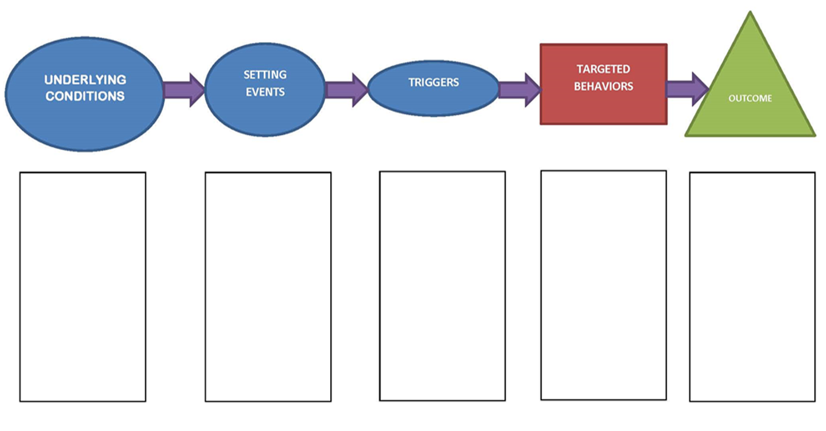
Mr. A becomes agitated with staff. He may yell or become combative.
Mr. A wants to be a part of the staff meeting. Is trying to gain some social interaction.
Medication reactions
Constipated
Dementia
Staff meeting in the hallway
Not engaged in another activity-bored
Being redirected by staff multiple times.
Notes:
Take some time to talk in groups. Okay what did you notice?
What was the behavior? What were the triggers? Are there others- Are there some details missing here that could give you more information in filling this out.
When thinking about this outline its often easiest to start by thinking about the behavior itself.

Slide 18

Helpful to know:
What if I told you that Mr. A had formerly been a CEO of a very large and successful company?
Individual’s personal history
Identify triggers/ historical triggers
Helpful to know coping strategies that work to help stop/minimize behaviors when they occur
This Photo by Unknown Author is licensed under CC BY-SA

Slide 19
What could be done differently?
What can be done differently with residents you work with who may be having some challenging behaviors?
Notes:
Ultimately what we were watching with Mr. A was his interpretation of watching his staff conducting a meeting without his involvement. As he was redirected to move away from the meeting, he communicated his frustration in the only way he could at this time. An intervention that would have worked well in this scenario would have been to have staff be mindful of reporting during shift change-for future reference this could be done in a private room versus in the hallway to ensure confidentiality is being maintained and to help minimize Mr. A’s agitation. At the same time the activities director could be keeping Mr. A entertained with an activity that he enjoys. If there are other meetings or gatherings where confidential information is not being shared, staff might consider allowing Mr. A to join them.

Slide 20
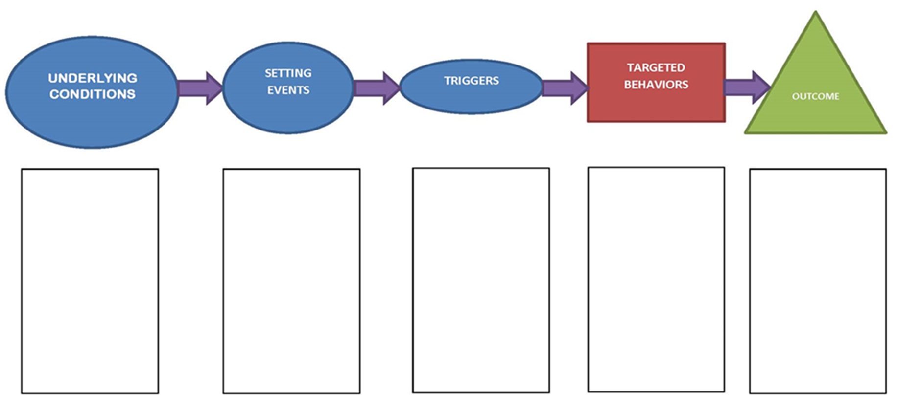
Behavior Support Process

Slide 21
How to respond to behaviors
Remain calm
Respond to the individual as needed
Support the individual in communicating choices and wishes
Get support when needed (and available)
If your approach has not worked, try something else
It’s all about the other person
Acknowledge their feelings
Set boundaries/limits if necessary
Direct and redirect by...

Slide 22
The importance of Building Rapport with residents
Greet everyone you see and/or pass.
Learn the names of the individuals in your care.
Ask how their day is or went.
Say hello, good morning, good afternoon, good evening.
Ask if you can be of assistance in any way.
Be visible and available to your consumers.
Exchange pleasantries and have conversations.
Have meaningful engagements and activities.
LISTEN!
Find opportunities to partner and work together.
Build trust.
Promote empowerment.
Encourage their voice and choice.
Educate.
Respect one another.
Acknowledge effort.
Celebrate differences and accomplishments.
Support each other through understanding.
Notes:
Sometimes the elderly have a reputation for being a bit irritable. This trait can manifest itself quite strongly when seniors are placed in the hands of new caregivers, companions or medical staff. Care providers may face a tough first week (or longer) being met with distrust, dislike, and ill-temper from their new patients. So, how do you break the ice and connect with the residents you've come to help?
Listen to them. Its not the: “Oh really Ms. Brown? That’s nice. Now lets move you to this chair.” Having many resident in your care can be hard but getting to know them is important. What is their favorite color, what do they like to watch or listen to, their birthday, what did they do in the past as a profession or hobby- all those things that make a person an amazing individual not just “an elderly person”
RESPECT on another- let the insults slide-Occasionally you will care for someone who has unlimited insults. They may insult your size, shape, name, color, accent, methods, manners, work, clothing, etc. Or they may insult others and try to get you to agree with them.
Sometimes you can find out what is really bothering them and come up with a solution (as mentioned above). Sadly, sometimes the person is just being the same person they've always been, and it’s very unlikely they will change.
You have to have a thick skin. Don't let them bait you into an argument, and don't stoop to countering with more insults
What are some ways that you builr rappoer with your residents

Slide 23
Takeaways
Caregiving is hard work
Caregivers do a great job
“Problem” or “challenging” behaviors always need to be defined before being addressed
Changes in the environment and personal responses can have a ripple effect on the behaviors of others
Remember behaviors are not always easy to address
Remember what works today might not work tomorrow
Remember don’t take it personal!!!

Slide 24


Most importantly
Don’t forget self-care!!!!!

Slide 25

Stephanie Arciga
arcigas@co.yamhill.or.us
971-267-6391
This Photo by Unknown Author is licensed under CC BY-NC-ND
Notes:
If you have any questions, comments, feedback about this PowerPoint ple

Slide 26

Resources
https://www.naminh.org/
https://www.alz.org/national/documents/brochure_behaviors.pdf
https://www.crisisprevention.com
https://eldercareissues.blogspot.com/2016/12/how-to-win-elderly-persons-trust-tips.html

