Slide 1


Refusal of care
Stephanie Arciga,
Behavior Consultant

Slide 2

Why does ________ refuse _______ (showers, change of clothing, to take medications) ?

Slide 3
Objectives
Understanding the reason behind the “no”
Know when to offer choices when providing personal care

Slide 4

Why Might Residents Refuse to Shower?
This Photo by Unknown Author is licensed under CC BY-SA

Slide 5

Why Might Resident(s) Refuse Showers:
Fear of injury
Fear in general-think Dementia
Embarrassment
Decreased Olfactory perception / Increased Olfactory perception
Decreased Sense of Time
Loss of Independence

Slide 6
Why Might Resident(s) Refuse Showers:
Depression
Physical Pain or Fatigue
Sequencing
Temperature issues
Time of the Day
Sensitive skin
Childhood habits

Slide 7


Recommended Response
Check water temperature
Be prepared with all supplies
Reassure
Ask how they feel and prefer to do things
Be flexible with the bath time
Use more pleasing terms (spa)
Create soothing atmosphere
Install safety rails and use shower chair
Limit bathing to twice a week
Communicate what you are doing
Provide privacy and warmth for the individual (i.e. towel)
Install handheld shower head

Slide 8
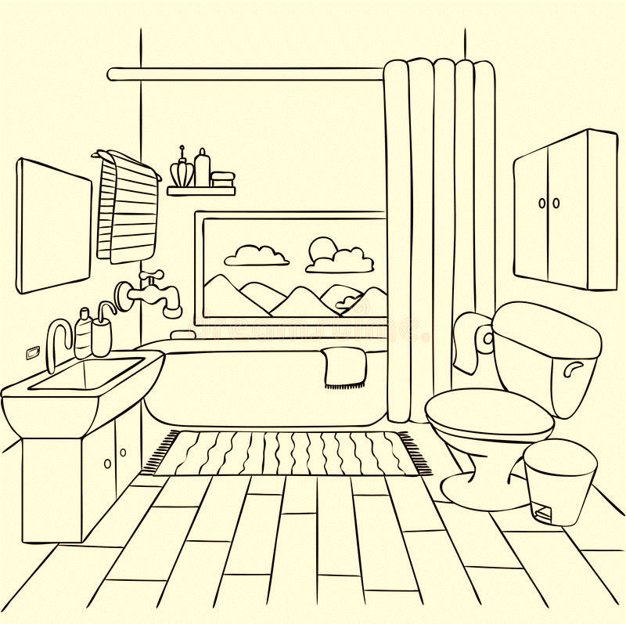
Why Might Residents Refuse to use the restroom?

Slide 9

Reasons Why Resident(s) Refuse to use the restroom:
Inability to recognize the need to use the restroom
Forgetting where the bathroom is located
Medical conditions
Medications
Environment
Embarrassing

Slide 10
Recommended Response
Make the restroom more inviting
Get the supplies from “home”
Respect the need for privacy as much as possible

Slide 11

Tips to help with Toileting?
Be consistent with a bathroom schedule
Be patient
Smile and don’t frown or show frustration
Give plenty of time for toileting
Don’t rush the individual
Use a calm tone of voice
Be consistent with your approach

Slide 12
Tips to help with Toileting?
Validate their feelings of embarrassment or confusion
Normalize bathroom use
Stop placing judgement on people and try to put yourself in their shoes, be a detective; why are they acting this way?
Don’t “bark” orders, be sensitive to culture needs
How do you want to be treated when you need help to the bathroom as an older adult?

Slide 13
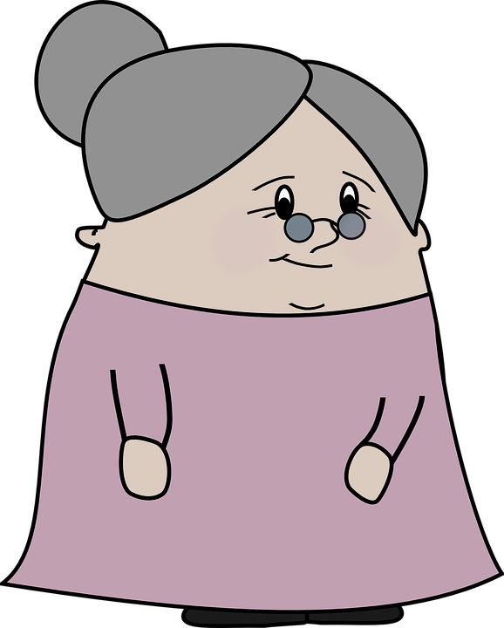
Why Might Residents Refuse to change their clothes?

Slide 14

Why Might Residents Refuse to change their clothes?
Impaired memory or judgment
Need for control
Need for comfort and security

Slide 15
Why Might Residents Refuse to change their clothes?
Struggles with everyday tasks
Feeling overstimulated or uncomfortable
Weakened or dulled senses

Slide 16
Recommended Response
Decide if a change of clothing is necessary
Consider timing
Avoid challenging
Be creative in your approach
Make dressing easier
Gain perspective on the situation

Slide 17

Why Might Residents Refuse to take medications?
This Photo by Unknown Author is licensed under CC BY

Slide 18

Why Might Residents Refuse to Take Their Medications?
Environment
May be a response to feeling rushed, afraid, confused about what they are supposed to do.
Loss of control
Overwhelming
Taste
Side effects
Delusional belief that staff is intending to harm (“poison”) him/her.
This Photo by Unknown Author is licensed under CC BY-NC

Slide 19
Types of Refusal
Active refusal
Passive refusal

Slide 20

Recommended Response
Ask questions/ observe refusal
Notify PCP, prescribing practitioner, etc.
Choose a person they want to please (person advised to take medication)

Slide 21
Recommended Response cont..
Sit down to offer medications
Explain importance of meds
Be patient and Calm (allow to calm down and try again)
Document

Slide 22


Tips and Tools

Slide 23


Tips to Build Rapport with Residents
Break the Ice
Be Professional and Personal (set boundaries)
Use your “tool belt”
Be a GOOD Listener
Be Courteous and Respectful
Be Positive
This Photo by Unknown Author is licensed under CC BY-SA-NC

Slide 24
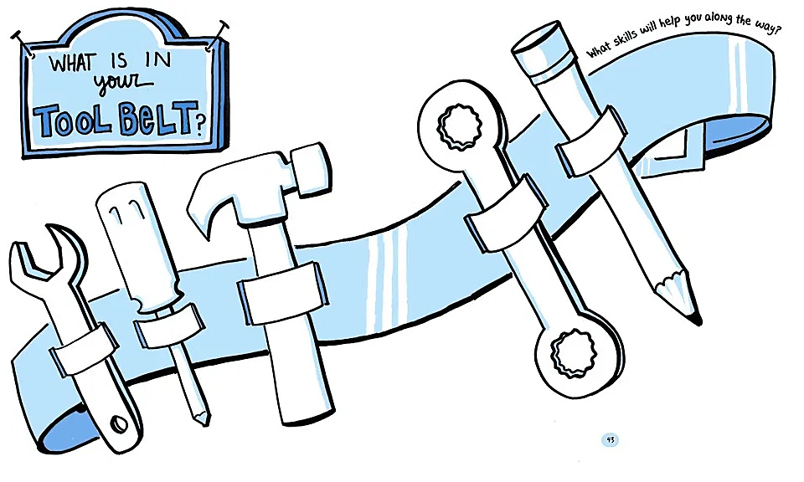
Professional
Compassionate
Observer
Organized
Good communicator
Timely
Problem solver
Patient
Interpersonal skills

Slide 25
Using Routines
Identify the routine
Retain important rituals
Remove distractions and limit choices
Recognize that change may be necessary
STAY FLEXIBLE

Slide 26

Teepa’s 5 A’s
Anticipate
Acknowledge
Alternative
Accept
Appreciate
This Photo by Unknown Author is licensed under CC BY
https://teepasnow.com/blog/responding-to-someone-who-says-no/

Slide 27
Anticipate the “NO”
Know the history surrounding the “ask”.
Preplan your approach. Consider the use of different phrases that don’t use the words “shower” or “bathroom” such as:
“Hey, how about if we have a spa day today?”
“Good morning, how about if we go get cleaned up?”
“How about if we go freshen up a little bit?”
“Your spa starts at 2pm, I will come in get you in about 10 minutes, so we have everything ready for you today.”
Rehearse for a or prepare for a “no” so it’s not a surprise and it doesn’t catch you off guard.

Slide 28

Acknowledge the message
Reflect what was said/ heard

Slide 29

provide Alternative options
Provide alternative options (what are they-bed bath, using wipes, etc.)
What is the most vital?
Try to understand what the hardest part of the process for the individual is. Is it getting out of the chair, walking to the bathroom, the cold, etc.?

Slide 30

Accept the “NO”
If “no” is still the final answer, let it go.
Important to remember- you are giving up on the asking but NOT on the person. It’s important to reconsider and reevaluate

Slide 31
Appreciate
You can say things like:
“Thank you for trying.”
“I appreciate your point of view. I know you said no.”
“I hear you. I’m not the right person to help you today.”

Slide 32
Resources
https://eldercareissues.blogspot.com/2015/11/how-to-shower-reluctant-elder-part-1.html
https://dailycaring.com/11-ways-to-get-someone-with-dementia-to-take-medication/
https://healthcareassociates.net/tips-caregivers-can-use-to-deepen-rapport/
https://teepasnow.com/blog/responding-to-someone-who-says-no/

Slide 33
THANK YOU!
arcigas@co.yamhill.or.us
971-267-6391

