Slide 1
Yamhill County Opioids, Pain, Addiction & Recovery Summit
October 14, 2025

Slide 2






Thank You to Our Sponsors!

Slide 3
Agenda
6:00pm → Welcome & Data Snapshot - William Koenig, DO
6:10pm → Marijuana: Impacts on Pregnancy, Youth, and Communities - Jill Pearson, MD
7:00pm → The Psychology of Pain - Catriona Buist, Psy. D
7:45pm → Yamhill County Deflection Update - Sam Elliott, Kate Lynch, Gavin Boldizar
8:15pm → Yamhill County Overdose Fatality Review Update: Findings and Recommendations - Savanna Santarpio, Laura Bivens
8:45pm → Closing Remarks

Slide 4
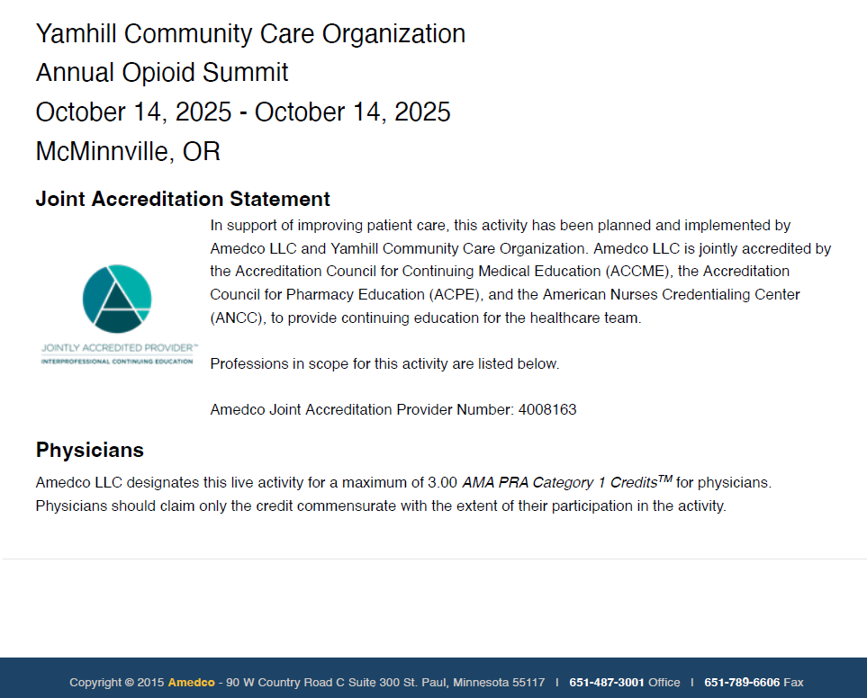
CME Information
To get your CME, scan the QR code on your table!

Slide 5
Medical Examiner’s Snapshot
*2025 counts as of September 25, 2025

Slide 6
Medical Examiner’s Snapshot
*2025 counts as of September 25, 2025

Slide 7
Medical Examiner’s Snapshot
*Most recent tox result: April 20, 2025
20 pending overdoses

Slide 8
Marijuana: Impacts on Pregnancy, Youth, and Communities –
Jill Pearson, MD

Slide 9
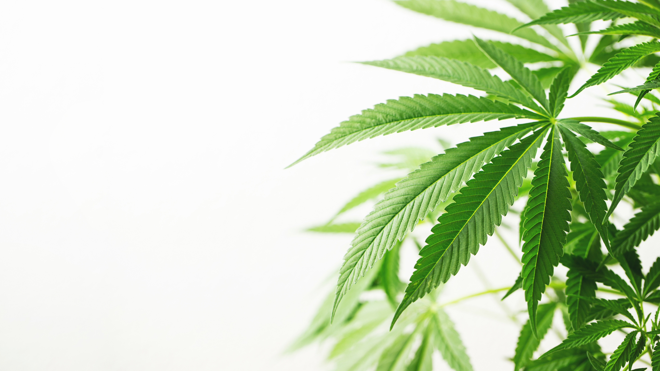


High-Potency, High Risk: The Hidden Dangers of Today’s Marijuana
The Most Commonly Used Illicit Drug in the United States
Impacts on Pregnancy, Youth, and Communities
Jill Pearson, MD FAAP
Marion County Substance Use Prevention Campaign
October 14, 2025
Notes:
Introduction
Peds 25yr
SH NOWS work
Trauma-informed care
Community networking
Pivot to grassroots prevention
MCHHS
National Alliance for DEC
HOPE Initiative (Tufts)
Bring updates to primary care clinics to spread information that will impact patients
Extension of the voices of the NOWS babies, teens, and parents who have had their lives altered or lost their lives to substances

Slide 10

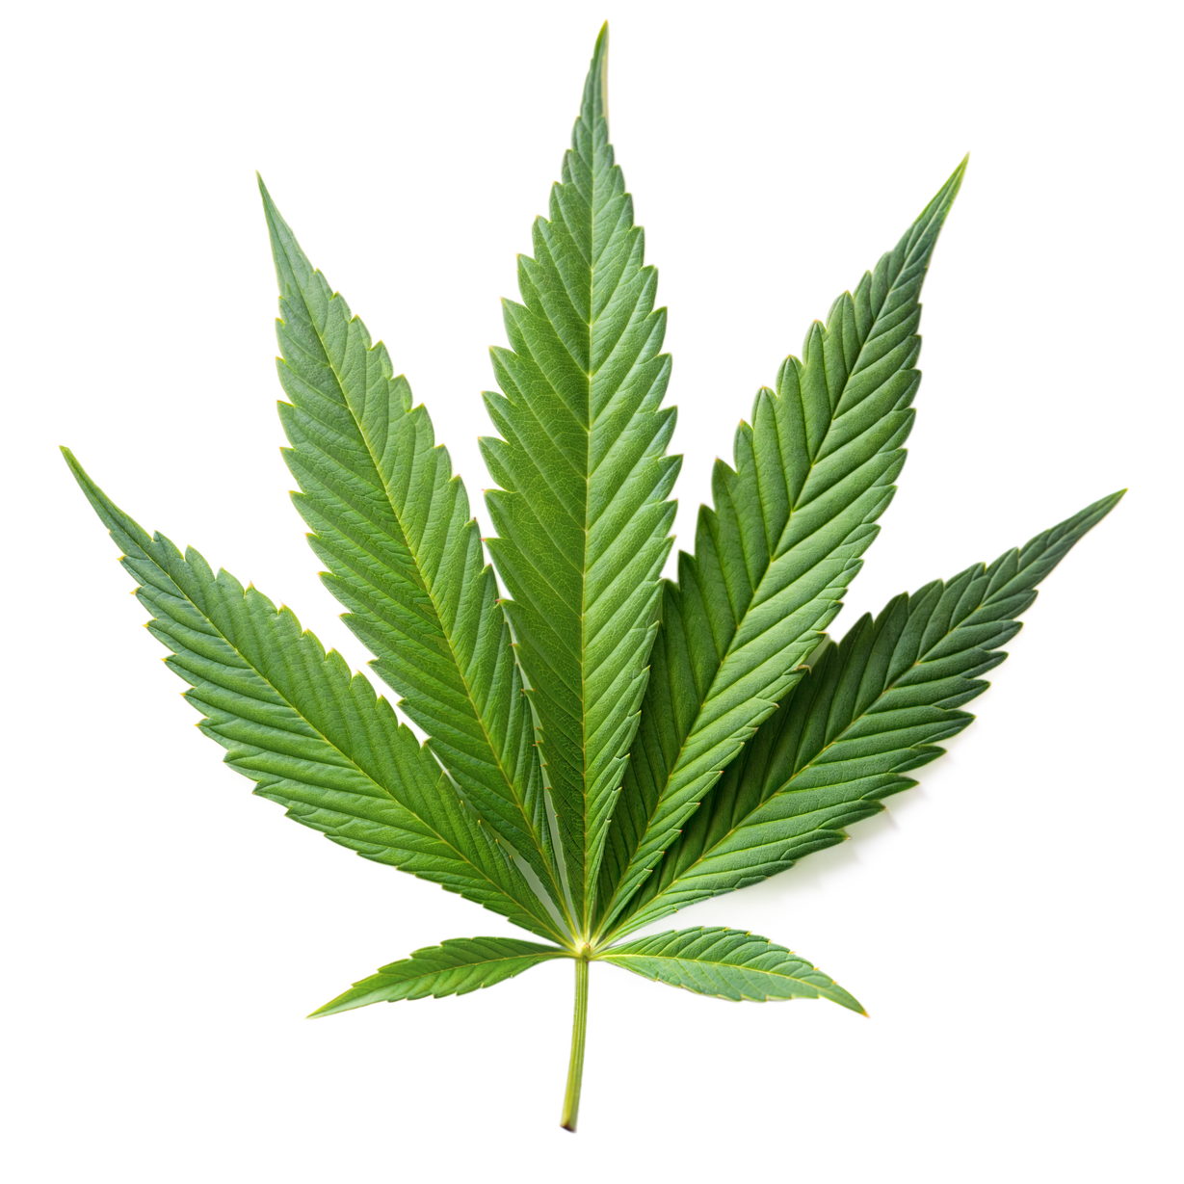
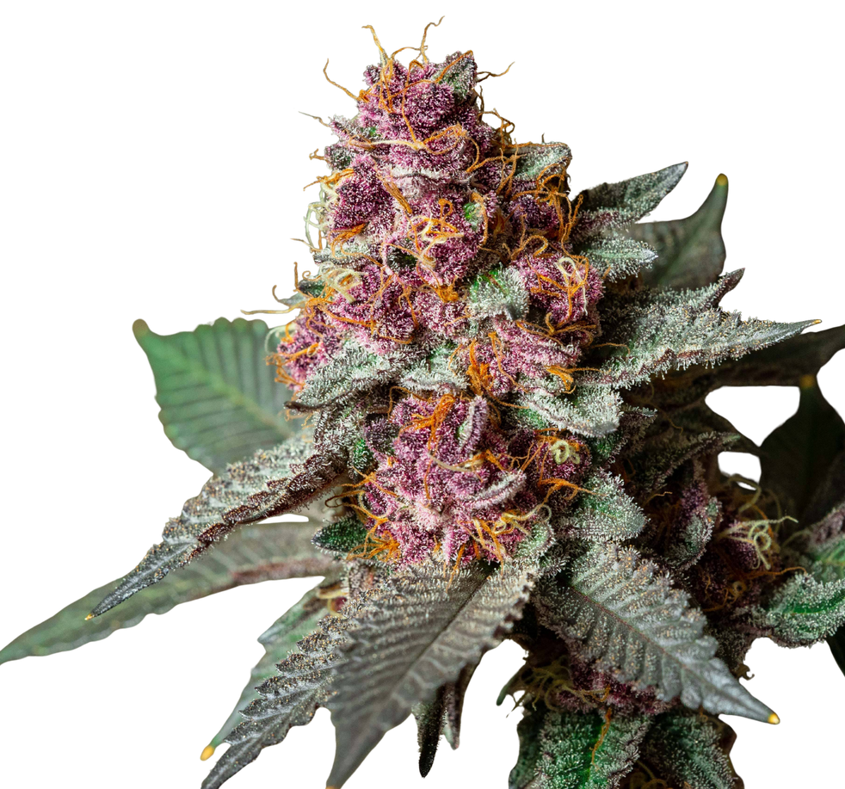
Objectives
  Evolution of Marijuana
  Update on High Potency Products
  Prenatal and postnatal exposure and impacts
  Toddlers in the weeds
  Adolescent brain development and addiction
  Public health recommendations and the gap between actual and perceived risk since legalization
Notes:
First, marijuana use has come to play a significant role in the overall uptrend among general substance abuse in America: Per NSDUH data, 2024 saw 20.1 million cases of marijuana use disorder, vastly more than opioids, cocaine, and meth. Those numbers are also climbing for marijuana even as they declined over that period for almost all other drugs including alcohol. And speaking of alcohol: By 2022 there were more daily or near-daily users of marijuana in America than there were of alcohol, a major shift driven by an 1867% increase in daily weed use.
Weed is now the most common substance among 12-25 year olds being treated for a substance abuse disorder, outpatient or inpatient. In 2024, emergency room visits linked to marijuana surpassed those driven by opioids, and the slice of those visits related only to marijuana use has risen from 37% in 2021 to 58% in 2024. The combo of normalization and sky-high potency is just as deadly as you’d think.
On mental health, too: One study estimated that as much as 30% of schizophrenia cases among young men were linked to marijuana. No shock there: data suggests that the number of lifetime uses of the drug is intimately linked to schizophrenia rates and that using the drug young drives that risk even higher.

Slide 11

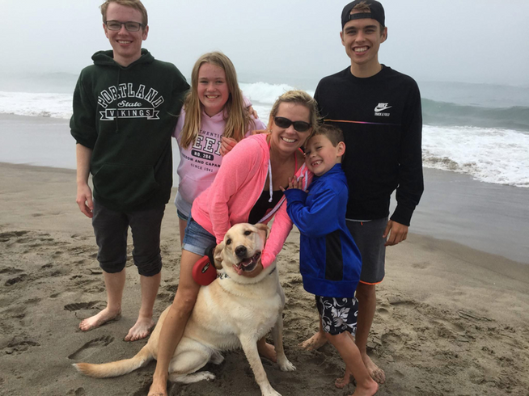

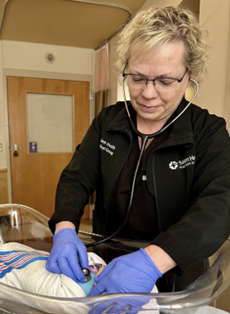
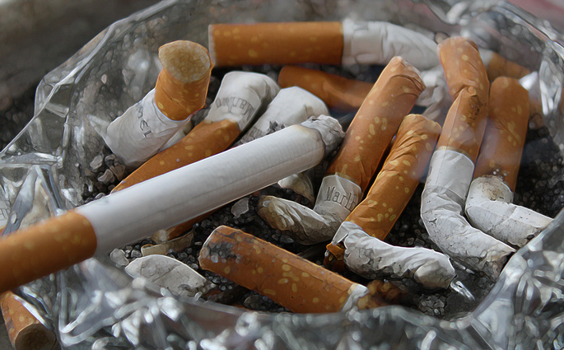
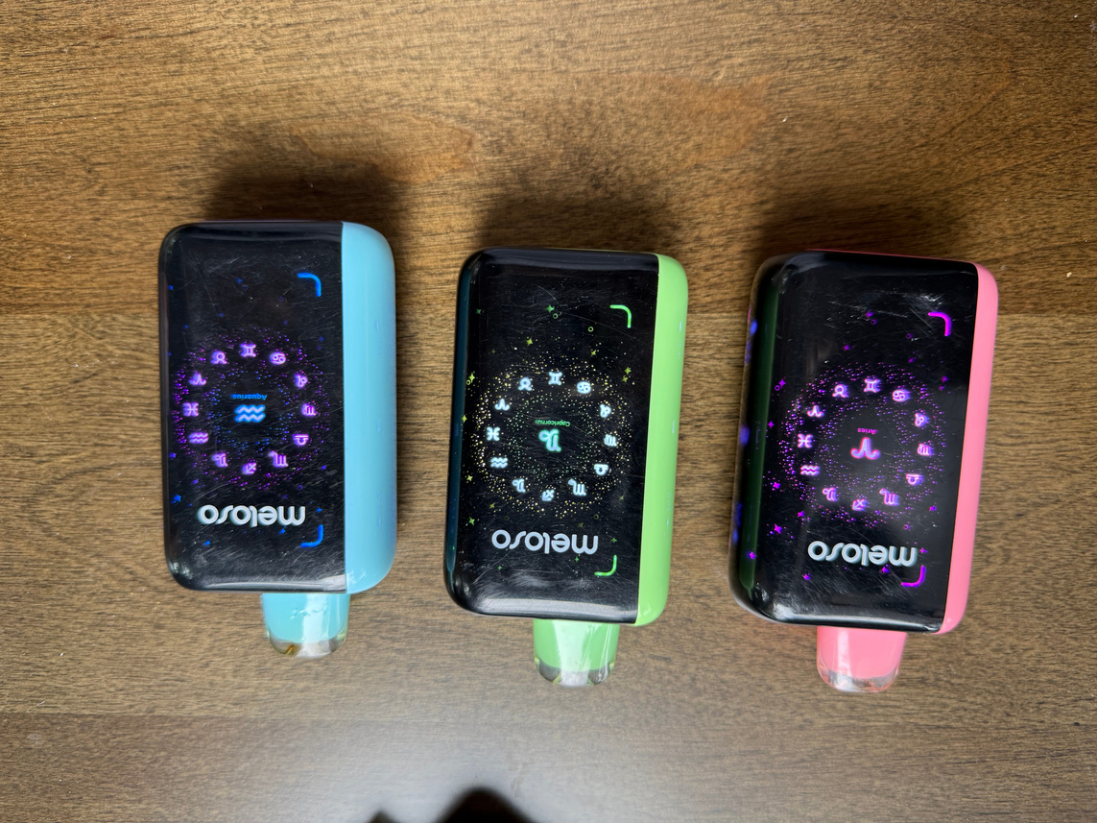
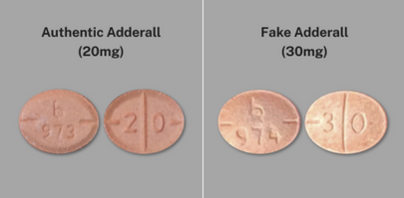

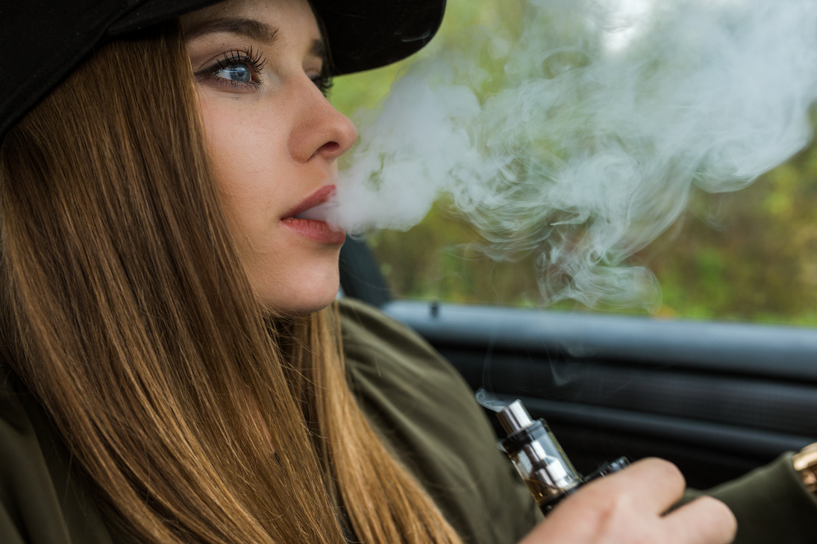
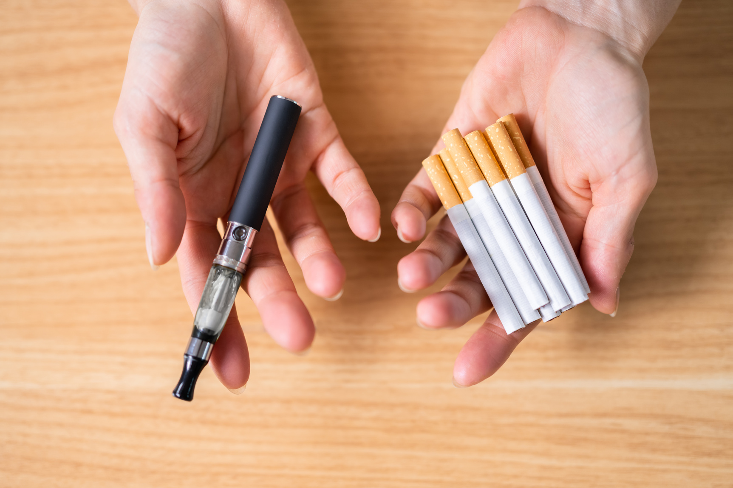
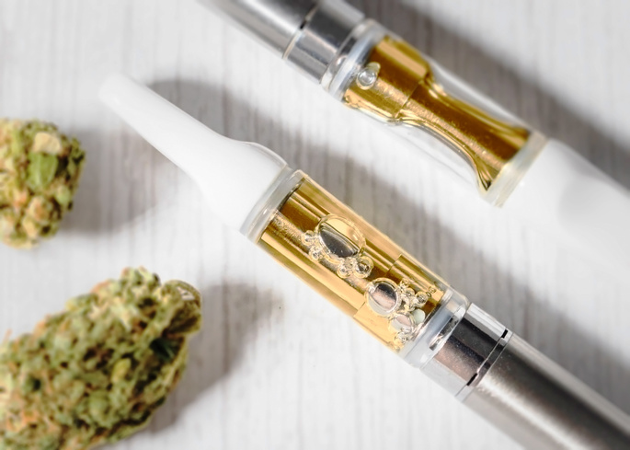
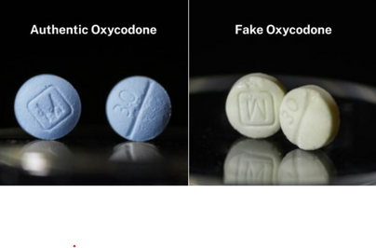

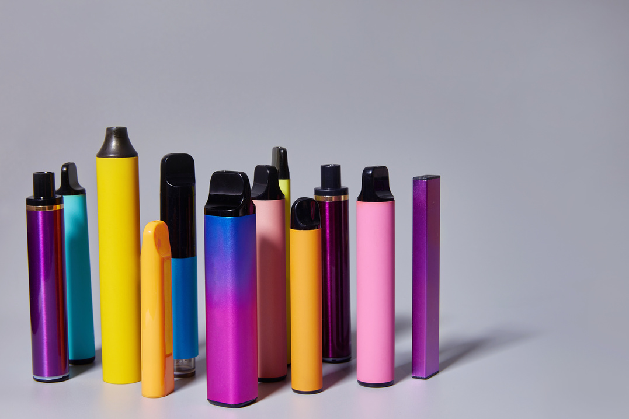
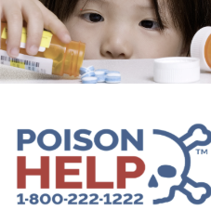
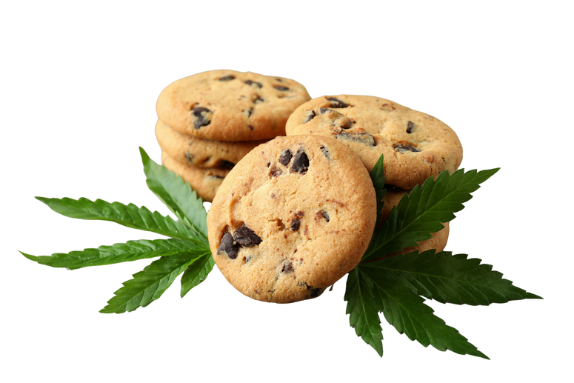
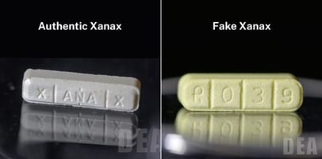
Introduction

Slide 12
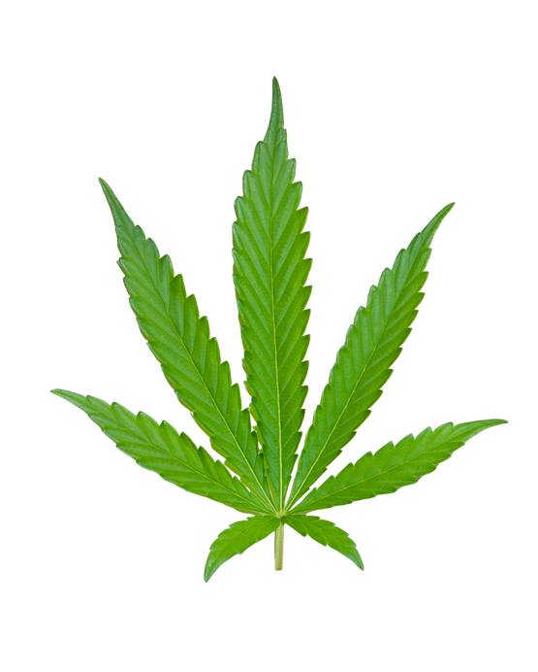
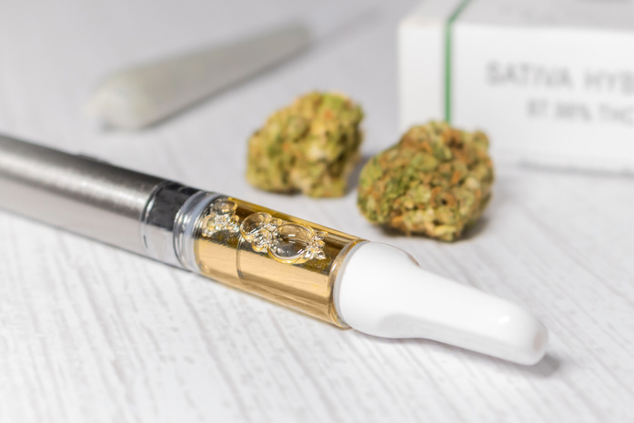
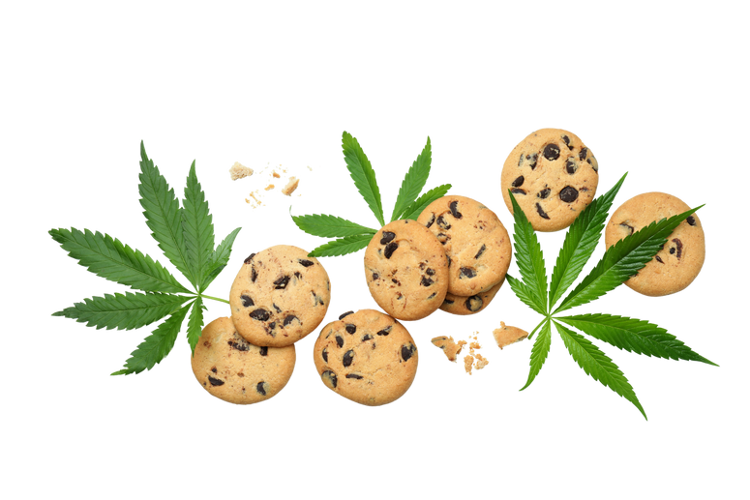
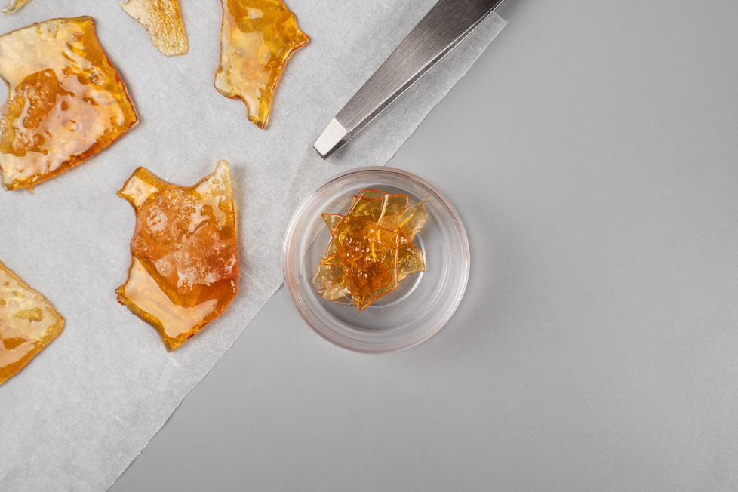
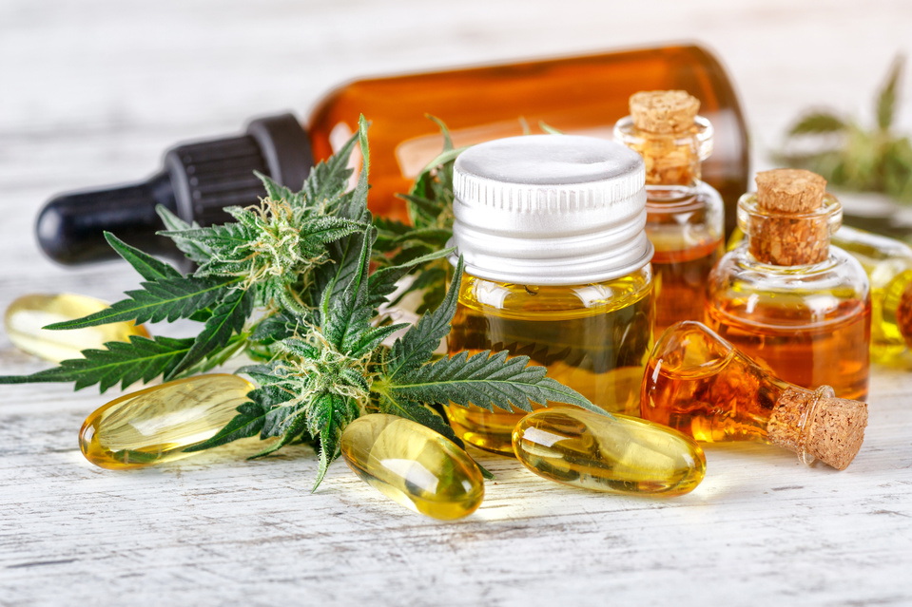
Evolution of Marijuana products
  “Today’s weed is not your grandparent’s” weed
  Potency of flower was 4% in the 90's to now up to 25-35%.
  Vapes, Dabs and other high potency extracts (up to 90%).
  Expanding world of edibles.
  Marketing to youth (Joe Camel) - what did we learn?
  Competitive market trends, with consumers seeking higher potency products.
  Evolving ways to consume.
Notes:
Show the potency shift over time and why today's cannabis is not comparable to the 1970's cannabis.
Tie potency to dose-responsive risk:
psychosis,
cannabis hyperemesis syndrome,
cannabis use disorder,
and unintended pediatric exposures.
* Smoke, vape, dab, eat, sprinkle, drink, lotions and other topicals, and even rectal and vaginal suppositories

Slide 13
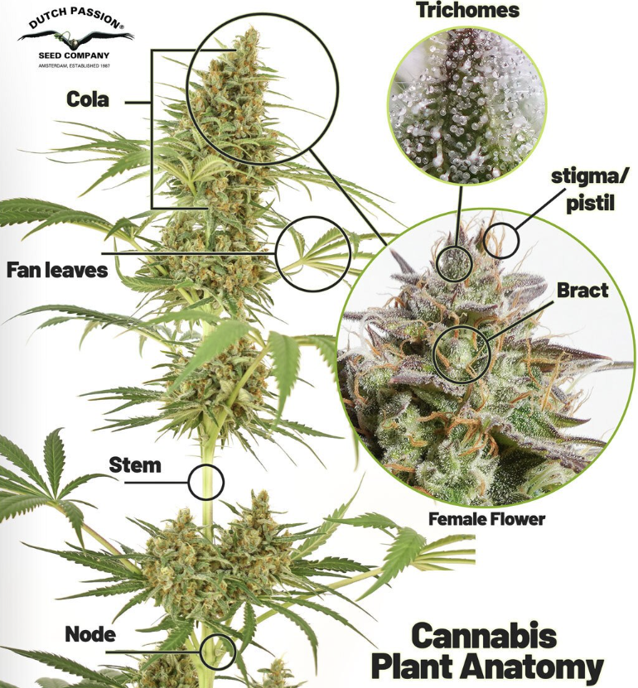
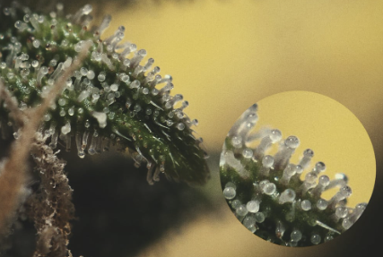

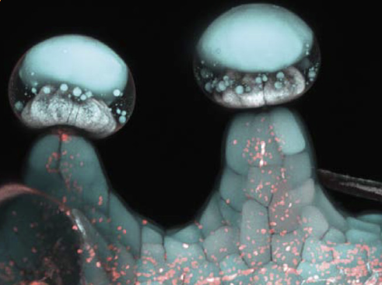

Cannabis Plant Anatomy and Physiology
Trichomes
Source: Royal Queen Seeds
Secretory cavity
(contains cannabinoids (THC and CBD) and terpenes)
Secretory discs
Source: Dutch Passion, Amsterdam
Trichomes
Source: Livinston et al.
Notes:
Emphasize route-specific onset/duration: edibles = delayed onset, risk of overconsumption.
Dabbing delivers very high THC rapidly
Different risk profile than smoking flower
While the cannabis leaf is iconic, it's the chemicals produced by the tiny, frostlike hairs on cannabis flowers that give the plant its psychoactive and medicinal properties and distinctive smell.
These mushroom-shaped stalked glandular TRICHOMES are the richest source of THC- and CBD-forming metabolites and fragrance-giving TERPENES.
Process of extracting these cannabinoids - physical or chemical means
Extraction techniques

Slide 14

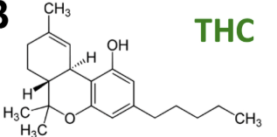
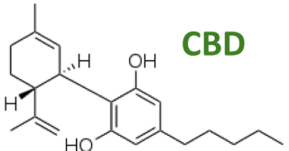

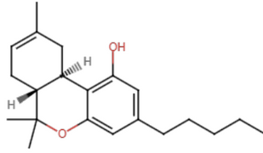
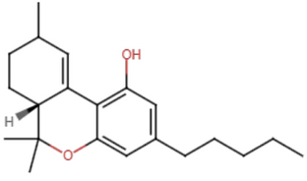
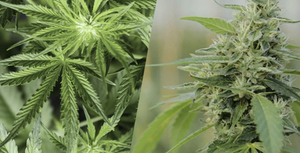
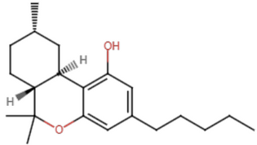
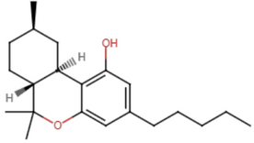



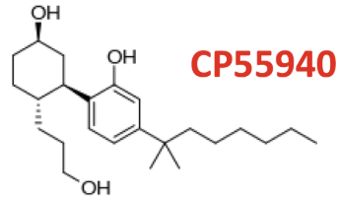
Cannabinoids 101
Cannabinoids (naturally occuring compounds in cannabis plants)
  THC - delta-9-tetrahydrocannabinol
  CBD - cannabidiol
delta-9-THC
Semi-synthetic cannabinoids
(Made from hemp-derived cannabidiol)
  delta-8-THC
delta-8-THC
delta-10-THC
  delta-10-THC
  HHC - hexahydrocannabinol
Fully synthetic cannabinoids
9R-HHC
9S-HHC
(Not made from plant, banned in US)
  K2, Spice
Spice
Notes:
There are over 100 different types of cannabinoids found in cannabis.
The human body produces its own cannabinoids, called endocannabinoids.
THC - psychoactive chemical in cannabis - causes a 'high'
CBD - non-psychoactive cannabinoid that can provide feelings of relaxation and may reduce pain and inflammation, but does not cause a 'high'
Delta 8 and 10 - more mild than 9
10 mildest
Difference - placement of a double bond in the carbon chain
Hemp - different species of cannabis plant -rope, textiles, paper, fuel (0.3% THC)
8 and 10 made by converting CBD from hemp
HHC contains R and S isomers
9R active psychoactive cannabinoid with effects similar to THC
9S inactive with lower binding affinity for CA receptors

Slide 15
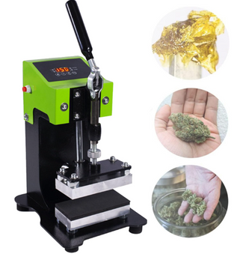
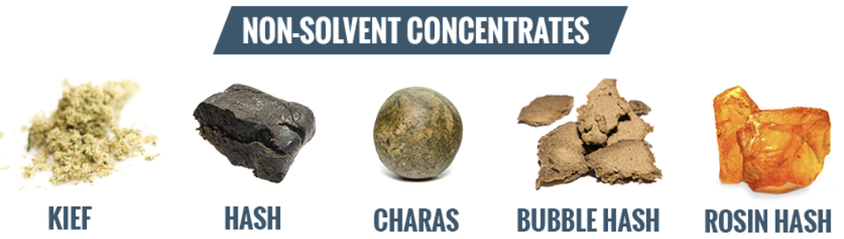
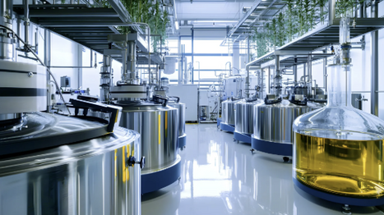

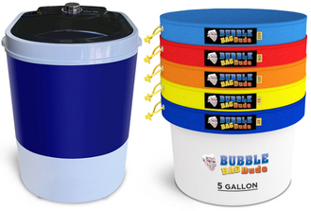
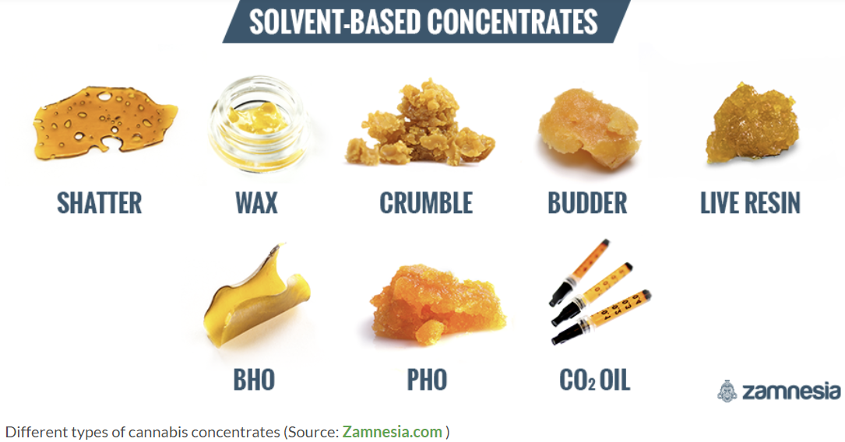
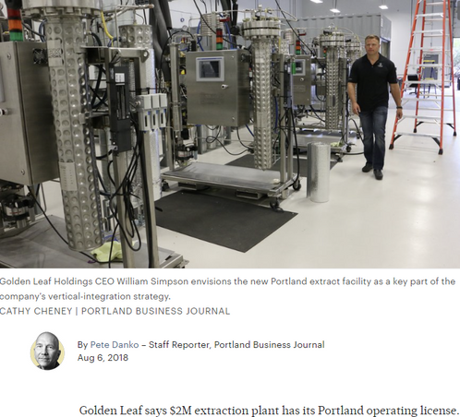
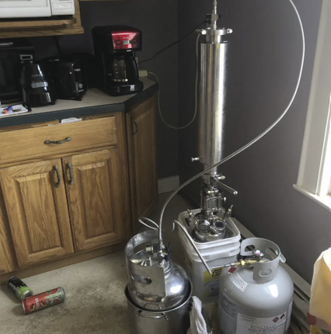
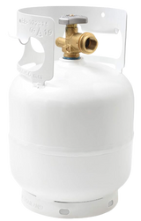
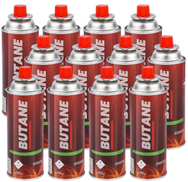
Extraction Techniques for High Potency Products
Rosin Heat Press
Industrial - Advanced Extraction Labs (Santa Rosa)
Pressure, Heat, Friction, Cold
Bubble machine
Industrial - Golden Leaf Holdings (Portland)
Supercritical CO2, Ethanol, Hydrocarbon
Notes:
Extraction of THC from the TRICHROMES using physical or chemical means
BubbleAgDude - 5 gallon bubble machine with 5 gallon filter bag set $189 Walmart
Advanced Extraction Labs
Santa Rosa, CA
BHO butane HASH oil
PHO propane HASH oil

Slide 16
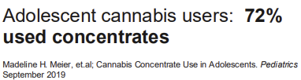
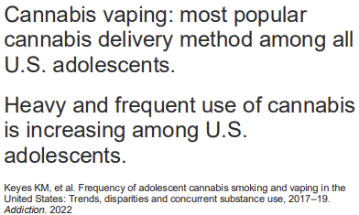
High Potency Products
far from natural
Notes:
12-pack butane bottles on Amazon, made in Korea $27.99
5-pound Propane Tank $47.29 on Amazon

Slide 17

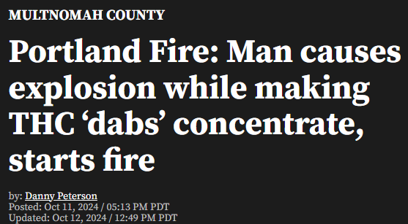
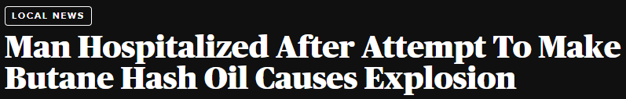
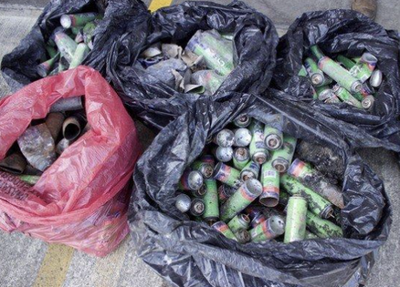
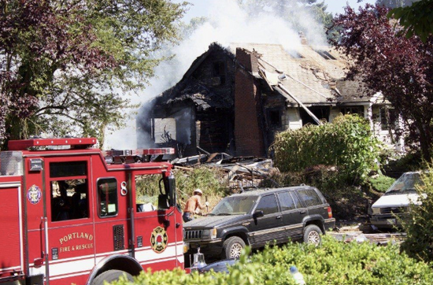
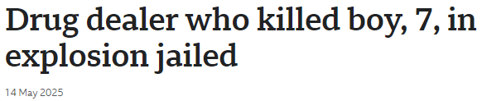
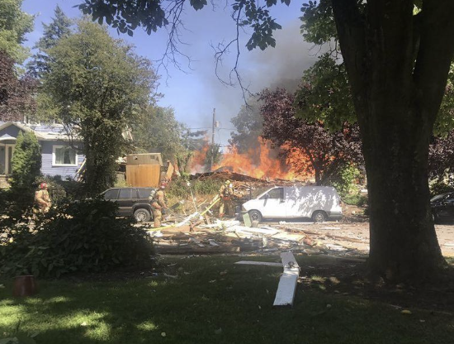



Home Extraction Techniques for High Potency Products Prove dangerous
CLEARLY, LEAGALIZATION
DID NOT STOP ILLEGAL MANUFACTURING
Image from BBC
Image from The Portland Press Herald
Images from Oregon Live
Notes:
* Douglas County-Glendale (Aug 3-4, 2024)
A structure fire destroyed a ~1,500 sq. ft. building. Deputies determined it was caused by an illegal BHO lab.
Medford Alert News
Found thousands of pounds of processed marijuana and ~5 pounds of finished BHO product.
Additional illicit drugs and firearms also seized.
Medford Alert News
* Lane County / Eugene — Kelso Street bust (July 24, 2023)
Deputies executed a warrant on an illegal BHO operation before an explosion happened.
Site had extremely volatile chemicals and unsafe electrical work.
Located among homes, businesses, a lumber mill (so risk of large collateral damage).
One suspect arrested, linked to prior lab explosions.

Slide 18








What is Dabbing?
Use of concentrates
The Dab Rig
Source: Lookah.com
The Dab/Wax Pen
Source: Mooselabs.us
Source: www.thchealth.com
Source: reddit
Source: Lookah.com
Notes:
Dabbing is a method of cannabis consumption that involves vaporizing concentrates (also known as “dabs”) at high temperatures and then inhaling the vapor.
This is done mostly using a specialized water pipe called a dab rig (or sometimes an e-rig).
Rigs seen as more "hardcore" or connoisseur method
To take a dab - heat the nail of your rig - butane torch - apply a small dab of your chosen concentrate. -
The heat quickly vaporizes the oils - then inhale through the mouthpiece.
And since concentrates are super potent (from 60% all the way up to 90% THC), dabbing has become super popular among cannabis users who crave maximum potency.

Slide 19





How to Vape/Dab THC
Cannabis oil concentrate
Mouthpiece/Tip
Cartridge
Button
Base/Battery
Anatomy of a Vape Pen - vaporizes cannabis oil concentrate.
  Smaller than Dab Pens, lower temperatures.
  Preferable to new users, more gentle experience.
Anatomy of a Dab Pen - vaporizes thicker cannabis concentrates.
  Provides inhalation of higher potency product than vaping.
  Provides faster, stronger, longer lasting high with a single dab.
Notes:
Benefits to new users:
* Convenience (pre-filled carts, no torch)
* Discretion (on the go, pocket-sized)
* Portability
* Ease of Use (public)
* Cost (fewer accessories)
* Accessibility (widely available)
* Perception of Safety
- oil concentrates - Vapes
- thicker concentrates - Dabs
wax
shatter
budder
crumble

Slide 20



“To say that we have legalized weed
is misleading. We’ve commercialized THC.”
~ Ben Cort
One of the worst effects of widespread marijuana legalization is widespread marijuana normalization.
~ Smart Approaches to Marijuana
Addiction for Profit Industry.
~ Dr. Roneet Lev
Notes:
SAMHSA National Survey on Drug Use and Health 2022 showed:
Oregon students 12-17 have the lowest perception of risk in the US
87% perceive NO great risk from smoking marijuana once/month
Storefront availability increases
use
use with alcohol
lower perceived risk
perceived parental approval
2024 CA study Keizer
(Less retail availability to teens)
less use
less problematic use
less mental health issues (anx/dep, psychosis)

Slide 21

Canadian Health Warnings - March 2025
Using cannabis before age 25 can:
  harm brain development worsening attention, concentration, and memory
  increase risk of mental disorders like psychosis and schizophrenia
  cause psychotic symptoms like severe paranoia
Cannabis can be addictive. The higher the THC, the greater the risk and adverse effects.
Cannabis use increases the risk of anxiety and depression (the more you use, the greater the risk).
Do not drive under the influence of cannabis. It puts your life and other people's lives at risk.

Slide 22



Cannabis Use in Pregnancy and Breastfeeding

Slide 23
Prenatal Exposures and Impacts on Pregnancy
  With legalization, perception of safety changed.
  Keizer study in 2021, maternal use correlated with accessibility.
  Budtenders making medical recommendations.
  American College of Obstetricians and Gynecologists 2025 update.
  Complications include hypertension, placental abruption, anemia, restricted uterine blood flow, preterm birth, low birth weight.
  American Academy of Pediatrics last update 2018.
  Fetal endocannabinoid system.
  Mesocorticolimbic system.
  Language, memory, attention, cognition, emotional regulation, executive functioning.
Notes:
Legalization, recs for appetite, nausea, sleep, pain.
Now the most commonly used federally illegal drug used in pregnancy.
Use rose 69% 2009-2016 in preg women.
Legalization - inc retailer density - accessibility
ACOG 2017-2025. Screening and avoid use due to risks (planning to conceive, pregnant or BF)
ABDC Adolescent Brain and Cognitive Development Study. 655/11489 prenatal exposure.

Slide 24

Prenatal Exposures and Impacts on Brain Development
  The ABCD study suggests that prenatal cannabis exposure is associated with greater risk for psychopathology during middle childhood.
  2-fold increase in early onset of cannabis use, independent of prenatal exposure to or use of other substances or family history of drug or alcohol problems.
Postnatal Exposure and Impacts
ACOG, AAP
  THC (lipophilic) - found in breast milk for up to six days.
  0-3 years - brain development.
  Overlay deaths due to parental impairment.
  Post partum depressive symptoms.
Notes:
ABCD study started in 2015
(Adolescent Brain Cognitive Development Study).
Longest long-term study of brain development and child health in the US.
Nearly 12,000 children, ages 9-10 years old
Studies the impact of various experiences (sleep, screen time) and substances on the brain.
Periodic surveys and fMRIs
Gathers data on brain development, cognition, emotion, physical health, mental health, and substance use through neuroimaging, assessments, and other measures

Slide 25



Cannabis Exposures in Childhood

Slide 26








Toddlers in the Weeds
Recreational legalization
Medical legalization
thcphotos.org
Notes:
Stress safe storage (locked, out of sight/reach) and child-resistant, plain packaging.
Consider co-exposures; manage airway/breathing; observe for delayed onset (edibles)
Candy photos from thcphotos.org - One chance to grow up.

Slide 27



Children in the Weeds
Pediatrics (2023) 151 (2): e2022057761.
  Study out of Southern Illinois University School of medicine looking at national trends between 2017-2021. Ages 0-5 yrs.
Number of Cases per year
2017 - 207 (2.9% of ingestions)
2021 - 3054 (43.4% of ingestions)
An increase of 1375%
Notes:
Over the study period of 2017-2021 there was an overall inc of # of cases during a time when more states have legalized medical and recreational cannabis products.
Increase in acute toxicity and severity of cases being reported, particularly when comparing the pre-pandemic years vs during the pandemic.
Bring awareness to rising # of cases and increase in acute toxicity.

Slide 28




Children in the Weeds
poisoncenters.org
Oregon packaging limit (2022) - 5mg/50mg to 10mg/100mg
Notes:
Opportunity for education and poison prevention, safety in home.
OR legalized in 2014
Approved 100mg (prev 50mg) packaging 6/2021, into 4/2022
Edibles: Following a 2022 policy change in Oregon that doubled the allowable THC content in edibles, the number of cannabis-related cases reported to the Oregon Poison Center for young children rose sharply. Edibles often appear as cookies or brownies, which can be mistaken for regular food by children.

Slide 29





Marketing to Children
  Required warnings:
"For use only by adults 21 and older"
"Keep out of reach of children"
  Universal symbol:
  Prohibited imagery:
To avoid appeal to minors, packaging cannot feature:
  Cartoons, celebrities, or other imagery that is associated with products marketed to children.
  Designs that resemble non-cannabis food or drinks typically marketed to minors.
Notes:
Stress safe storage (locked, out of sight/reach) and child-resistant, plain packaging.
Weedsy.ca -$18 for 350/500mg packages 91%THC
granvilleilsandcannabis.com
Trips Ahoy 500mg %15
Policy considerations:
* marketing to minors
* single-dose packaging
* high-potency product cap
* public health warnings
Universal symbols approved by the OHA and is required on all marijuana item labels.
The hemp symbol must be used in place of the universal symbol if the product is only made of hemp.
Hemp products even more loosely regulated. Recent OLCC report indicated that many samples exceeded 0.3%THC

Slide 30




Portland Recreational Marijuana Retailers & Labs
2025
OR 16.8/100,000
WA 5.8/100,000
CO 11.5/100,000
K-12 school locations
OLCC-licensed retailers and testing labs
Notes:
Recall Keizer study on legalization, retail store availability and use in pregancy.
Teens also impacted by proximity. Retail exposure - increased perception of safety and use.
Colorado has more dispensaries than McDonald's and Starbucks combined.
As of mid-2025, Oregon has one of the highest proportions of cannabis retailers per capita in the US.
OR 16.8 per 100,000 residents
WA 5.8 per 100,000
CO 11.5 per 100,000

Slide 31


Human Brain Development -

Slide 32


Human Brain Development
Proceedings of the National Academy of Sciences (PNAS)
Teen brains are wired to take risks
Notes:
Age 12 - during adolescence, the brain goes through a lot of changes. Gray matter diminishes as connections between neurons are cut back (pruned).
The PFC, which handles reasoning, grows during the preteen years, but pruned back during adolesc, inc impulsive and risk-taking behavior - and susceptibility to addiction
Age 16 - Because the brain is still developing, it is more sensitive the the effects of drugs.
Age 20 - By adulthood, the changes caused by beginning drug use are less likely to "stick" and becomes hardwired as addiction.
Proceedings of the National Academy of Sciences (PNAS)

Slide 33


Human Brain Development
From a lecture by Caroline Hoxby, Stanford University April2022
Notes:
Pruning - critical period needed for creating adult behavioral performance, and also render the teen highly susceptible to perturbations, such as exposure to psychoactive drugs, during this critical developmental time.
Variety of maturational processes occurring in the endocannabinoid system during this time, making the still-developing brain highly susceptible to cannabis.
Can impact future cognition, risk for neuropsych d/os, promote further illegal drug intake and inc chance of CUD/dependence.

Slide 34

Endocannabinoid System (ECS)
  Uses proteins (endocannabinoids) and receptors on cells to regulate mood, appetite, sleep, pain, immune response, memory, and metabolism.
  Modulates inhibitory and excitatory synapses in the brain, regulates emotion and motivation and involved in the formation of habit and implicit learning. Disruption of the ECS has been associated with symptoms of psychosis.
Source: Getty Images
  Helps sculp and mature neural circuits in teens, balancing excitatory and inhibitory neurotransmission tied to the development of brain regions that regulate stress and anxiety responses.
  Stress and cannabis use can disrupt the normal developmental trajectory of neural circuits, with potential for long-lasting effects on emotional behavior and stress reactivity.
Notes:
Numerous papers have been published exploring the association b/n CU and psychosis over the past 2 decades.
Studies find cannabis use in adolescence to be associated with elevated Psychotic Episodes, specifically paranoia, hallucinations, and cognitive disorganization.
THC binds to Cannabinoid receptors, interfering with the developing ECS.
Chronic use has been linked to alterations in brain structure (dec PFC thickness and functional connectivity)
These disruptions can result in long-term neurobiological changes, potentially leading to cognitive impairments, educational underachievement, and an increased risk of developing psychosis later in life.

Slide 35



Pediatric Brain Development
Pediatric Brain Development
Hippocampus
Memory, Learning
Amygdala
Emotional Regulation
(fear, anxiety, reward system)
Prefrontal Cortex
The Endocannabinoid System
Executive functioning skills (planning, delayed gratification, regulating of emotions). Recall pruning, use it or lose it.
ABCD Study
Adolescent Brain and Cognitive Development Study (started 2015)
Largest longitudinal study of this size in history
Following >10,000 children from 9-10 through adulthood
Prenatal exposure through adolescence
Notes:
Adolescence is a gateway to establishing health patterns for decades
The brain's capacity for plasticity in developing executive function, emotional regulation and habit formation last into adulthood.
Sleep, physical activity, nutrition, coping styles, relationship health, mental health management and SUBSTANCE USE impact brain development.
CDC reports that cannabis use can have permanent effects of the developing brain when use begins in adolescence, especially with regular or heavy use.

Slide 36



ABCD study findings
Depression
Cognition
Cannabis use
Worse picture memory
Worse vocabulary
Cannabis use
The Endocannabinoid System
Lower self regulation
Depression sx
Worse performance on inhibition tasks
Smaller amygdala
Notes:
More to come with ongoing data points.
define who will be most impacted
and who is at greatest risk
and how to mitigate or prevent consequences

Slide 37


Normalize screening, trends, warnings
2020
35.2% 12th
“The majority of youth are NOT using”
28% 10th
11.4% 8th
2024
25.8% 12th
15.9% 10th
7.2% 8th
Source: Monitoring the future 1975-2024
Notes:
Normalize screening and brief interventions (SBIRT). Ask about vapes/dabs specifically.
Start at 11
CRAFFT (Car, Relax, Alone, Forget, Friends, Trouble)
S2BI (Screening to Brief Intervention)
BSTAD (Brief Screener for Tobacco, Alcohol and other Drugs)
Screen for CUD (DSM 5)
Diagnostic and Statistical Manual of Mental Disorders)
1. W/D
2. Tolerance
3. Inc freq strength
4. Unable to control use
5. Inc time spent getting/using/recovering
6. Use despite problems
7. Failing obligations
8. Interpersonal problems
9. Risky use
VAPING
Screen for FH of SUD
Screen for ACE/PCEs
Discuss safe driving timelines: no driving or at least 6 hours after use; longer with edibles

Slide 38

1995
THC 3.96%
CBD 0.28%
2022
THC 16.14%
CBD 0.12%
Source: Monitoring the future 1975-2024
Source: DEA delta-9-THC seizures 1995-2022
Notes:
Under contract with NIDA, the National Center for Natural Products Research (NCNPR) located at the University of Mississippi (UM), conducts analyses to monitor the potency of cannabis products distributed in the illegal marijuana marketplace in the United States.
Reminder about the ongoing research understanding the balance between THC and CBD
CBD thought to mitgate some of the cognitive impairments of THC.
With THC potency increasing 4-fold in the past several decades, while CBD potency has remained stable
- CRITICAL to understand this relationship on the developing adolescent brain

Slide 39




Oregon Youth Cannabis Use
smoke 74%
vape 67%
edible 34%
drink 11%
dabbed 24%
2024 Student Health Survey
Have you ever used marijuana in any form?
During the past 30 days, did you use marijuana?

Slide 40


Predictors of Adolescent Substance Use

Slide 41

Predictors of Adolescent Substance Use
  Family History of Substance Use
  Peer Influence
  Untreated Depression/Anxiety
  Prenatal Exposure to Substance Use (emerging data)
  Adverse Childhood Experiences (1998)
  Absence of Positive Childhood Experiences (2015)
Notes:
Growing body of research has identified the importance of PCE, mitigate ACEs
1. Ability to talk with family about feelings
2. The sense that family was supportive in hard times
3. Felt safe and protected by an adult in the home
4. Enjoyed participating in community traditions
5. Feeling a sense of belonging in high school
6. Feeling supported by friends
7. Had at least 2 non-parent adults who genuinely cared.
Higher peer approval of substance use (since legalization
Social media use and exposure to advertising

Slide 42

Adverse Childhood Experiences

Slide 43

Adverse Childhood Experiences

Slide 44


Adverse Childhood Experiences
IMPACTS:
  Physical Health
  Mental Health
  SUBSTANCE USE PREVENTION

Slide 45








Absence of Positive Childhood Experiences
  Feel able to talk to your family about feelings
  Feel your family stood by you during difficult times
  Feel safe an protected by an adult in your home
  Feel supported by friends
  Enjoy participating in community traditions
  Have at least two non-parent adults who took a genuine interest in you
  Feel a sense of belonging in high school
Notes:
Growing body of research has identified the importance of PCE, mitigate ACEs
1. Ability to talk with family about feelings
2. The sense that family was supportive in hard times
3. Felt safe and protected by an adult in the home
4. Enjoyed participating in community traditions
5. Feeling a sense of belonging in high school
6. Feeling supported by friends
7. Had at least 2 non-parent adults who genuinely cared.
Higher peer approval of substance use (since legalization
Social media use and exposure to advertising

Slide 46


Cannabis and the Adolescent Brain
Addiction
Suicide
Mental health
Psychosis

Slide 47

Adolescent Brain Development and Addiction
  Studied long-term trends over 2 decades.
  Compared use patterns pre- and post-cannabis legalization.
  Increased likelihood of any cannabis use.
  Increased likelihood of daily cannabis use.
  Increased likelihood of cannabis dependence.
Notes:
Long-term trends over the two decades of observation
Pre-cannabis legalization period (2001–2017)
Post-cannabis legalization period (2019)

Slide 48

Adolescent THC use and psychosis
Published May, 2024
  New evidence of a strong and age-dependent association between cannabis use and risk of psychotic disorder.
  Consistent with the neurodevelopmental theory that adolescence is a vulnerable time to use cannabis.
  The strength of association during adolescence was notably greater than in previous studies (5x risk reported in UK studies), possibly reflecting the recent rise in cannabis potency.
  Eleven times greater risk!
Notes:
Background: Ontario, Canada
Socialized medicine
Epidemiologic research suggests that youth cannabis use is associated with
psychotic disorders.
However, current evidence is based heavily on 20th-century data when cannabis was substantially less potent than today.
They found that cannabis use, compared to no cannabis use, was associated with over 11 times (95% CI 4.6–27.3) greater risk of psychotic disorder at any point during adolescence (ages 12–19 years).

Slide 49
Adolescent THC use and psychosis
From ABDC cohort:
JAMA Pediatrics 2023
  Prenatal cannabis exposure consistently demonstrated reward-delayed neural circuitry and impulsivity. These findings are associated with future psychotic-like episodes and early psychosis.
  Teens who used cannabis at any point during the study period reported more psychosis and distress.
  More research needed to sort out self-medication of early psychosis symptoms and substance use vs cause and effect.
Notes:
~ 1,400 papers related to the ABCD study have been published
REWARD-DELAYED NEURAL CIRCUITRY
= the process of mentally reducing the value of a reward based on how long you have to wait for it.
There is diminished or disrupted reward processing (e.g., reduced responsiveness to reward) in both individuals with psychotic disorder and individuals at clinical high risk for psychosis

Slide 50

Adolescent THC use suicidal ideation
  Australia and New Zealand
  2,000 teens < 17 yrs
  daily THC use
Lancet Psychiatry Sept, 2014
  7-fold increase in suicide attempts.
  Substantial increased odds of later cannabis dependence / use of illicit drugs.
  Reduced odds of high-school completion and degree attainment.
  Call to action to delay use in adolescents, reform cannabis legislation to reduce accessibility.

Slide 51



Adolescent THC use and psychosis/schizophrenia
Psychological Medicine Dec, 2024
  144,698 patients UK - genetic markers for schizophrenia risk was not associated with patterns of cannabis use.
  Regular users of high potency THC (over 10%)
  Highest odds of psychotic disorder
  Independent of schizophrenia genetic risk

Slide 52

Adolescent THC use suicidal ideation
Journal of Psych Research Sept, 2022
  Reviewed 20 studies of US youth with suicidal ideation, planning, and attempts.
  Cannabis use significantly increased risk of suicidial ideation, planning, and attempts, compared to non-cannabis users.
  Early age of cannabis use of initiation worsened the risks.
The impact of recreational cannabis legalization on youth: the Colorado experience. Inc depression and suicidality
  Once per month use - 5x more likely to attempt suicide
  1-2 days/wk - 7x
  3-4 days/wk - 9x
Notes:
The impact of recreational cannabis legalization on youth: the Colorado experience. 2024
Hinckley and colleagues found a dose-response relationship, meaning that the greater the youth’s exposure to cannabis, the higher the odds of MDD, suicidality, and more severe depression. “For example, youth who used cannabis occasionally—once a month or less—in the past year were five times more likely to have attempted suicide than youth who did not use cannabis at all,” Hinckley said. “Meanwhile, youth who used cannabis one to two days a week or three to four days a week were seven and nine times more likely to have attempted suicide, respectively.”

Slide 53


Suicide death rates among youth 10-24 years old in Oregon and the US.
Source: 2023 Youth Suicide Intervention and Prevention Plan Annual Report
Notes:
Oregon consistently has a higher youth suicide rate than the US

Slide 54


Adolescent THC use and suicide
Colorado youth suicide (10-18yrs) and associated toxicology - 2033
Colorado Violent Death Reporting System 2023
Notes:
In Colorado, marijuana is the most commonly found substance in the toxicology reports of youth aged 10-19 who commit suicide.
In fact, 43% of Colorado teens aged 15-19 who commit suicide test positive for THC in their system.
That figure rises to 49% for Hispanic youth and 67% for African American youth.

Slide 55



Slide 56

Summary of the Negative Impacts of Cannabis Use in Adolescents
  Critical time period of brain development, missed opportunities, and significant long term consequences.
  Psychosis and schizophrenia.
  Depression, anxiety, and suicidal ideation/planning/attempts.
  Increased risk for future misuse of prescription drugs.
  4-7 times more likely than adults to develop a cannabis use disorder.
  Withdrawal is reported by up to 30% of regular users and up to 50-90% of heavy users in treatment.
Notes:
Research shows that adolescents who smoke marijuana once a week over a two-year period are almost six times more likely than nonsmokers to drop out of school and over three times less likely to enter college.
psychological and physical withdrawal symptoms.
THC / CBD relationship of balance, and experience, severity of withdrawal symptoms
Return to use to treat sx's

Slide 57
Summary of the Negative Impacts of Cannabis Use
  Hospital visits related to cannabis use are increasing.
Tripled in Colorado, since legalization.
Increased by 83% in San Diego from 2011-2016 .
  Cannabis hyperemesis syndrome (“scromiting”).
  Cardiovascular effects from chest pain, arrhythmias, heart attacks and stroke.
  Hundreds of drug interactions with THC and CBD (Drugs.com).
  Hallucinations, psychosis and suicidal ideation.
  Marijuana is the most common illicit drug identified in impaired drivers.

Slide 58

PUBLIC HEALTH RECOMMENDATIONS
  Parents: Early education, modeling healthy coping, open conversations, share importance of positive childhood experiences.
  Clinicians: Normalize screening, counsel on delayed initiation and safe storage of THC products, unsafe for pregnancy/breastfeeding.
  Law Enforcement: Prioritize youth access to prevention, impaired driving enforcement, and retailer compliance (youth decoys), improved screening for fake IDs.
  Schools: Evidence-based prevention education, speak to students about risks despite perceived safety, nicotine gateway, youth-led campus campaigns and peer support.
  Communities: advocate for smart drug policies - plain packaging, potency caps, packaging limits for edibles, enforce child-proof packaging, marketing enforcement, high-quality product testing for potency and contaminants, demand ongoing research on health impacts of high potency products.
Notes:
Share handouts (safe storage, teen talks). Consider local ordinance options for packaging and signage.
Encourage data sharing across sectors to track trends and respond quickly.

Slide 59

PUBLIC HEALTH RECOMMENDATIONS
What Does Smart Drug Policy Look Like?
  Prioritizes public health over profit.
  Protects our youth by eliminating marketing that targets kids (candy ban).
  Invest in primary prevention - HB3321 (especially targeting youth and education of high potency products).
  Potency caps, packaging caps, child-proof packaging.
  Regulation and transparency - clear labeling, warnings, and risks.
  Ensures public safety by criminalizing false health claims.
  Study negative impacts of substances before legalization.
  Engage lawyers who understand drug policy to protect pubic interest.
Learns from the health hazards the tobacco industry introduced.
Notes:
Keep our north star being the current drug use and pathways to addiction
Foundation for drug policy solutions.
Sister company of SAM. To create a blue print to (gooddrugpolicy.org) knowledge collection of a large spectrum of stakeholders from prevention through recovery.
Bipartisan. Aims to pass policy on federal and state level.
Top 10 diagnoses related to drug use and addiction.
Farm bil 2018 Hemp, unregulated (0.3%THC)
How ethical is it to have our children be the canaries in the coal mine.

Slide 60

CONCLUSION
  This is a message about children and prevention.
  MOST teens are not drinking, smoking or using illicit drugs.
  Initiation before 18 yrs are 4-7x more likely to become dependent, despite negative consequences.
  Oregon’s ranking for adolescent mental illness and available resources is putting kids at risk for self-medicating, experimenting, anxiety, depression, psychosis, and suicidality.
  More adults are using daily marijuana than alcohol, meaning more children have access to THC products than ever before.
  Accessability, flashy youth-attractive advertising, and the perception of safety since legalization is putting youth at risk.
Public Health over Profit.
Notes:
2023 Annual Report of the National Poison Data
System® (NPDS) from America’s Poison Centers®
Marijuana use is the #1 reason why teens are seeking SUD treatment

Slide 61

REFERENCES
  Lac A, Luk JW. Testing the Amotivational Syndrome: Marijuana Use Longitudinally Predicts Lower Self-Efficacy Even After Controlling for Demographics, Personality, and Alcohol and Cigarette Use. Prev Sci. 2018 Feb;19(2):117-126. doi: 10.1007/s11121-017-0811-3. PMID: 28620722; PMCID: PMC5732901.
  Volkow ND, Han B, Einstein EB, Compton WM. Prevalence of Substance Use Disorders by Time Since First Substance Use Among Young People in the US. JAMA Pediatr. 2021;175(6):640–643. doi:10.1001/jamapediatrics.2020.6981
  Madras BK, Han B, Compton WM, Jones CM, Lopez EI, McCance-Katz EF. Associations of Parental Marijuana Use With Offspring Marijuana, Tobacco, and Alcohol Use and Opioid Misuse. JAMA Netw Open. 2019;2(11):e1916015. doi:10.1001/jamanetworkopen.2019.16015
  The Bradford Hill Analysis of Causation Applied to Cannabis Use and the Development of Chronic Psychotic Disorders Christine L. Miller, Ph.D., Catherine Antley, MD and Dean Whitlock (editor) with a review and contributions from Carsten Hjorthoj, Ph.D. Library – IASIC (iasic1.org)
  Livingston, S.J., Quilichini, T.D., Booth, J.K., Wong, D.C.J., Rensing, K.H., Laflamme-Yonkman, J., Castellarin, S.D., Bohlmann, J., Page, J.E. and Samuels, A.L. (2020), Cannabis glandular trichomes alter morphology and metabolite content during flower maturation. Plant J, 101: 37-56. https://doi.org/10.1111/tpj.14516
  Tanney, C. A., Backer, R., Geitmann, A., & Smith, D. L. (2021). Cannabis Glandular Trichomes: A Cellular Metabolite Factory. Frontiers in Plant Science, 12, 721986. https://doi.org/10.3389/fpls.2021.721986
  https://doi.org/10.1080/15563650.2024.2412423
  Smart Approaches to Marijuana
  International Academy on the Science and Impact of Cannabis

Slide 62
REFERENCES
  Thomas AA, Von Derau K, Bradford MC, Moser E, Garrard A, Mazor S. Unintentional pediatric marijuana exposures prior to and after legalization and commercial availability of recreational marijuana in Washington State. J Emerg Med. 2019;56(4):398-404. doi: 10.1016/j.jemermed.2019.01.004
  Wang GS, Le Lait M, Deakyne SJ, Bronstein AC, Bajaj L, Roosevelt G. Unintentional Pediatric Exposures to Marijuana in Colorado, 2009-2015. JAMA Pediatr. 2016;170(9):e160971. doi:10.1001/jamapediatrics.2016.0971
  Hinckley J, Bhatia D, Ellingson J, Molinero K, Hopfer C. The impact of recreational cannabis legalization on youth: the Colorado experience. Eur Child Adolesc Psychiatry. 2024 Mar;33(3):637-650. doi: 10.1007/s00787-022-01981-0. Epub 2022 Apr 15. PMID: 35428897; PMCID: PMC10097013.
  Conner S.N., Bedell V., Lipsey K., Macones G.A., Cahill A.G., Tuuli M.G. Maternal Marijuana Use and Adverse Neonatal Outcomes: A Systematic Review and Meta-Analysis. Obstet. Gynecol. 2016;128:713–723. doi: 10.1097/AOG.0000000000001649
  Murnan A.W., Keim S.A., Yeates K.O., Boone K.M., Sheppard K.W., Klebanoff M.A. Behavioral and Cognitive Differences in Early Childhood Related to Prenatal Marijuana Exposure. J. Appl. Dev. Psychol. 2021;77:101348. doi: 10.1016/j.appdev.2021.101348.
  El Marroun H., Tiemeier H., Franken I.H.A., Jaddoe V.W.V., van der Lugt A., Verhulst F.C., Lahey B.B., White T. Prenatal Cannabis and Tobacco Exposure in Relation to Brain Morphology: A Prospective Neuroimaging Study in Young Children. Biol. Psychiatry. 2016;79:971–979. doi: 10.1016/j.biopsych.2015.08.024.
  Metz T.D., Borgelt L.M. Marijuana Use in Pregnancy and While Breastfeeding. Obstet. Gynecol. 2018;132:1198–1210. doi: 10.1097/AOG.0000000000002878.

Slide 63
REFERENCES
  Nomura Y., Ham J., Pehme P.M., Wong W., Pritchett L., Rabinowitz S., Foldi N.S., Hinton V.J., Wickramaratne P.J., Hurd Y.L. Association of Maternal Exposure to Superstorm Sandy and Maternal Cannabis Use with Development of Psychopathology among Offspring: The Stress in Pregnancy Study. BJPsych Open. 2023;9:e94. doi: 10.1192/bjo.2022.595.
  Gunn J.K.L., Rosales C.B., Center K.E., Nuñez A., Gibson S.J., Christ C., Ehiri J.E. Prenatal Exposure to Cannabis and Maternal and Child Health Outcomes: A Systematic Review and Meta-Analysis. BMJ Open. 2016;6:e009986. doi: 10.1136/bmjopen-2015-009986.
  Brik M., Sandonis M., Gil J., Hernandez-Fleury A., Parramón-Puig G., Maiz N., Suy A., Carreras E. Intrauterine Cannabis Exposure and Fetal and Maternal Blood Flow: A Case–Control Study. Acta Obstet. Gynecol. Scand. 2022;101:1207–1214. doi: 10.1111/aogs.14439.
  Metz T.D., Allshouse A.A., Hogue C.J., Goldenberg R.L., Dudley D.J., Varner M.W., Conway D.L., Saade G.R., Silver R.M. Maternal Marijuana Use, Adverse Pregnancy Outcomes, and Neonatal Morbidity. Am. J. Obstet. Gynecol. 2017;217:478.e1–478.e8. doi: 10.1016/j.ajog.2017.05.050.
  Jarlenski M, Koma JW, Zank J, et al. Trends in perception of regular marijuana use among US pregnant and non-pregnant reproductive aged women. Am J Obstet Gynecol. 2017;217:705–707. doi: 10.1016/j.ajog.2017.08.015.
  Amir CM, Ghahremani DG, Chang SE, Cooper ZD, Bearden CE. Altered Neurobehavioral Reward Response Predicts Psychotic-Like Experiences in Youth Exposed to Cannabis Prenatally. Biol Psychiatry. 2025 Jun 2:S0006-3223(25)01218-1. doi: 10.1016/j.biopsych.2025.05.019. Epub ahead of print. PMID: 40466988.

Slide 64
REFERENCES
  Hayes, S., Delker, E. & Bandoli, G. The prevalence of cannabis use reported among pregnant individuals in the United States is increasing, 2002–2020. J Perinatol 43, 387–389 (2023).
  Lo JO, Ayers CK, Yeddala S, et al. Prenatal Cannabis Use and Neonatal Outcomes: A Systematic Review and Meta-Analysis. JAMA Pediatr. 2025;179(7):738–746. doi:10.1001/jamapediatrics.2025.0689.
  Miller AP, Baranger DAA, Paul SE, et al. Characteristics Associated With Cannabis Use Initiation by Late Childhood and Early Adolescence in the Adolescent Brain Cognitive Development (ABCD) Study. JAMA Pediatr. 2023;177(8):861–863. doi:10.1001/jamapediatrics.2023.1801.
  Schmidt, Kristen MD*; Tseng, Irene BS†; Phan, Amanda BS†; Fong, Timothy MD‡; Tsuang, John MD†. A Systematic Review: Adolescent Cannabis Use and Suicide. Addictive Disorders & Their Treatment 19(3):p 146-151, September 2020. | DOI: 10.1097/ADT.0000000000000196.
  Hurd Y.L., Ferland J.-M.N., Nomura Y., Hulvershorn L.A., Gray K.M., Thurstone C. Cannabis Use and the Developing Brain: Highs and Lows. Front. Young Minds. 2023;11:898445. doi: 10.3389/frym.2023.898445.
  https://doi.org/10.1016/j.childyouth.2019.03.035
  Giedd, J., Raznahan, A., Alexander-Bloch, A. et al. Child Psychiatry Branch of the National Institute of Mental Health Longitudinal Structural Magnetic Resonance Imaging Study of Human Brain Development. Neuropsychopharmacol 40, 43–49 (2015). https://doi.org/10.1038/npp.2014.236
  Winters KC, Lee CY. Likelihood of developing an alcohol and cannabis use disorder during youth: association with recent use and age. Drug Alcohol Depend. 2008 Jan 1;92(1-3):239-47. doi: 10.1016/j.drugalcdep.2007.08.005. Epub 2007 Sep 20. PMID: 17888588; PMCID: PMC2219953.
  ACOG Clinical Consensus. Cannabis Use During Pregnancy and Lactation. October 2025.

Slide 65
REFERENCES
  Schneider M. Puberty as a highly vulnerable developmental period for the consequences of cannabis exposure. Addict Biol. 2008 Jun;13(2):253-63. doi: 10.1111/j.1369-1600.2008.00110.x. PMID: 18482434.
  Kiburi, S. K., Molebatsi, K., Ntlantsana, V., & Lynskey, M. T. (2021). Cannabis use in Adolescence and Risk of Psychosis: Are there Factors that Moderate this Relationship? A Systematic Review and Meta-Analysis. Substance Abuse. https://doi.org/10.1080/08897077.2021.1876200
  Austin-Zimmerman I, Spinazzola E, Quattrone D, et al. The impact of schizophrenia genetic load and heavy cannabis use on the risk of psychotic disorder in the EU-GEI case-control and UK Biobank studies. Psychological Medicine. 2024;54(15):4160-4172. doi:10.1017/S0033291724002058
  Spinazzola E, Forti MD, Murray RM. Which Cannabis Users Develop Psychosis? In: D’Souza DC, Castle D, Murray SR, eds. Marijuana and Madness. Cambridge University Press; 2023:148-155.
  Ertl, N., Freeman, T.P., Mokrysz, C. et al. Acute effects of different types of cannabis on young adult and adolescent resting-state brain networks. Neuropsychopharmacol. 49, 1640–1651 (2024). https://doi.org/10.1038/s41386-024-01891-6
  Meyer HC, Lee FS, Gee DG. The Role of the Endocannabinoid System and Genetic Variation in Adolescent Brain Development. Neuropsychopharmacology. 2018 Jan;43(1):21-33. doi: 10.1038/npp.2017.143. Epub 2017 Jul 7. PMID: 28685756; PMCID: PMC5719094.
  Hasin DS. US Epidemiology of Cannabis Use and Associated Problems. Neuropsychopharmacology. 2018 Jan;43(1):195-212. doi: 10.1038/npp.2017.198. Epub 2017 Aug 30. PMID: 28853439; PMCID: PMC5719106.
  https://mhanational.org/wp-content/uploads/2025/09/State-of-Mental-Health-2025.pdf

Slide 66
REFERENCES
  Leubitz A, Spiller HA, Jolliff H, Casavant M. Prevalence and Clinical Characteristics of Unintentional Ingestion of Marijuana in Children Younger Than 6 Years in States With and Without Legalized Marijuana Laws. Pediatr Emerg Care. 2021 Dec 1;37(12):e969-e973. doi: 10.1097/PEC.0000000000001841. PMID: 34908380.
  Oregon Map of OLCC-licensed retailers and testing labs
  Marijuana and Hemp packaging - OLCC
  McDonald AJ, Kurdyak P, Rehm J, Roerecke M, Bondy SJ (2024). Agedependent association of cannabis use with risk of psychotic disorder. Psychological Medicine 54, 2926–2936. https://doi.org/ 10.1017/S0033291724000990
  Hiraoka D, Makita K, Hamatani S, Tomoda A, Mizuno Y. Effects of prenatal cannabis exposure on developmental trajectory of cognitive ability and brain volumes in the adolescent brain cognitive development (ABCD) study. Dev Cogn Neurosci. 2023 Apr;60:101209. doi: 10.1016/j.dcn.2023.101209. Epub 2023 Feb 6. PMID: 36791556; PMCID: PMC9950823.
  Osborne KJ, Barch DM, Jackson JJ, Karcher NR. Psychosis Spectrum Symptoms Before and After Adolescent Cannabis Use Initiation. JAMA Psychiatry. 2025 Feb 1;82(2):181-190. doi: 10.1001/jamapsychiatry.2024.3525. Erratum in: JAMA Psychiatry. 2025 Feb 1;82(2):208. doi: 10.1001/jamapsychiatry.2024.4165. PMID: 39504015; PMCID: PMC11541740.
  Silins E, Horwood LJ, Patton GC, Fergusson DM, Olsson CA, Hutchinson DM, Spry E, Toumbourou JW, Degenhardt L, Swift W, Coffey C, Tait RJ, Letcher P, Copeland J, Mattick RP; Cannabis Cohorts Research Consortium. Young adult sequelae of adolescent cannabis use: an integrative analysis. Lancet Psychiatry. 2014 Sep;1(4):286-93. doi: 10.1016/S2215-0366(14)70307-4. Epub 2014 Sep 10. PMID: 26360862.

Slide 67

REFERENCES

Slide 68




Feedback Survey
Jill Pearson, MD FAAP
doc.pwpconsulting@protonmail.com

Slide 69


The
Psychology of
Pain
Catriona Buist, Psy.D.,
Associate Professor
Department of Anesthesiology & Psychiatry OHSU
Yamhill County Opioids, Pain, Addiction & Recovery Summit
McMinnville, OR
October 14, 2025
Notes:
This reframes the whole project from fixing their pain, to moving ahead with their life. But many people can reduce their pain quite a lot.

Slide 70

What is Pain?
An unpleasant sensory and emotional experience associated with actual or potential tissue damage (IASP)
Notes:
This definition, updated in 2020, emphasizes pain as a personal, subjective experience that is influenced by psychological and social factors, and that a person's report of pain should be respected, even if it cannot be solely attributed to tissue damage.

Slide 71


Slide 72

Nociplastic pain
nervous system is hyperexcitable and amplifies pain signals

Slide 73


Neuroplasticity =
The ability of the brain to form and reorganize synaptic connections.
The brain learns pain and therefore can unlearn pain!
Neuroplastic Transformation
Moskowitz, M & Golden, M
Neuroplastix.com
.
Notes:
We now know that the old model is insufficient to explain pain.
Pain is a complex process the includes input from the tissues and environment, processing at the level of the nervous system and the train which results in the output of the pain response.
Multiple brain centers contribute to the assessment of potential threat to get us to pay attention to that part.
The brain and the body become more efficient at producing pain.
There may be little or no input from the tissues, like with phantom limb pain or fibromyalgia and less nociception is needed to trigger pain.
“With chronic pain the amount of space dedicated to pain processing expands, stealing space previously dedicated to other activities like creative thinking or playing music. As we learn any new skill by consistently repeating and practicing it, it is given more space in the brain, like real estate. The brain had expanded the amount of space dedicated to pain processing because it had been engaged in the process for so long it had gotten better at it. I started imagining a cool blue wind blowing on the yellow hot spot in the brain, making it simmer down to smoldering embers, then blow again until the embers were out.”

Slide 74

2 predictors of who will developed CLBP:
kinesiophobia & catastrophizing
(Chou, R., & Shekelle, P. Will This Patient Develop Persistent Disabling Low Back Pain? JAMA. April 7, 2010; Vol 303, No. 13, 1295-1302)
Notes:
Allodynia – complaints of pain from things that would not normally be painful, like their bedsheets.
Hyperalgesia – more severe pain to painful stimulus
Widespread pain – pain that spreads into new areas, is vaguely located or hard to find.

Slide 75

YOUR WORDS MATTER AND CAN CREATE A SENSE OF FEAR OR SAFETY
Negative thoughts about pain can lead to maladaptive coping and increased suffering and disability
  Thought: “I have DDD.” “My back is crumbling”
  Emotion: FEAR!!!
  Behavior: seek additional medical treatment
  Idea: change wording from “DDD” to “normal age-related changes.”

Slide 76


Slide 77


A 2025 systematic review and meta-analysis found approx rates for depression and anxiety 40% for pts with CP, highest among those with fibromyalgia.
(Prevalence of Depression and Anxiety Among Adults with Chronic Pain A Systematic Review and Meta-Analysis. JAMA Network Open, March 7, 2025)

Slide 78

What Are We Often Really Medicating With Opiates???

Slide 79

Assessment
PHQ-9 (depression)
GAD-7 (anxiety)
Pain Catastrophizing Scale (PCS)
Widespread Pain Index (WPI) (central sensitization)
Pain, Enjoyment of Life, & General Activity (PEG) Scale

Slide 80

CBT for Chronic Pain
Evidence Based
Time-limited
Encourages
  Problem solving
  Self-management
Focuses on relationship
  cognitions (thoughts)
  emotions (feelings)
  behaviors
CBT for Chronic Pain Therapist Manual from VA
Notes:
CBT can help individuals identify and challenge negative thoughts and beliefs about pain, and develop coping strategies to manage pain and reduce avoidance behaviors.

Slide 81

Acceptance & Commitment Therapy
(ACT)
Steven Hayes, 1994
ACT is an empirically based psychological intervention that uses acceptance, mindfulness strategies, commitment and behavior-change strategies, to increase psychological flexibility.
Goal of ACT is to help you live a rich, full, and meaningful life while effectively handling the pain that inevitably comes your way.

Slide 82
Common Co-morbid Psychological Conditions With Chronic Pain
 | Thought | Emotion | Behavior
Anxiety & PTSD | “I feel overwhelmed” “I feel out of control” “Nobody understands me” “Nobody believes me” | Fear | Withdraw from activity
Depression | “Last time I went to the ___ I had a flare up, I can’t do anything I enjoy” “I feel guilty I can’t contribute to my family” “I feel worthless or hopeless” | Grief Guilt | Withdraw from activity
Grief & Loss of Identity | “I’ve always worked hard to be the best ___” “Who am I now?” “I used to be the provider for the family” “My daughter has to help me wash my hair & shave my legs” “I’ve lost my sense of independence” | Shame Grief | Withdraw from activity
Notes:
A 2025 systematic review and meta-analysis found approx rates for depression and anxiety 40% for pts with CP, highest among those with fibromyalgia.
(Prevalence of Depression and Anxiety Among Adults with Chronic Pain A Systematic Review and Meta-Analysis. JAMA Network Open, March 7, 2025)

Slide 83
4 Common Cognitive Distortions to address in CBT for Chronic Pain
 | Thought | Emotion | Behavior
Catastrophizing | Magnifying the negative and anticipating the worst-case scenario for events and experiences. “If my pain continues like this I’ll end up in a wheelchair like my mother.” | Fear Helplessness Panic | Withdraw from activity
Selective Abstraction (Black and White thinking) | Attending to negative aspects of experiences and disqualifying the positive aspects. “If I can’t do ____ like I did before, then I am not going to do anything.” | Anger Sadness Shame Guilt | Withdraw from activity
“Should” statements | Expectations (often unrealistic) about what one should or must be able to accomplish. “I should be able to clean the house like I did before.” | Shame Guilt | Withdraw from activity
Overgeneralizing | Assuming that the outcome of one event inevitably applies to other or future events. “My pain always ruins my plans.” “I’ll never have a normal life again, nobody understands me.” | Sadness Fear | Withdraw from activity

Slide 84

Their Shrinking World…
Our goal is to help people get their life back…

Slide 85
If Pain is not going away, the Goal of Treatment is to Help the Patient Increase Life
Life
Treatment
Pain
Life
Pain

Slide 86





Slide 87


Pain Education Toolkit
is housed on
Northwest Pain Guidance website

Slide 88

Why Use the Pain Education Toolkit?
Changes the conversation
Focus on function and QOL
Plant seeds for behavior change
Timeline varies
Self-management
Builds self-efficacy
Learning how pain works is effective treatment

Slide 89

63 y/o female with fibromyalgia 20 years
Work: retired shopkeeper 20 yrs ago when got “sick”
Function/ Activity: Spends most of time on couch, hurts to walk 10’, husband does chores, no energy to exercise or clean house.
Social: supportive husband of 36 years, kids & grandkids live close, volunteers at church, Bible group
Mental health hx: anxiety, depression, bipolar, ADD, PTSD, suicide attempt 8 y ago, trauma hx (abuse, neglect)
Sleep: 5-6 hours broken sleep, untreated sleep apnea (never had sleep study)
Nutrition: gained 40’ in last year, in Weight Watchers, “emotional eater”
Medication: Opioids 110 MED, zolpidem for sleep, Abilify, Lamictal, prazosin for nightmares, cymbalta
Substances: smoked age 16-20, hx of alcohol abuse 21 yrs ago, family hx substance abuse

Slide 90


All pain is real
pain is complex and has many contributors besides tissue or bodily injury
Pain changes continuously and can change for the better
You have more ability to change your pain yourself than others are able to change pain for you
Learning how pain works is an effective treatment

Slide 91


A 2024 meta-analysis found approx 50-88% of people with CP report sleep difficulties (Cell Reports Medicine, Vol 5, Issue 10, October 2024)
Keep a regular schedule
Bed for sleep and partner time only
Referred her to CBT-i group (CBT-I coach app)
Referred her to sleep clinic – now on CPAP for sleep apnea
Encourage exercise –pace activities
PCP tapered her off zolpiderm
Sleep improved to 7 hours

Slide 92


Replaced other addictions with eating and ready to work on triggers for eating and stress
Small changes for weight loss
Consult to dietician

Slide 93


Body’s response to pain is guard and protect
Taught pacing
START LOW AND GO SLOW
MOTION IS LOTION
SORE BUT SAFE - Refer to PT to develop HEP to decrease fear of movement
Warm pool class
Got a dog to walk

Slide 94
Taught about the relationship between stress and pain
Taught relaxation and mindfulness skills
Apps: Headspace.com, Calm.com, Insight Timer.com, Curable
Neuroplasticity = encouraged engagement in FUN and meaningful activities
Started planting flowers

Slide 95


Pacing activities with grandkids
Bible study group
Volunteering at church
Got a companion dog to walk
Increase independence at home

Slide 96


Expect Flare Ups and develop a proactive flare up management plan to build self-efficacy and to increase sense of control

Slide 97

Tapered off:
opiates
zolpidem
abilify
lamictal
ADD medication
Kept:
duloxetine
prazosin

Slide 98

2 years: ”breaking down the wall” that kept her stuck.
She saw HOPE and felt “alive” for first time in years
Function
  Showering, dressing, putting on make up, brushing teeth
  Cleaning the house
  Taking care of grandkids few hours week
Quality of life
Planting flowers in garden
Time with grandkids

Slide 99


Slide 100
Framing a Referral to The Other Team Members:
“Their focus will be to help you develop tools to manage the pain so that you can improve your quality of life and get back to activities you enjoy.”

Slide 101

Examples of Toolkit use in Oregon
Individual or group
In person
Virtually
Homework on AVS
Embed in EPIC (dot phrase)
Behavioral Health
PT clinic
Pre-surgery (TPIAT clinic)

Slide 102


Resources
Follow
Catriona Buist, Psy.D.
Comprehensive Pain Center
OHSU
buistc@ohsu.edu

Slide 103
Cat’s frequently used resources
Fibromyalgia: The Fibromanual (Liptan), The Fibroshow podcast (Liptan), Anything by Dan Clauw, Tami Stackelhouse podcast and 2 books
EDS/hypermobility: Taming the Zebra (Purdin), Disjointed (Jovin)
Pain Education: Explain Pain (Moseley and Butler), anything by Moseley and Butler, Tame the Beast video (Moseley), Why Do I Hurt (Louw)
CBT: The Pain Management Workbook (Zoffness), Managing Pain Before It Manages You (Caudill)
Neuroplasticity: The Way Out (Gordon), The Pain Reprocessing Therapy Workbook, Curable app
Mindfulness: Jon Kabat-Zinn
Self-Compassion: Kristin Neff

Slide 104
Helpful Tools to Assess Patients with Chronic Pain
PHQ-4 (anxiety and depression)
  (0-2 none, 3-5 mild, 6-8 moderate, 9-12 severe)
PHQ-9 (depression)
  (0-4 minimal, 5-9 mild, 10-14 moderate, 15-19 moderately severe, 20-27 severe)
GAD-7 (anxiety)
(0-5 mild, 6-10 moderate, 11-15 severe, > 10 probably dx of GAD)
ACES (adverse childhood experiences)
Primary Care PTSD Screen (PC-PTSD-5)
  Results considered positive if answers yes to any 3 items, does not mean has PTSD, but they may have PTSD or trauma related problems -> refer to MH)
Pain Catastrophizing Scale (PCS)
  (Rumination, magnification, feeling helpless about pain)
  (> 30 clinically significant)
Widespread Pain Index (WPI) (screens for fibromyalgia/central pain syndrome)
STarT Back Screening Tool – screens prognostic indicators in LBP patients (anxiety, depression, fear avoidance, catastrophizing) to categorize into risk groups (low, medium and high) to guide treatment
PEG Tool (Pain, Enjoyment in Life, and General Activity)

Slide 105

Required Pain Management Education
Physicians
Physician Assistants
Optometric Physicians
Chiropractic Physicians
Nurses
Pharmacists
Psychologists
Dentists
Naturopaths
Acupuncturists
Physical Therapists
Occupational Therapists
Massage therapists
Notes:
We are going to take you through the module, so that you have something to work with when you return to work.

Slide 106

Toolkit for Clinicians
NW Pain Guidance

Slide 107


Slide 108

Chronic Pain and Opioids ECHO
January – March 2026 https://www.oregonechonetwork.org/

Slide 109

Sunriver November 3-5, 2025

Slide 110



Yamhill County Deflection
October 14, 2025

Slide 111
Deflection
Reports sent to assigned Deputy District Attorney for review
Temporary prosecution decline pending engagement with deflection
If deflection is successful, no charges filed
How “success” is measured

Slide 112
Prosecution
Charges filed if deflection is not successful
Conditional discharge
Probation
Jail

Slide 113



Slide 114


Slide 115
Health & Human Service's
Role in Deflection
outreach
Assessment
Treatment
Support & Engagement

Slide 116

Client #1
  Referral from Newberg/Dundee PD, possession of Methamphetamine.
  Client admitted substantial Meth use to combat severe mental health symptoms.
  Client had significant suicidal and homicidal symptoms. Was immediately referred to engage in mental health services in addition to SUD treatment.
  Client succeeded in Deflection and was the first person to complete program.

Slide 117

Client #2
  Referral from Yamhill County Sherriff’s Office for possession of Fentanyl.
  Client had been engaged in treatment in the past.
  Admitted to using Fentanyl to cope with grief of losing a loved one.
  Was placed in a 90-day inpatient treatment center following detox.
  Will engage in outpatient treatment upon completion.

Slide 118

Client #3
  Referral from McMinnville Police for possession of Meth and Fentanyl.
  Completed initial assessment but did not engage.
  Ordered by PO but only engaged for a few weeks.
  Came back on his own. Currently engaged in treatment.

Slide 119

Yamhill County
Overdose Fatality Review (OFR) Update:
Findings & Recommendations
Savanna Santarpio, MPH, CHES
Oregon Health Authority
Laura Bivens, MPH
Yamhill County Public Health

Slide 120
What is OFR?
An evidence-based method that cultivates community-tailored recommendations
The analysis of aggregate data and individual death reviews
A locally-based, multi-disciplinary, systematic process
Notes:
OFRs occur nationwide and have national standards. OFR is a locally-based, multi-disciplinary, systematic process with the shared understanding that overdose deaths are preventable.
OFRs involve the analysis and review of aggregate data and a series of individual death reviews by a multidisciplinary team to identify system gaps and innovative, community-specific overdose prevention and intervention strategies These case reviews take a deep dive into the decedent’s life to understand the risk factors and circumstances leading to fatal overdose.
OFRs help to address complex public health issues and preventable injury and death through strong cross-sector collaboration and can help identify potential systemic gaps. By convening multidisciplinary teams including people with lived experience, OFRs combine community data with information about a decedent’s life cycle and experiences facilitates a deeper understanding of the risks, circumstances, and missed opportunities that prevent an overdose death.
Details collected cultivate recommendations to prevent future similar deaths and enhance service coordination, and inform local, state, and system-wide policies and programs.

Slide 121
OFR Process
Recruit OFR team members
Plan an OFR meeting
Facilitate meeting
Build recommendation plan
Collect data
Notes:
Based on Bureau of Justice Assistance (BJA)’s Comprehensive Opioid, Stimulant, and Substance Use Program (COSSUP) National OFR Standards
Module 1: Recruit OFR team
OFR teams are multidisciplinary and include individuals who can share information about a decedent or contribute to the analysis of available data to make recommendations that will prevent future overdose deaths.
Every team member will come to the table with different experiences, knowledge, prejudices, and ideas about substance use and overdose.
Module 2: Plan for an OFR meeting
Logistics – meeting schedule, format
Case Selection - trends or type of case (by age, geographic area, method of drug use)
Request case information
Send reminder email
Summarize case
Prepare meeting materials
Module 3: Facilitate review meetings to build trust and identify recommendations
Set ground rules
Confidentiality
Information sharing
Group brainstorming
Problem solving
Formulate recommendations
Module 4: Securely collecting and storing relevant case review data
OFR teams must understand and adhere to the Health Insurance Portability and Accountability Act (HIPAA) and the Family Educational Rights and Privacy Act (FERPA; and 42 CFR) in addition to the confidentiality policies of other government-private institutions that serve children and other vulnerable populations to protect decedent information.
Module 5: Build recommendation plan, spanning developing to sustaining recommendations
The overdose fatality review (OFR) process is driven by an action-oriented partnership and problem-solving process to identify recommendations
Problem solving occurs during a collaborative process that fosters accountability and transparency. Identified solutions usually involve a cross-agency response that reduces duplication and information silos. The process is best served if it prioritizes addressing system issues and making recommendations for improvement.

Slide 122
OFR Structure
Governing Committee (LADPC)
Aggregate Data
Subcommittee A
Subcommittee B
Case Review
Recommendations
Notes:
Governing Committee: senior-level representatives of city, county, and state agencies; provides leadership and support for implementing recommendations; may be an already existing local drug prevention taskforce or newly formed for OFR
Aggregate data: Used to understand the local overdose landscape, provide context for cases and aid in case selection, identify gaps in OD prevention services and make recommendations; example: geographical neighborhoods with high rates of OD, recent spike in nonfatal ODs, specific substances or populations affected
Case Review: OFR involves a series of confidential individual death reviews and includes demographics, death scene investigation, history of life circumstances, mental health history, information from family members, ME information, LE reports
Recommendation Strategy and Subcommittees: Bulk of work happens outside of the case review meetings. Identify community specific facilitators and barriers for proposed interventions. May include OFR team members, outside experts and those with lived experience to support implementation of recommendations.

Slide 123
Oregon OFR Pilot Program
A CDC Overdose Data to Action in States initiative that:
Builds state-level infrastructure
Supports local counties in developing community-tailored materials
Leverages partnerships to establish and sustain OFR teams
Provides ongoing technical assistance and training
Notes:
A CDC Overdose Data to Action in States initiative that:
Builds state-level infrastructure in Oregon Health Authority (OHA) Injury & Violence Prevention Program (IVPP)
Supports local counties in developing community-tailored materials and resources
Leverages new and existing partnerships to establish and sustain OFR teams
Provides ongoing technical assistance and training
Role of State in OFR Pilot Program
Provide insight and technical assistance about the OFR process
Support the local OFR team to develop community tailored materials such as charters, confidentiality, data sharing, and release of information agreements
Share state-level data during reviews: SUDORS, Hospital/ED Discharge, ODMAP
Facilitate connections state-level and statewide across program and agencies, particular the overdose response strategy
There is one active OFR team (Yamhill County) participating in the pilot program who are participating with no legislation or specific funding to support OFRs.

Slide 124
OFR History in Oregon (2022 – Present)
National standards, technical assistance, and National OFR Forums
Informational interviews and participated on State Child Fatality Review Team
Consulted with state-level partners
Presented to Oregon’s Regional Overdose Prevention Coordinators
Administered a capacity and interest survey
Met with five interested counties
Partner with the Overdose Response Strategy
Notes:
Process (Late 2022 to present)
National Standards, technical assistance, and attend National OFR Forums
Informational interviews and participated on State Child Fatality Review Team
Consulted with state-level partner such as State Medical Examiner and Department of Justice,
Presented to Oregon’s local and regional Overdose Prevention Coordinators.
Administered a capacity and interest survey
Met with five interested counties for initial meeting, continued meeting with three counties regularly, presented to two governing bodies, one county is successfully conducting case reviews (will dive deeper in Yamhill County later).
Partner with the Overdose Response Strategy
Yamhill County established Oregon’s first OFR Team as a standing subcommittee of the Local Alcohol and Drug Planning Committee (LADPC), a state mandated committee that establishes community tailored priorities for alcohol and drug prevention and treatment services.

Slide 125






Yamhill Implementation Timeline
Conversations with Yamhill County’s Overdose Prevention Coordinator (Jill Dale)
Recruited & convened OFR Team
First OFR Team convening & data review
March 2023
Sept 2023
Dec 2023
January 2024
March 2024
June 2024
Presented to governing body - LADPC
Formed workgroup to draft a charter, confidentiality, data sharing, and release of information agreements
Conducted first identified case review

Slide 126

OFR Team Members
Local health department | Human services department | Medication-assisted treatment provider (MAT) | Mental health worker | ED physician | Primary care provider
Law enforcement | Substance use treatment provider | Pain management clinician | Pharmacist/ toxicologist | High Intensity Drug Trafficking Area (HIDTA) | Sheriff
Medical examiner/ coroner | Culturally specific provider or peer recovery specialist | Probation and parole | Harm reduction outreach | Tribal elder, traditional leader | Housing authority
Emergency medical service | Community leader | Drug treatment court | Patient advocate | Substance use prevention | Child protective services
Notes:
OFR teams are multidisciplinary and include individuals who can share information about a decedent or contribute to the analysis of available data to make recommendations that will prevent future overdose deaths.
Every team member will come to the table with different experiences, knowledge, prejudices, and ideas about substance use and overdose.
Provoking Hope, Kate Lynch, Undersheriff, parole officers, local doctors, tribal liaisons, public health prevention, HHS substance use treatment teams, county commissioner

Slide 127
Case Reviews to Date
March 26, 2024
Data Review
June 25, 2024
Identified Case Review – younger person
Sept. 24, 2024
Cluster Review
Jan 28, 2025
Identified Case Review - recent incarceration
April 22, 2025
Identified Case Review - older adult
October 28, 2025
TBD
Notes:
Cluster: rescinded ROI, non identified
Us learning to pivot to still be effective, figured out other ways to still have a good conversation
Data review was to set the stage – state level, provoking hope, hospital data, high level aggregate data of drug users and OD deaths
Try to reach out in advance to get good date before each review, calling each person individually
June 25 case – reviewed before getting tox back, needed more information and background

Slide 128
LADPC Prioritized Recommendations
Offer more awareness/education trainings to community members and decision-makers to address stigma, misconceptions, and knowledge gaps related to substance use
Pivot county distribution of naloxone from 8 mg doses back to 4 mg naloxone based on feedback from public safety, first responders, and people who have been revived
Update Yamhill County Overdose Emergency Response plan to ensure a coordinated community response
Explore drug checking/testing and partner notification systems
Improve surveillance of overdoses and increase use of tools like ODMAP

Slide 129
Recommendations Started or Completed
Adding Narcan to release kits as individuals leave prison and hygiene kits for officers
Pivoted county distribution of naloxone from 8 mg doses back to 4 mg naloxone based on feedback from public safety, first responders, and people who have been revived
Updating Yamhill County Overdose Emergency Response plan to ensure a coordinated community response
Offering more awareness/education trainings to community members and decision-makers to address stigma, misconceptions, and knowledge gaps related to substance use
Notes:
Main distributor of Narcan – all law enforcement gets it from us
ODMAP stuff on pause for now – waiting on the state
DUII campaign, partnership with YCCO for substance use treatment services
Overdose response plan – in process

Slide 130
System-wide & Long-Term Recommendations
Emphasize that language matters and provide myth busting trainings
Post-overdose outreach and warm handoffs between CBOs
Better surveillance and agreements to LEAs & other first responders to submit data to PH and/or use of ODMAP
Working with older adult services for overdose and upstream pain messaging
Explore drug checking/testing and partner notification systems
Notes:
Which ones were prioritized by the LADPC? Which ones are we currently making progress on?
Breaking up into multiple slides: State vs local level recommendations, long term vs short term goals, individual level vs systemic level, look @ OPAT proposal, LADPC recs vs other ones we want to do

Slide 131
Next Steps
Continue meeting quarterly, as we are able
Finalize local OFR protocol
Review recommendations and prioritize
Revising administrative side of OFR process (note taker, data collection, ROI process)
Onboarding a new coordinator
Notes:
Model for other counties, documents and processes, lessons learned, that any county can also do.
Challenging to get ROIs as it’s not legislatively mandated, that would really help

Slide 132

Thank You for Coming!
Please take a moment to fill out our feedback survey:

